Slide 1
Questionnaires and Reports. Some suggestions
«MERGE» ERASMUS+ CBHE PROJECT
Third and Fourth Training Event in the Framework of W.P. 2 «Human Capacity Building»
November 16/18, 2022
Andrea Mignone
University of Genoa

Slide 2
Introduction
As known, we had proposed the compilation of a questionnaire, suitable for verifying the methods of monitoring the internationalization process by the partner universities.
Eight completed questionnaires were expected, but we only received four. For this reason we asked colleagues to prepare a short report on the situation of their respective universities on the measurement of internationalization processes.
I will give some indications based on the responses received, to then allow colleagues from the four universities to present their reports. Presentations which will then be included in the project website.

Slide 3
Questionnaires
The questionnaires returned allow us to make some initial considerations:
First of all, the questionnaires returned confirm the validity of the objectives that we had indicated in the MERGE project template;
Internationalization activities are well established but need improvement and coordination;
The connected activities seem to be indicated across the university's strategies, rather than a specific objective distinct from the others (this situation is present in a large part of the SP of universities around the world); internationalization is a «transversal» objective;
It is necessary to strengthen the role and organization of the IROs, also in the monitoring of the internationalization process;

Slide 4
…………….
It would be advisable to develop training and updating activities for the personnel in charge of these tasks, especially for linguistic and technological skills, also with experience abroad;
There is a QA (quality assurance) control in all universities, mainly for student curricula and for research, but the tools for assessing the ongoing processes are still inadequate or absent;
In some cases monitoring is carried out even if not in a widespread and regular way, in other cases it remains a formal aspect («on the paper»);
It could be useful to acquire skills, through the ICT Centers of the universities, on the new assessment tools, introduced by the growing use of NPM models in universities. There are many softwares at disposal;

Slide 5
…………
Improve the involvement of stakeholders in new relevant initiatives in terms of international cooperation and research, such as start-up, spin-off, third mission, incubators, international patents and licenses.

Slide 6
Tools
Traditionally, performance measurement and reporting, that are the requirements of effective accountability, were based on the financial accounting model emphasizing profitability, cash flow, sales growth, ROE (Return on equity), economic value added. Financial measures are used to provide a basis for accountability, stewardship, comparability. However, financial indicators alone are limited in their ability to adequately represent the range of factors associated with organizational excellence, specially in organizations as Universities.
The increased interest in issues concerning the accountability of universities led to many internal and external accountability mechanisms in higher education that were introduced to ensure the information needs of stakeholders are met. One of them may be the Balanced Scorecard.

Slide 7
Some Instruments
Based on the reports that emerged in the responses to the questionnaires, we will provide little information on some of the most used tools for monitoring internationalization processes:
Balanced ScoreCard
OGSM Methodology
Dashboard

Slide 8
Balanced ScoreCard
The increased interest in issues concerning the accountability of universities led to many internal and external accountability mechanisms in higher education that were introduced to ensure the information needs of stakeholders. One of them may be the Balanced Scorecard
BSC embodies a set of measures that gives top managers a quick but exhaustive vision of the business; in fact, it complements the financial measures with operational measures on: 1) customer satisfaction; 2) internal processes 3) organizational innovation; 4) improvement activities.

Slide 9
F I N A N C I A L
STRATEGIC OBJECTIVES | KEY PERFORMANCE INDICATORS | TARGETS |  |  | INITIATIVES
 |  | YEAR 1 | YEAR 2 | YEAR 3 | PROGRAMS | BUDGETS
UNIVERSITY NAME
THE BASIC BALANCED SCORECARD | FINANCIAL

Slide 10
STAKEHOLDERS
STRATEGIC OBJECTIVES | KEY PERFORMANCE INDICATORS | TARGETS |  |  | INITIATIVES
 |  | YEAR 1 | YEAR 2 | YEAR 3 | PROGRAMS | BUDGETS
UNIVERSITY NAME
THE BASIC BALANCED SCORECARD | STAKEHOLDERS

Slide 11
I N T E R N A L P R O C E S S E S
STRATEGIC OBJECTIVES | KEY PERFORMANCE INDICATORS | TARGETS |  |  | INITIATIVES
 |  | YEAR 1 | YEAR 2 | YEAR 3 | PROGRAMS | BUDGETS
UNIVERSITY NAME
THE BASIC BALANCED SCORECARD | INTERNAL PROCESSES

Slide 12
L E A R N I N G
STRATEGIC OBJECTIVES | KEY PERFORMANCE INDICATORS | TARGETS |  |  | INITIATIVES
 |  | YEAR 1 | YEAR 2 | YEAR 3 | PROGRAMS | BUDGETS
UNIVERSITY NAME
THE BASIC BALANCED SCORECARD | LEARNING

Slide 13
Bibliography
For more information:
https://bscdesigner.com/university-kpis.htm
A., Savkin, An example of University Scorecard with Specific KPIs,
13.3.2017

Slide 14
Balanced Scorecard Framework for Higher Education
BSC Assessment and Training | BSC Design & Development | BSC Automation | BSC Cascading | BSC Review
Readiness assessment done by Consulting Services and sometimes internally by the organization in order to provide recommendation and assistance in prioritizing BSC implementation, including education, strategic alignment, and internal marketing. The training should include Introduction to BSC, Intermediate courses in Designing & Developing BSC and advanced courses in Cascading Scorecards. Training will give ideas on the importance of BSC as well and how to make the best out of BSC. | During the stage of BSC design and develop- ment, the ‘top level’ strategy maps should be set. Together with strate- gy maps the measures and targets should be determined as well. Another important pro- cess that should take place during this stage are the initiatives concerning the agreed implementation and communication guidelines. This stage usually ranges from eight to twelve weeks. | In this stage, there are technicalities that will take place like, installing BSC software the server as well as client side. This stage usually takes from one to four weeks. | BSC cascading means that there will be multiple scorecards developed and those scorecards are aligned and cascaded across multiple divisions across the whole institution. | During this stage consulting services should review the effectiveness of the BSC and should provide recommendation for any enhancement. They should perform a gap analysis on original requirements versus what is implemented to see whether the requirements are met or not. Lastly, in this stage, there should be included the services to fine-tune and further optimize the BSC.

Slide 15
A New Approach in University Evaluation: the Balanced Scorecard
The Balanced scorecard of the University of Edinburgh/1
Four perspectives and performance indicators

Slide 16
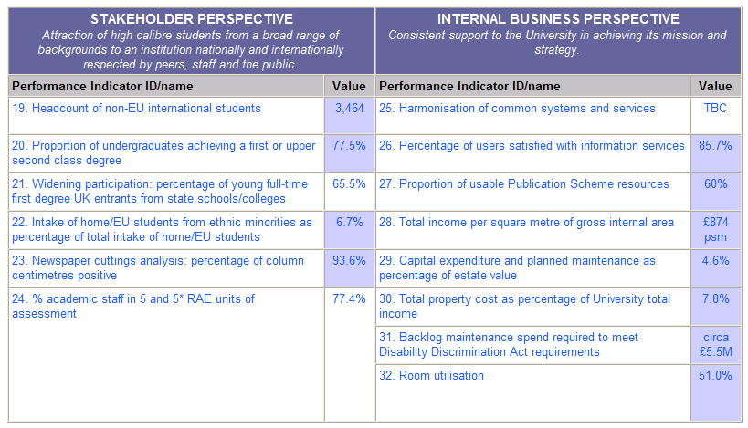
A New Approach in University Evaluation: the Balanced Scorecard
The Balanced scorecard of the University of Edinburgh/2
Four perspectives and performance indicators

Slide 17
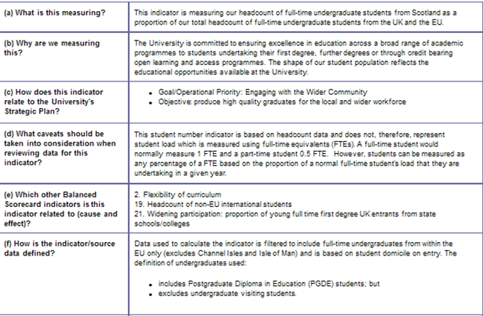
The Balanced scorecard of the University of Edinburgh/3
Specification of the single indicator (1)

Slide 18
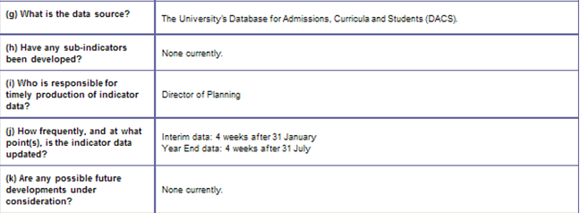
The Balanced scorecard of the University of Edinburgh/4
Specification of the single indicator (2)

Slide 19
A New Approach in University Evaluation: the Balanced Scorecard
Figure 1 - BSC Perspectives and Guidelines of University planning

Slide 20
A BSC for University: some performance indicators of University (Italy)

Slide 21
OGSM Methodology
The 4 Elements of OGSM
The four elements of the OGSM model are:
1. Objective: The first stage of OGSM is an opportunity to consider long-term visions. Your aspirations and plans define the company or organization’s future. Having a clear concept of your three- or five-year targets helps organize and inspire your team to strive toward a shared overall objective.
2. Goals: After outlining your vision, identify the steps you need to take to achieve your mission. Identifying clear goals and measurable metrics turns your idea into a viable project.
3. Strategies: The strategies you create help explain how you will achieve each goal. During this stage, it’s crucial to outline resource allocation, project timelines, and team initiatives so everyone understands their responsibilities and expectations.
4. Measures: To evaluate the success of each strategy, utilize key performance indicators (KPIs) to measure results. By assessing performance metrics, you can understand the strong and weak points in your methods and identify areas for improvement.

Slide 22
OGSM Methodology
The OGSM methodology envisages that strategies are foreseen to achieve the goals of the objectives and that several indicators are used to measure the development of the actions. An analytical planning of the activity, and a fine granularity of the results, are correlated to this methodology.

Slide 23
BSC/OGSM

Slide 24
BSC/OGSM
These 2 methods are similar, but they have some differences:
The Balanced Scorecard tracks different performance Indicators in a very detailed way.
It studies Customer Satisfaction, Internal Processes, Financial indicators…
On the other hand, the OGSM method generally offers a broader overall view.
An essential part of the versatility of the OGSM model is how easy it is to implement. You don't need any special software or technical skills - you just need a single page. The most important part for success in creating an OGSM plan is making sure that you carefully and accurately define your terms: objective, goals, strategies and measures.
Objectives refers to your vision for what you need to achieve in the long term, taking into account your fundamental principles and mission statement.
Goals are about specific long-term targets aligned to your objectives, which should be measurable and will often have a financial basis.
Strategies are the ways you will deploy resources to achieve your goals. Measures are the things you will monitor to judge whether your strategies are working.
Overall, all stages of the model need to be strategically aligned, so that all your efforts feed back to your overall objectives for success.

Slide 25
Dashboard
The main characteristics of a performance dashboard are:
use visual components (charts, performance bars, gauges, maps, stoplights, etc) to highlight the data and exceptions that require action;
gathers data from a variety of source systems;
enables drill-down or drill-through to underlying data sources;
presents a dynamic, single view of the business with timely data refreshes;
needs to contain more than pure financial metrics to be effective;
display key performance indicators in a concise, intuitive format;
helps monitor individual, business unit and organizational performance and processes for a greater understanding of the business;
is not always Portal based;
is easy to use.

Slide 26
Dashboard
The key components are:
A data warehouse;
A reporting layer including ad hoc query and transactional reporting;
An analytical layer including multidimensional/OLAP* analysis, data mining, text mining, forecasting, predictive modeling, etc;
A monitoring layer including personalized dashboards and scorecards with key performance indicators;
University portal.
* OLAP: OnLine Analytical Processing

Slide 27
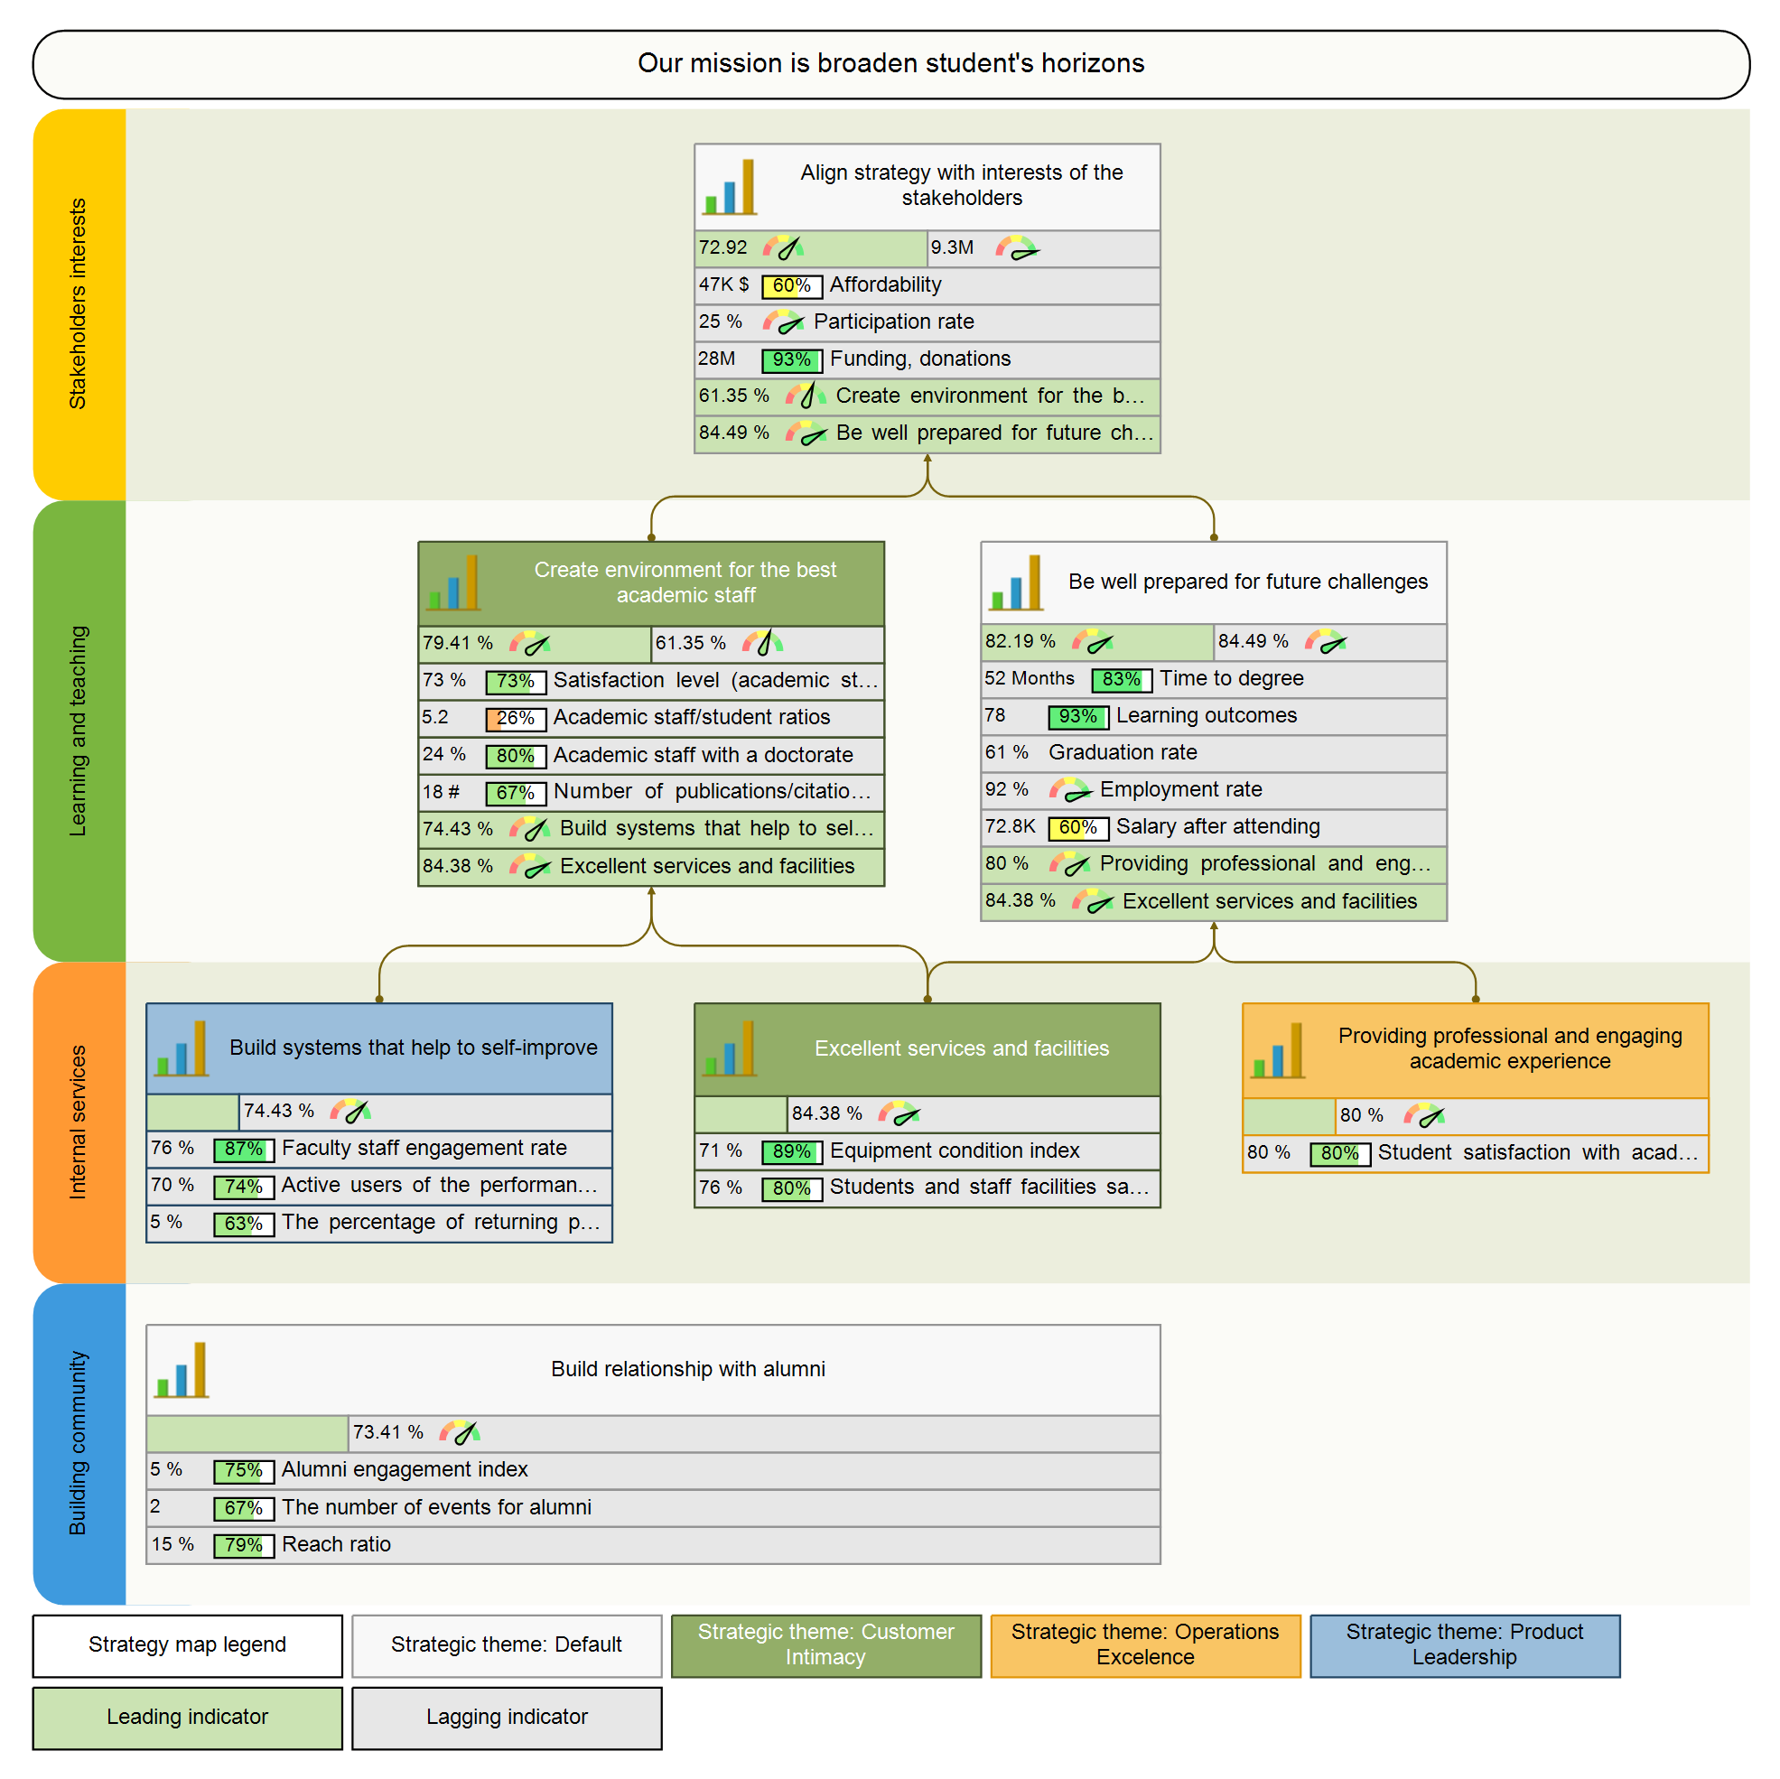
An example of a strategy map for university strategy. The goals are mapped in four perspectives. Each of the goal is quantified with leading and lagging indicators

Slide 28
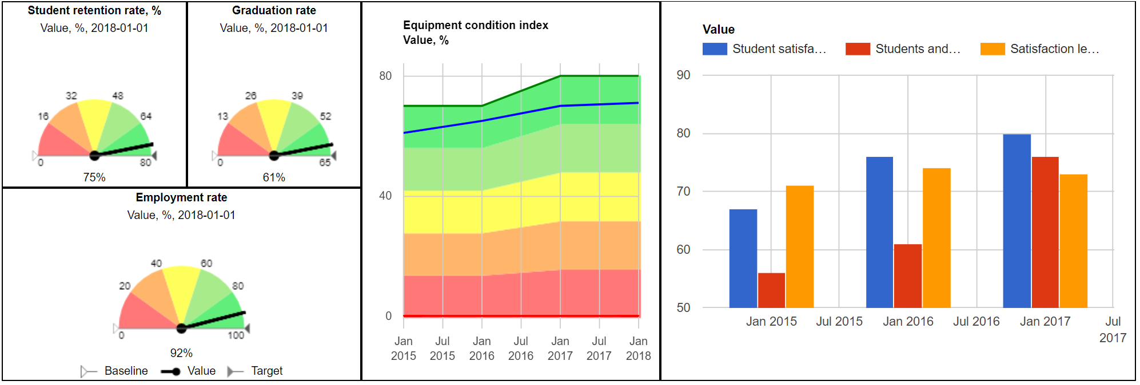
An example of dashboard customised to display key diagrams to monitor the strategy Excel Sheet

Slide 29
Dashboard Excel Sheet

