Slide 1

The monitoring of the internationalization processes in Universities. Measures
«MERGE» ERASMUS+ CBHE PROJECT
Third and Fourth Training Event in the Framework of W.P. 2 «Human Capacity Building»
November 16/18, 2022
Andrea Mignone, Monica Penco
University of Genoa, Italy

Slide 2
Summary
The aim of the foreseen training activities is:
to describe goals, priorities and actions of the internationalization process;
to develop a manageable system of internationalization’s indicators;
to monitor the performance assessment and progress of the process;
to evaluate the implementation process and the outcomes;
to define methodology for the evaluation of results: ongoing (in-itinere) monitoring.
Will follow a discussion of the returned questionnaires sent by Partners Universities from India and Nepal

Slide 3
Relevance of internationalization in universities
Over the past years, universities have undergone various changes, which have been largely conditioned by the demands of society. Other factors that are gaining in importance in Higher Education (HE) systems are the increasing demands to improve quality, the globalization of knowledge and the increase in the competitiveness at national and international levels. In particular, internationality currently plays a key role in HEIs and within the overall context of HE policies. Graduates are increasingly having to find their way and present themselves in a global job market. Internationalization is one of the most important values to be taken into account when referring to universities' performance and position in rankings.

Slide 4
Key Elements
K

Slide 5
Internationalization process
Internationalization of universities is the intentional process of integrating an international, intercultural or global dimension into purposes, functions and delivery of HEIs, in order to enhance the quality of education and research for all students and staff, and to make a meaningful contribution to society.
If internationalization is seen as a process, the monitoring measures are meant to help in the evaluation of the progress and quality of the process.
Internationalization is not a goal in itself, but a medium, a means which help universities to implement strategic goals and priorities.

Slide 6
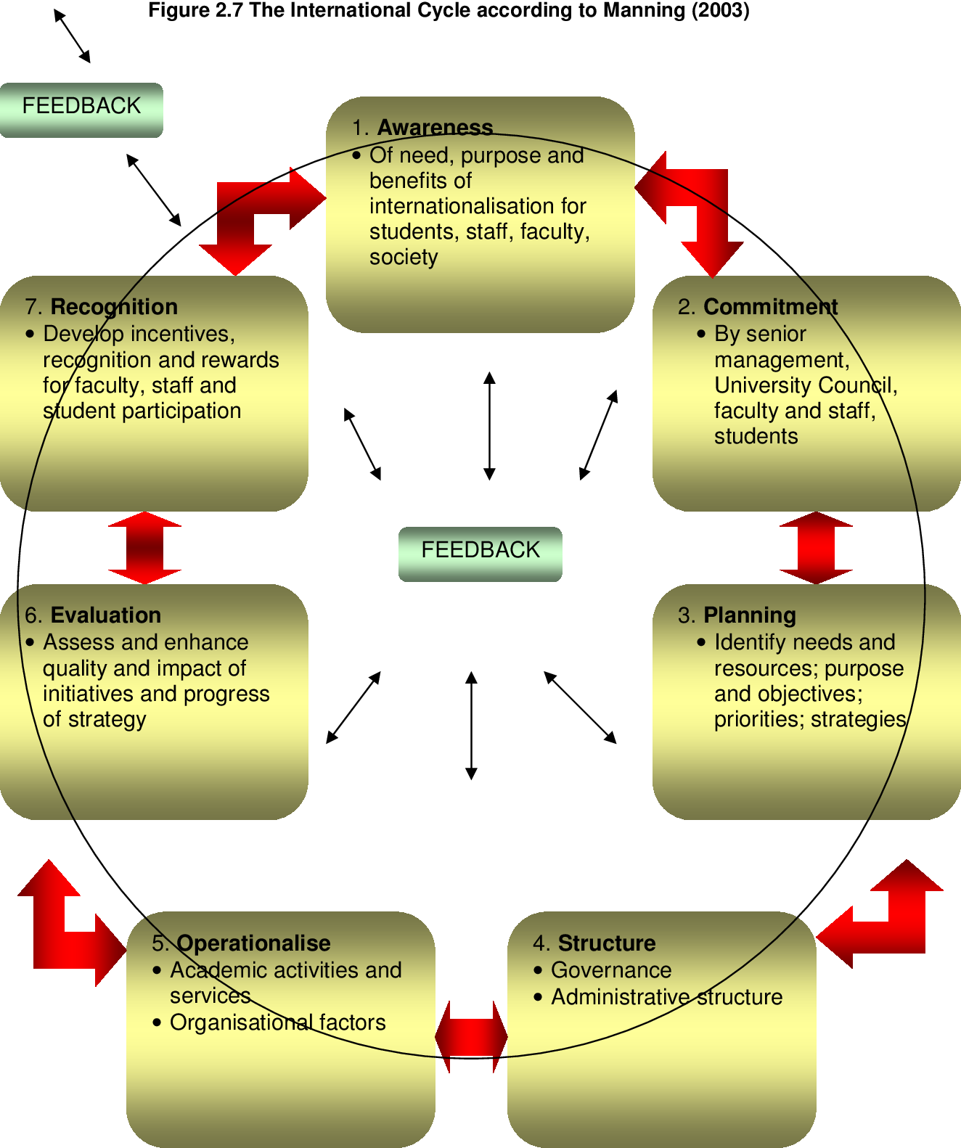
The Cycle of internationalization

Slide 7
Introduction
Internationalization requires substantial and long-term investment of institutional resources, both financially and in terms of human capital, complemented by considerable efforts to provide an efficient support structure (IRO/ICS), and perhaps an opportunity cost in some other areas.
It is therefore critical to develop assessment and quality control to ensure internationalizaton produces desirable outcomes

Slide 8
Why Measuring the internationalization processes?
The call for measuring university internationalization is driven by several concerns:
Universities requires reliable and concrete information to demonstrate to what extent and in what aspects they are internationalized, in order to avoid defining themselves vaguely as an internationalized universities;
Secondly, measures of explicit achievements will help provide the information necessary to analyze an institution’s strenghts and areas that need improvement in relation to internationalization;
Thirdly, HEIs also need information to make comparisons and benchmarking with peers in term of internationalization;
Finally, the emergence of accountability culture in higher education sector based on evaluations pushes the agenda. Accountability is required.

Slide 9
Phases of internationalization
The three phases of internationalization process. The first phase is to set up the design of internationalization (this would be mainly represented by the strategic intent, mission statement, strategic vision, corporate strategy and strategic plan). The second phase is to choose the best ways to activate the design with real actions (this is represented by the organizational steps taken by management to implement the design). The third phase is to evaluate this process by comparing the design with the implementation (this could be done by comparing real internationalization achievements with the intended initial strategy design).

Slide 10
Steps of the Strategic Plan for Internationalization
The steps are:
Define the organizational mission, create a mission statement
Acquire and analyze data. A SP has to be based on the best data available (from surveys and other sources). SWOT model is one of many analytical tools for this type of analysis
Set strategic priorities. To identify 3-5 major priorities that have emerged from the data and analysis conducted. Strategic priorities are broad goals that will move the institution towards the fulfillment of its mission and vision. The priorities are accomplished through concrete action plans defining the specific steps that must be accomplished over the life of the plan. Action steps should be SMART: specific, measurable, achievable, realistic/relevant, time-limited
Assess and measure progress. A critical step in every SP is to determine the standards by which success will be measured. A SP should be living documents, it needs to be fine-tuned and adjusted at least annually by applying the assessment methods to determine what has been accomplished, identifying obstacles blocking progress and consider emerging opportunities that warrant adjustment in the plan.

Slide 11
Factors that influence the internationalization strategy
External factors
Competitiveness
Reputation
University place in the market
Legal regulations
National priorities
Internal factors
University misssion and vision
University culture, traditions
Priorities and ambitions
Human and financial resources
University structure and infrastructure

Slide 12
Strategic Goals of internationalization
The general anticipated results of internationalization
Examples:
To extend international partnership
To increase international visibility (i.e. rankings)
To enhance the quality of research and education
To build organizational structures supporting internationalization processes

Slide 13
Strategic Components of internationalization
Main components of SP on internationalization
International mobility (students, academic and administrative staff)
Curriculum development
Joint and double degrees
International students’ recruitment
International marketing and promotion
Internationalization at home
International research and cooperation
International networks and partnership

Slide 14
Evaluating internationalization
As internationalization grows in importance, it is increasingly subject to measurement. A recent phenomenon has been the emergence of global rankings and much has been said about their positive and negative impacts. There is an attempt to review and evaluate internationalization. There has also been an increased focus on the internationalization of quality assurance, and the way national accreditation mechanisms cooperate in developing common standards and indicators and mutually recognizing their accreditation decisions.

Slide 15
Types of evaluation
There is a quantitative/ statistical assessment based on the percentage of results achieved with respect to the objectives set in the plan, according to the performance indicators chosen.
There is a qualitative evaluation based on satisfaction surveys, interviews, fora, and questionnaires

Slide 16
Methodology
From a methodological point of view, on-going evaluation is, in practice, a diachronic temporal comparison between different stages of implementation of internationalization policies.

Slide 17
Methodology
It is equally important to define in advance which are the main dimensions of the internationalization process that we intend to monitor. On this point, it is known that the literature presents several elements (Indicators) of dimensions that would characterize the process of internationalization.

Slide 18
Indicators
The indicators must:
be few and simple, but significant and detectable;
be consistent with strategic objectives (proxies of objectives rather than individual dimensions);
be based on data that can be collected in a homogeneous, stable and transparent way;
not be misleading;
express percentage values ​​to be related to the size of the university;
indicate how much the university is projected outside and how much it is capable of attracting from the outside

Slide 19
Instruments
The development of instruments specifically to measure the extent of internationalization is relatively new. In the last decade, it has been seen an increase in the number of studies intended to design various tools to assist HEIs in measuring their internationalization. These available instruments are varying in nature, purpose, scale and level of measurement.
Most recently, some projects have been conducted to develop instruments that can serve universities across national and regional borders. These large scale projects, like IMPI, resulted in very comprehensive and complicated metrics, which usually included hundreds of indicators and evaluation criteria.

Slide 20
Instruments
Over the years, several attempts have been made to develop instruments to assess internationalization. These include the Internationalization Quality Review Process by IMHE/OECD, the Indicators for Mapping and Profiling Internationalization (IMPI), the Internationalization Strategies Advisory Service (ISAS) of the International Association of Universities, the Mapping Internationalization (MINT) tool by Nuffic in the Netherlands, the 'Certificate for Quality in Internationalization', of the European Consortium for Accreditation (ECA). These certificates are for both institutions and programmes and assesses performance levels in internationalization.

Slide 21
Final indicators’ set for measuring internationalization
Dimensions:
Research
Student
Faculty
Curriculum
Engagement
Governance

Slide 22
Dimension: Research
Dimension | Component | Indicator
RESEARCH | Internationally cooperative research programmes | Percentage of research projects involving international partnership and collaboration
 | Internationally focused research centres | Percentage of research centres operated with international partners
 | International researchers | Percentage of international post-doctoral researchers
 | Internationally acknowledged research achievements | Percentage of publications cited by SCI, EI, ISTP

Slide 23
Dimension: Student
Dimension | Component | Indicator
STUDENT | International students | Percentage of international students (for degree study) on campus in total
 | Mobility of students | Percentage of students who have international experiences

Slide 24
Dimension: Faculty
Dimension | Component | Indicator
FACULTY | International profile of the faculty team | Percentage of international faculty members
 | International perspective and experience of faculty | Percentage of faculty members with at least one degree awarded by an institution abroad

Slide 25
Dimension: Curriculum
Dimension | Component | Indicator
CURRICULUM | Courses with international components | Number of subjects involving a partner in other countries
 | Joint degree programmes | Number of joint degree programmes collaborated with abroad institutions
 | Students’ participation in international studies | Number students who attend joint degree programmes collaborated with abroad institutions

Slide 26
Dimension: Engagement
Dimension | Component | Indicator
ENGAGEMENT | International network and partnership | Number of abroad partners with whom at least one academic activity has taken place
 | International presence of alumni | Percentage of international alumni

Slide 27
Dimension: Governance
Dimension | Component | Indicator
GOVERNANCE | Human resources for international activities | Percentage of administration staff proficient in more than one working language
 | Financial support for internationalization | Proportion of students who have international academic experiences funded by university relative to the total number of students who have international academic experiences

Slide 28
Different dimensions, sub-dimensions and indicators for measuring internationalization performance of the University

Slide 29
Table 1. Sub-dimensions and Indicators defined in dimension.
Academic exchange activities and recruitment of exchange students
Sub-dimension | Indicators
Volume of academic exchange activity | No of students sent
 | No of students received
 | Academic staff sent for teaching
 | Administrative staff sent for training
 | Academic staff received for teaching
 | Administrative staff received for training
 | International visiting students
 | International regular students
Efficiency in mobility | Efficiency in student mobility: sent
 | Efficiency in student mobility: received
 | Efficiency in academic staff mobility
 | Balance between Erasmus students sent and received

Slide 30
Table 2. Sub-dimensions and Indicators defined in dimension
Quality
Sub-dimension | Indicators
User satisfaction | Satisfaction level of students sent
 | Satisfaction level of students received
 | Satisfaction level of academic staff sent
 | Satisfaction level of administrative staff sent
Participation in excellence programs | No of active double degree agreements and official joint degrees with outgoing mobility
 | No of Erasmus + masters with active participation of the School/Faculty
Academic management | Subject credit recognition ratio for students sent with respect to the ECTS workload per semester
 | Ratio of students sent with a % of recognized credits of at least 70% of the whole number per stay decided by the School or department
 | Ratio of passed credits by students received studying subjects with respect to their ECTS workload per semester
 | No of degrees (bachelor & master) taught at School or department level with at least 10% of their credits in English offered for exchange students with respect to the total number of degrees of the School or faculty
 | No of institutions with Exchange activity of students and staff with respect to the total number of institutions with which the School has Exchange agreements in the two previous academic years.
International Accreditations | Percentage of students enrolled in a School covered by an International Accreditation Quality Agency

Slide 31
Table 3. Indicators defined in Dimension
International development cooperation
Indicators
No of international cooperation activities organized by Schools or Departments
No of students with actions in calls from the International Cooperation Services (ICS)
No of departments of a School with cooperation actions in cooperation promoted by the ICS
No of administrative staff from a School with actions in cooperation promoted by the ICS

Slide 32
Table 4 Indicators defined in Dimension
International projects
Indicators
No of competitive international projects
No of academic staff belonging to a School with participation in international projects from calls managed by the Vice-rectorate of International Relations and Cooperation
Study Abroad
.

Slide 33
Table 5. Indicators defined in Dimension
Other activities
Indicators
Collaboration in institutional activities, committees, events, etc.
Active participation in representing the School or University as speaker in conferences, courses, networks, seminars, exhibitions having to do with internationalization.
Resources in euros of external funding (not fees) for the support of internationalization actions not taken into account in previous indicators
Participation in courses and seminars dealing with internationalization with enrolment fees

Slide 34
Workplan and KPIs
Detailed list of activities to be carried out in the short term:
Define milestones to signal anchors, significant events or stages in the progress of internationalization
Increase the available human resource skills and capacities
Assign clear responsibilities for each prioritized activity in the plan
Define financial resources needs
KPIs – Measurable values that demonstrate how effectively the institution is achieving key internationalization objectives
Measuring inputs (resources to achieve outputs)
Measuring activities (actions taken to achieve the outputs using the inputs)
Measuring outputs and outcomes (results of activities)

Slide 35
Performance indicators for internationalization
Performance Indicators: 1. University Leadership for Internationalization
Performance Indicators: 2. Internationalization Strategic Plan
Performance Indicators: 3. Institutionalization of International Education and Research
Performance Indicators: 4. Support Infrastructure－Professional International Education Units and Staff
Performance Indicators: 5. Internationalized Curriculum
Performance Indicators: 6. International Students and Scholars
Performance Indicators: 7. Study Abroad
Performance Indicators: 8. Faculty Involvement in International Activities
Performance Indicators: 9. Campus Life/Co Curricular Programs
Performance Indicators: 10. Monitoring the Process

Slide 36
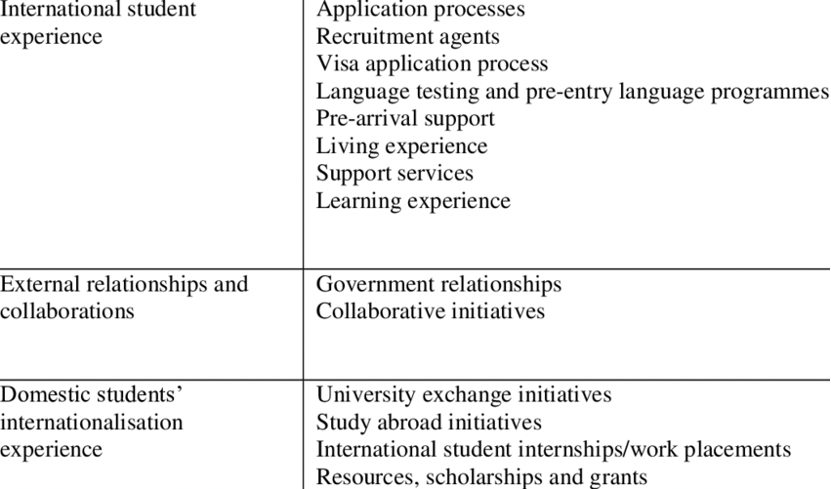
Example: KPIs with reference to students

Slide 37
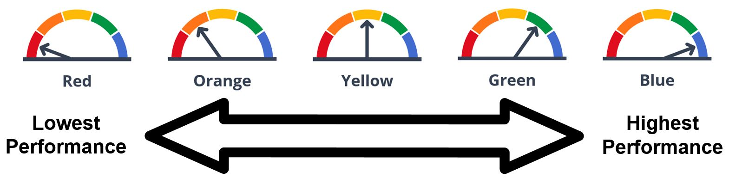
Monitoring tools: the Dashboard
The Dashboard is a powerful online tool to help universities identify strengths and weaknesses and pinpoint student groups that may be struggling. It reports performance and progress of a strategic plan on internationalization. It is a platform useful for self assessment and monitoring activities. Through this platform it is possible to carry out multidimensional analyses on all the information contained.
Performance is based on data from both the current and prior years. There are five performance levels, and each is assigned a different color: Red is the lowest performance level, Orange is the second lowest, Yellow is the middle point, Green is the second highest, and Blue is the highest performance level.

Slide 38
To be continued….
A dashboard is a HEIs tool that displays a set of indicators and other relevant information to an academic/administrative/student user. The information is usually represented graphically and must include the indicators involved in achieving the university objectives. In short, a dashboard should contain limited, understandable, visual, important and goal-oriented information. The main objective of a dashboard is:
transforming data into information and turn this into knowledge for the university;
analyze the root cause of problems by exploring relevant and timely information from multiple perspectives and at various levels of detail;
manage people and processes to improve decisions, optimize performance, and steer the organization in the right direction.

Slide 39
……………………
A dashboard shows the information needed to achieve specific objectives, so its design requires complex, unstructured and tacit information from various sources. Information is often a set of Key Performance Indicators (KPI), but other information may also be needed.
These indicators are usually high-level measurements of how well an organization is doing in achieving critical success factors. In short, more dynamic dashboards are obtained, to be adapted to the changing environment conditions. The need to reduce information means that many data and indicators collected at universities do not end up as part of the dashboard.

Slide 40
To be continued….
A dashboard is a visualizing tool which provides awareness, trending, and both planning and actual comparisons, frequently visualized in a slick simplified user interface.
In this regard, it is necessary for the dashboard to communicate information about the pros and cons of decision alternatives quickly, highlight factors that merit consideration, and provide information in a non-linear format to facilitate its incorporation in decision making deliberations.

Slide 41
Performance Dashboards: A Navigational tool for universities
It becomes critical for institutes offering higher education to develop tools that can be used to convey important information to those who are responsible for making decisions that can be readily understandable to all. One of such tools available for making ready-to-understand decisions is a dashboard. It is a document of one or two pages that contains critical information in a simple and visually appealing format. An institutional dashboard is designed in such a way that helps the university management guide the organization. Or it can also be called a key element which can be used to navigate or monitor the organization. The institutional dashboard for a university is a management tool that briefly explains and informs the viewers regarding the current state of affairs, provides information that can be used to evaluate the performance of the organization by the viewers, and thereby helps improve the decision-makers process of the institution.

Slide 42
Performance dashboard
The main characteristics of performance dashboards include:
Usage of visual components such as charts, gauges, performance bars, maps, stoplights, etc to highlight the data and exceptions that require action;
Data is gathered from a variety of sources;
Enables drill-down or drill-through to underlying data sources;
Refreshes the data timely to presents a dynamic, single view of the business
Contains effective financial metrics
Display key factors of the performance indicators in a concise, intuitive format;
It helps monitor individual business unit, and organizational performance and processes for a better understanding of the business;
It is not always based on Portal;
It is easy to use.

Slide 43
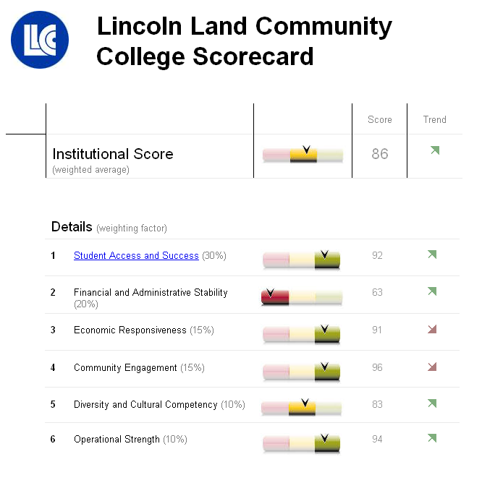
Dashboard example.
Lincoln Land Community College

Slide 44
Monitoring tools: the Balanced Scorecard (BSC)
The BSC makes it possible to monitor the performance trend over time using management indicators.
It is based on the balanced examination of many factors believed to be influential in achieving goals
It helps to consider intangible outputs and to anticipate any negative results (ex ante or ongoing strategy). It aligns strategy initiatives and provides information for strategic learning

Slide 45
To be continued…..
It is a balanced examination between quantifiable outcomes and subjective assessments of the participants in the process. Integrates past performance measures (lag indicators) with measures of future performance impact indicators (lead indicators).
A balanced evaluation form is prepared which contains:
Strategic objectives, essential drivers;
Human resources at disposal and internal processes;
Necessary actions (critical factors of success);
Growth and learning (reengineering);
Indicators (that inform about success/failure of actions)

Slide 46
OGSM Methodology - Definition
Objectives, goals, strategies and measures (OGSM) is a goal setting and action plan framework used in strategic planning. It is used to define and track measurable goals and actions to achieve an objective. Documenting your goals, strategies and actions all on one page gives unique insights that can be missing with other frameworks. It defines the measures that will be followed to assure that goals are met and helps groups work together toward common objectives, across functions, geographical distance and throughout the organization.

Slide 47
How to Use the OGSM Framework
Follow these steps to use the OGSM planning framework for your model:
Consider the big picture. Meet and discuss the purpose of your Institution. Establish a clear mission statement that embodies your strategic plan.
Identify business goals. Focus on goal setting to establish clear benchmarks that lead your university toward the objective. Phrase each task in specific, measurable terms.
Generate an action plan. The strategic planning process establishes a time frame and execution process for achieving your goals. Develop unique strategies for each goal so the steps are relevant to the benchmarks.
Execute and evaluate your strategy. Integrate your strategies into your current framework, making any necessary changes to ensure a smooth process. As you work toward each benchmark, evaluate key results and performance metrics to determine the success of your plan.

Slide 48
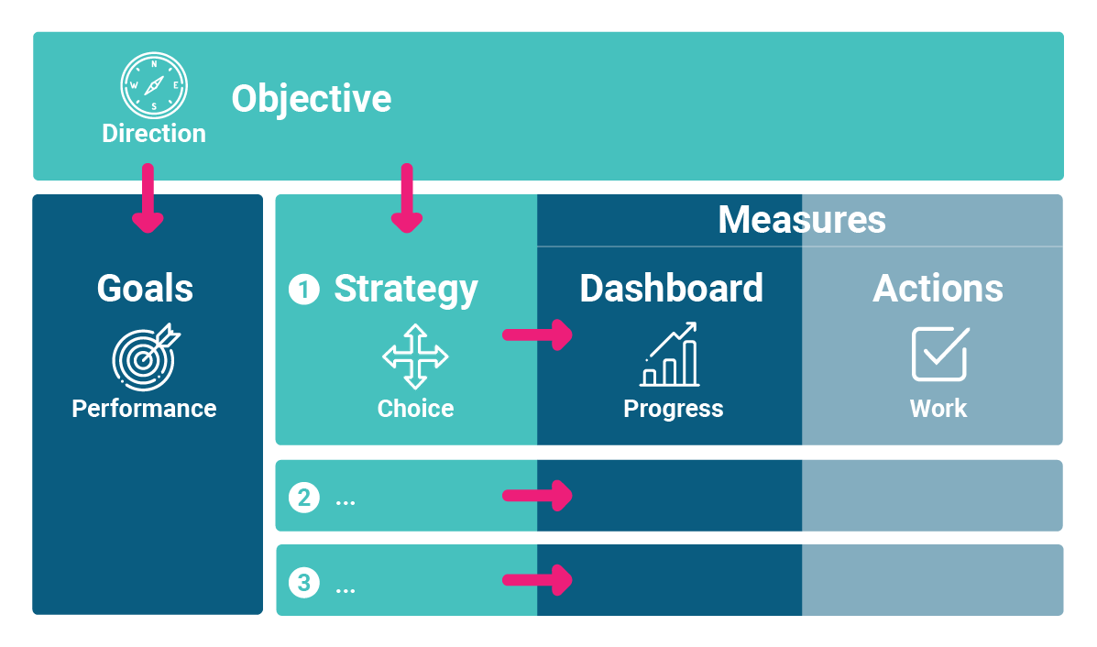
How the parts of the OGSM model link together

Slide 49
Optimise Implementation
➢ Learn from the experience of other institutions in implementing different internationalization approaches.
➢ Ensure that broader institution and department policies are well-aligned with internationalization objectives.
➢ Communicate effectively the rationale for internationalization to all stakeholders within and outside the university.
➢ Strengthen an international office to provide support services to both students and faculty and to promote the integration of international students into all the institution’s academic and social activities.
➢ Build internationalization considerations into all aspects of teaching and learning across the institution and support faculty in adapting to new challenges resulting from internationalization.
➢ Use internationalization to spark a deeper reflection about course content and effective pedagogy to promote better learning outcomes for all students.

Slide 50
Monitor and evaluate
➢ Build monitoring and evaluation into the strategic plan for internationalization to assess whether the approach is achieving its objectives and delivering the benefits expected of it.
➢Develop statistical indicators and surveys to support effective monitoring of internationalization.
Incorporate internationalization objectives into the institution’s broader quality assurance processes for teaching and learning, and student satisfaction.
Final dimension is monitoring the process. It is important to have monitoring systems in place to track the progress of internationalization. If no one is responsible for developing performance indicators, collecting data, interpreting data, and making suggestions for improvement, it will be to accomplish the internationalization agenda.

Slide 51
Some conclusions
Measures could be combined: quantitative measures (statistics, data, etc.) and qualitative measures (satisfaction surveys, panel reviews, delphi method, fora, etc.);
Weights have to be assigned to different metrics (universities tend to place different priorities on the internationalization strategies);
Inputs and outputs rather than outcomes are more feasible to be measured. But oucomes are crucial for the evaluation of a policy.

Slide 52
Thank you for your attention! andrea.mignone@unige.it monica.penco@unige.it intstrat@unige.it https://erasmus-merge.eu/
Project number: 610391-EPP-1-2019-1-IT-EPPKA2-CBHE-JP
"This project has been funded with support from the European Commission. This publication [communication] reflects the views only of the author, and the Commission cannot be held responsible for any use which may be made of the information contained therein"

