Slide 1



«MERGE» ERASMUS+ CBHE PROJECT
3rd-4th Training workshop, November 2022, online
Enhancing the international dimension by means of teaching offer improvement
Prof. Alfredo Squarzoni, Professor Emeritus University of Genoa, Italy
Mr. Angelo Musaio, Head of ICO, University of Genoa, Italy

Slide 2
Contents of the presentation
Main policy objectives aimed at enhancing the international dimension of the University. The Bologna Process or Declaration
Main internationalization actions undertaken by Italian universities and related indicators currently in use in accordance with the CRUI guidelines *
Methods of data collection and construction of system indicators
Defining the strategic plan (SWOT Analysis) and contents of the strategic plan
Process of defining the Study Programmes (SPs) for internationalization
* «Conferenza dei Rettori Università italiane», association of the Italian state and non-state universities

Slide 3
Main actions implemented by the EU
Erasmus+ (European Community Action Scheme for the Mobility of University Students), 2021-2027 programme and former Erasmus programme.
  Large scale mobility for driving changes, keeping into account:
    compatibility of Higher Education systems,
    definition of clear rules for the recognition of periods of study abroad.

Slide 4
Main actions implemented by the EU
Bologna Declaration or Process, 1999. It is an agreement among Ministers of HE based upon series of ministerial meetings, set-up to create an EHEA and featured by three main requirements:
  to introduce a three-cycle HE system consisting of bachelor's, master's and doctoral studies to link to the EHEA “Qualifications frameworks»;
  to ensure the mutual recognition of qualifications and learning periods abroad completed at other universities, according to the “Lisbon Recognition Convention”;
  to implement a system of internal and external quality assurance – QA of the study programmes, to strengthen quality and relevance of learning and teaching according to “Standards and Guidelines for quality assurance in the European Higher Education Area”.

Slide 5
Main actions implemented by the EU
By means of Bologna Declaration or Process, the setting-up of EHEA has been achieved, in order to:
  ensure comparability in the standards and quality of HE qualifications,
  create a Higher Education Area based on cooperation and academic exchange to students and staff both from EU Member States and Partner Countries from other parts of the world,
  adapting universities to the knowledge society,
  compare HE global world to the EU background.

Slide 6
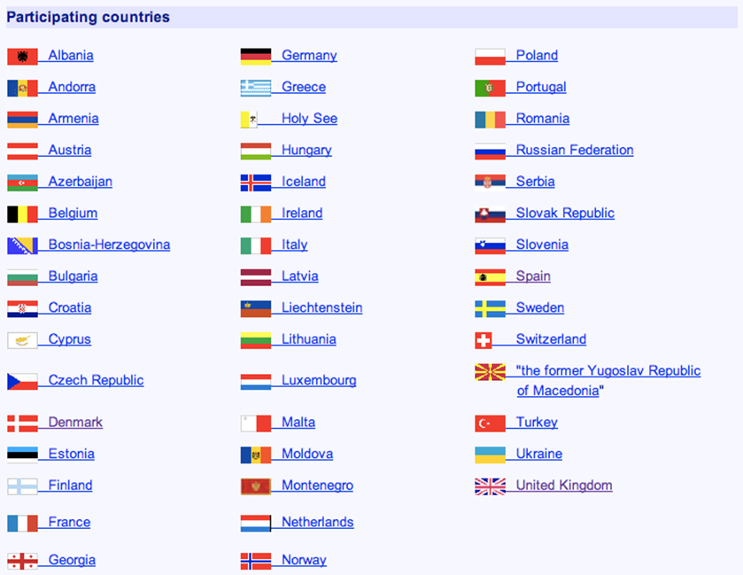
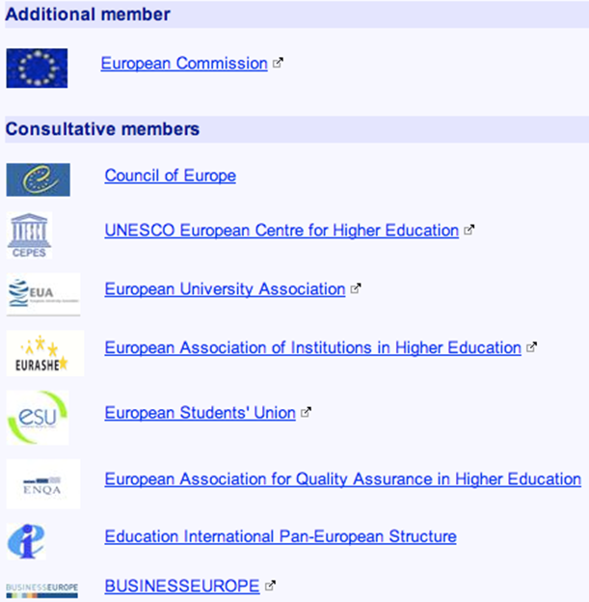

47 countries into Bologna Process

Slide 7
47 countries into Bologna Process
N.B.
→ Rejected / in transition countries
Four countries (Israel, Kosovo, Kyrgyzstan and the unrecognized Northern Cyprus) applied to join but did not meet the membership criteria.
As regards Kosovo, it was suggested that Kosovo could be associated with the process in a category appropriate to its situation, such as guest or special-observer status.
Kyrgyzstan is not a party to the European Cultural Convention of the Council of Europe, although has also ratified the Lisbon Recognition Convention. The HEIs of the Country actually adopt the BP requirements related to the first two cycles. A process of transformation of the Doctoral Studies from the current system to the one adopted in EU is undergoing.
Northern Cyprus is not a party to the European Cultural Convention of the Council of Europe and not recognized as an independent political entity by any member of the BP except Turkey.
Some countries of South Mediterranean Countries (Morocco, Algeria, Tunisia) never applied to get the membership. Nevertheless, they currently adopt the Bologna Process requirements for the setting-up and implementation of study programmes.

Slide 8
Starting point in 1999
Different systems difficult to compare
Lack of transparency
Difficulty in preserving the richness of diversity
How does the Bologna Process work?
Every two years Ministerial Conferences (Communiqué) to assess the progress made and to decide the new steps.
The Bologna Follow-up Group (BFUG) is the main follow-up structure, oversees the BP between the ministerial meetings and set up working groups to deal with specific topics.

Slide 9
Ministerial Conferences
Latest meetings held in Yerevan (2015) focused on:
Enhancing the quality and relevance of learning and teaching as main mission of the EHEA.
Fostering the employability of graduates due to rapid change of labour markets.
Making the HE Members systems more inclusive as populations become more and more diversified, also due to immigration and demographic changes.
Implementing agreed structural reforms as a prerequisite for the consolidation of the EHEA and, at long-term, for its success: common degree structure and credit system, common QA standards and guidelines, cooperation for mobility and joint programmes and degrees.

Slide 10
Ministerial Conferences
Latest meetings held in Paris (2018) focused on :
Structured peer support approach for the implementation of the three main Bologna key commitments:
  three-cycle HE system
  mutual recognition of qualifications and learning periods abroad
  a system of QA, to strengthen the quality and relevance of learning and teaching.
Belarus strategy for 2018-2020, as newcomer in the Declaration
Short cycle qualifications as a stand-alone qualification level within the overarching Qualifications Framework of the EHEA
Revised Diploma Supplement, with a recommendation for its adoption in identical form in the respective frameworks.

Slide 11
Ministerial Conferences
Latest meetings held in Rome (2020). The Communiqué expressed some specific recommendations to the Ministries of HE, as follows:
The context of the Covid-19 health crisis underlines the importance of the BP Group’s recommendations in several regards. Particularly relevant are those on the need for pedagogical innovation and online education development and open educational resources, as well as that on strengthening link between educational research and teaching.
Furthermore, Public authorities in charge of HE should commit:
To make student-centred learning a reality,
To foster continuous enhancement of teaching,
To strengthen HEIs’ and systems’ capacity to enhance learning and teaching.

Slide 12
Bologna Process common principles
“A student-centred system”
The three-cycles degree course have to based on:
The learning outcomes
The learning outcomes describe what an average student, with a suitable starting background, is expected to know, understand and be able to do at the end of a learning process
The learning times (ECTS credits)
The credits quantify the time that an average student needs to carry out all the learning activities required for the attainment of the expected learning outcomes

Slide 13
Qualifications system based on 3 cycles. Elaboration of an European Framework
Length of the study programmes
First cycle: from 180 to 240 credits
Second cycle: from 90 to 120 credits
Third cycle: 3-4 years
Learning outcomes in each cycle (Dublin Descriptors) based on 5 elements: <http://www.quadrodeititoli.it/descrittori.aspx?descr=172&IDL=2>
Knowledge and understanding;
Applying knowledge and understanding;
Making judgements;
Communication skills;
Learning skills.

Slide 14
Student-centered programmes
Each cycle should be seen as an entity in itself. In particular, the first two cycles should give access to the labour market.
Study Programmes are no longer described and planned according to their contents, but mainly according to the “competences” expected in the graduates at the end of the educational process and the “learning outcomes” (LO) achieved by students during their educational process.
The focus is no more on what a teacher has taught, but on what a student has learned and is able to do.

Slide 15
Student-centred programmes and Tuning approach https://www.unideusto.org/tuningeu/tuning-information-centres.html
A methodology for design educational programmes consistent with the Bologna process principles has been developed within the framework of the Tuning Educational Structures in Europe.
Tuning is a university driven initiative originally set up to offer a concrete approach to implement the Bologna process at the level of HEIs and subject areas, and is gradually becoming the leading approach within the common European education space.

Slide 16
Tuning approach and QA system
The Tuning approach needs for an adequate QA system having the following features:
confirm the existing social need for the SP,
describe the Study Programme - SP objectives and identify key competences it should develop,
identify and formulate measurable LO,
design and describe the SP structure in terms of modules and credits,
select methods of assessment in line with the competences to be developed.

Slide 17
PRIORITY OBJECTIVES
Looking at the global context, we can list the following 5 priority objectives to be achieved through internationalization actions:
student's increased international awareness and engagement with global issues;
improved quality of teaching and learning;
strengthened knowledge production capacity;
increased networking of faculty and researchers;
revenue generation.

Slide 18
2) Internationalization actions
WE can group internationalization objectives and actions within the following categories:
1. Internationalization of the Higher Education offer over the three cycles.
2. Internationalization of research.
3. Internationalization and mobility of the students.
4. Internationalization and mobility of the teaching staff.
5. Internationalization of the organization.
6. Cooperation and transfer of knowledge.
7. Networks and networking.
8. Promotion and communication.
9. Language policies.

Slide 19
2.1 Internationalization of HE offer over the 3 cycles
Actions
Study Programmes - or individual courses - taught in a foreign language (or in a multilingual way).
Design and activation of Study Programmes (over the three cycles) in collaboration with other universities or foreign companies (flexible educational paths, continuously updated in content, based on the actual needs of the companies themselves).
Design and activation of Study Programmes with educational objectives/learning outcomes/contents relevant in an international context.
Integrated/joint Study Programmes.
Disciplinary networks also aimed at mutual recognition (e.g. EuroBachelor).
International integration of PhD Programmes (with other actions than the ones mentioned above).

Slide 20
Indicators
Number of international Study Programmes (Bachelor and/or Master and/or single cycle Master Degree Programmes) with joint, double or multiple degree awarded.
Number of Study Programmes offered in a foreign language.
Number of PhD Programmes offered in the frame of a cooperation agreement with foreign universities or research institutions.

Slide 21
2.2 Internationalization of research
Actions
Research projects funded by foreign/international bodies.
Research projects with international partners.
Knowledge transfer initiatives with international partners.
Research initiatives on global topics (e.g. UN post-2015 agenda).
Indicators
The size of the resources acquired by the European Union and by foreign and international agencies and bodies.
Number of publications with foreign co-authors.

Slide 22
2.3. Internationalization and mobility of the students *
Actions
Here are included the actions aimed at the international recruitment of students and PhD students and at fostering mobility as functional to the same political objective.
Appropriate scholarships for international students.
PhD scholarships for candidates from abroad (even for periods limited to one semester).
Reduction of fees for international students.
Development of specific reception, accommodation and communication services.
Monitoring quality performance of international students.
…
* including mobility of PhD students, graduates and placement

Slide 23
…
Mutual visits of teachers to learn about the academic cultures in force (quality and evaluation systems, study conditions, etc.).
Student mobility for periods of study integrated into the curriculum and recognition.
Easier and less standardized recognition of credits acquired from abroad.
Student mobility for traineeships.
Student mobility for research activities.
Student mobility for intensive courses, also in groups.
Intensive language preparation.

Slide 24
Indicators
Proportion of enrolled students who have participated in international mobility programmes (exchange and non-exchange regime).
Proportion of foreign students enrolled in the first year of study programmes (Bachelor and/or Master and/or single cycle Master Degree Programmes) with a degree obtained abroad.
Proportion of foreign students enrolled in study programmes (Bachelor and/or Master and/or single cycle Master Degree Programmes) with a degree obtained abroad.
Proportion of PhD students enrolled in the first year of PhD Programmes with a degree obtained abroad.
...

Slide 25
...
Proportion of foreign students (foreign citizenship) enrolled in study programmes (Bachelor and/or Master and/or single cycle Master Degree Programmes).
Proportion of foreign students (foreign citizenship) enrolled in PhD Programmes.
Proportion of foreign students enrolled in the first year in all the Study Programmes fully taught in a foreign language.
Proportion of graduates who, under the Erasmus Programme, spent a period of study abroad lasting at least 3 months.
Number of students on mobility abroad.
Number of incoming students.
…

Slide 26
…
Proportion of credits achieved abroad.
Number of credits achieved abroad for ERASMUS mobility/Number of months spent in mobility.
Number of incoming ERASMUS mobility students/Number of outgoing ERASMUS mobility students.
Number of ERASMUS mobility students enrolling in A.Y. ….
Number of ERASMUS mobility students graduating in A.Y. ….
Credits obtained abroad in the A.Y. … by students, within the normal duration of the Study Programme.
…

Slide 27
...
Number of graduates, who acquired at least 9 credits abroad within the normal duration of their Study Programme.
Proportion of graduates who, under the ERASMUS Programme, spent a period of study abroad lasting at least 3 months.
Ratio between the percentage of PhD students who spent a documented period of at least one month in foreign universities or in a foreign laboratory or archive or library, and the average percentage of PhD students who spent a documented period of at least one month in foreign universities or laboratory or archive or library, during PhD Programmes of the same area.
Ratio between the percentage of foreign candidates, i.e. the ones who graduated in foreign universities, and the average percentage of external Italian candidates in PhD Programmes of the area.

Slide 28
2.4 Internationalization and mobility of teaching staff
Actions
Integration of visiting professors into teaching activities.
Recruitment of international researchers and teachers, also through the so-called ‘brain return’.
Outbound teacher mobility and survey/database of teachers' international experiences.
Professional updating of teachers with a view to exchange between centres of excellence (improving the quality of teaching).

Slide 29
Indicators
Number of teachers from foreign universities (visiting professors), who have been assigned an official course or in any case with certified visiting professor periods of at least three months.
Number of researchers recruited as winners of programmes funded at national level (like the ‘Levi Montalcini’ programme).
Number of professors recruited for ‘clear fame’, or who have served for at least 3 years in universities or foreign research institutions in equivalent academic positions, or who have previously been beneficiaries of direct call in the frame of the so-called ‘brain return’ programme.
Teachers on international mobility (months/person in and out).
...

Slide 30
...
Number of foreign researchers (affiliated to foreign bodies/institutions) visiting the Department in the reference years.
Number of teachers, researchers, PhD students and grant holders on international mobility during the reference years.
Number of fellows of international scientific societies.
Assignment to teachers, researchers, PhD students and fellows of officialized and documented teaching activities at foreign universities, during the reference period.

Slide 31
2.5 Internationalization of the organization
Actions
Development of skills useful for enhancing the international dimension of the university concerning all the actors involved, students, university staff (e.g. foreign language training, knowledge of different academic systems regarding admission rules, assessment and evaluation systems, exams, student rights, etc.).
Development of administrative services to support teacher mobility, student mobility, reception. Improving IROs organization
Systematization: internal coordination of strategies, creation of governance bodies.

Slide 32
Indicators
Skills of the staff: methods of selection and promotion of specific professional competence.
ICT policies, managerial and management support to internationalization actions.
Synergies with the local territory and the entrepreneurial domain.
Widespread culture of internationalization, incentives for innovation.
Commitment and planning of financial resources, also in terms of incentives.

Slide 33
2.6. Cooperation and transfer of knowledge
Actions
International cooperation initiatives and commitment for the development with international partners.
Cultural promotion initiatives with partners on international and development issues (also with a view to offering to NGOs, humanitarian workers, etc. the skills of the university system).
Interaction with the territory and regional convergence.
Indicators
Number of international cooperation initiatives.
Number of cultural promotion initiatives.
Number of initiatives of interaction with the territory and regional convergence.

Slide 34
2.7. Networks and networking
Actions
Participation of Italian Universities in international networks.
International networks coordinated by Italian universities.
Indicators
Number of participations of Italian Universities in international networks.
Number of international networks coordinated by Italian universities.

Slide 35
2.8. Promotion and communication
Actions
National Portals.
Participation in HE fears.
Indicators
Number of participations in national portals.
Number of participations in HE fears.

Slide 36
2.9. Language policies
Actions
Policies for the language training of students with attention to the European objectives of multilingualism.
Linguistic certifications.
Language training functional to mobility.
Policies for intercultural training.
Use of international publications in different languages ​​in the prescribed text.
...

Slide 37
...
Policies for teaching in vehicular language and for teacher training.
Mother tongue foreign language teachers.
Create multicultural events, make more visible the presence of a body of international students and teachers.
Indicators
In general, presence of the actions.

Slide 38
3) Methods of data collection and construction of system indicators
It should be noted, as can be seen from the mapping of the indicators above shown, that the Indicators can be functional to two objectives:
within the institutions, to assess the impact of the specific actions chosen in order to profile their internationalization strategy and improve their international dimension. In this case, the indicators used may differ from institution to institution both in the formulation and in the parameters used in the measurement, and they will have a strong qualitative emphasis.
At the university system level, to encourage all institutions to implement coherent actions with the general and shared objectives of the national system within the European system and useful for any comparison at interregional levels.

Slide 39
In any case, the Indicators must be:
few and simple, but particularly significant and objectively detectable;
coherent with the political objectives (proxy of the objectives rather than of single actions);
based on data that can be collected in a homogeneous, stable and transparent way at national level;
built on measurement parameters compatible with the parameters used at least at the European system level.

Slide 40
It is also important that the indicators:
are not misleading, i.e. they are not such as to lead universities to maximize those values, sacrificing other equally important priorities;
give an idea of both how much the system is projected outwards, and how much it is able to attract from outside;
express percentage values, and not absolute values, to be compared to the size of the system and of each single university within it.

Slide 41
4) Process of defining the SP for internationalization
The Strategic Plan is the result of an articulated and shared process that involves, in various ways, multiple actors:
the top academics of the University - in particular the Academic Senate, Board of Administration, General (Administrative) Directorate - who are responsible for defining the strategic plan;
the fundamental structures of the University - typically, the Departments - which are responsible for formulating observations and proposals with reference to their areas of competence;
the stakeholders of the University, internal and external, who are responsible for formulating observations and proposals with reference to their expectations and needs for the mission areas of their interest.

Slide 42
The process of defining the strategic plan for internationalization (like that relating to any other mission area of ​​the University), usually includes:
the identification of strategic objectives;
a 'SWOT Analysis’;
the definition of the operational objectives associated with the strategic objectives and the identification of the actions for their pursuit.

Slide 43
4.a) Identification of strategic objectives
As a rule, strategic objectives are defined in a very general way.
Example of definition of strategic objectives for the strategic 'Internationalization' area relating to both teaching and research
Encouragement of international research projects, focusing in particular on the inclusion within the most qualified international networks.
Recruiting excellent international students and faculty.
Increase in the exchange rate and mobility for teachers and students, as well as for technical-administrative staff.
Development of international double and joint degree programs at all levels (bachelor's, master's, doctorate), also linked to an increase in teaching in English.
Increase in visibility and international attractiveness, in terms of research activity and positioning in international rankings.
Attracting financial resources from internationalization programs.

Slide 44
4.b) SWOT Analysis
SWOT analysis is the strategic planning tool generally used to evaluate Strengths, Weaknesses, Opportunities and Threats in order to achieve strategic objectives.
Strengths are the organization's attributions that are helpful in achieving goals.
Weaknesses are the organization's attributions that are detrimental to achieving goals.
Opportunities are the external conditions that are useful for achieving goals.
Threats are external conditions that could harm performance.

Slide 45
SWOT Matrix
Usually, the results of the SWOT Analysis are reported in a matrix (SWOT Matrix).
SWOT Matrix
 | Helpful to achieve the objective | Harmful to achieve the objective
Internal Origin (attributes of the organization) | Strengths Good level of knowledge of English by students … | Weaknesses Outgoing student mobility lower than the average of other universities …
External Origin (attributes of the environment) | Opportunities Ad hoc funding available from the Ministry of University … | Threats Training courses of the partner Universities poorly compatible with those offered by the University …

Slide 46
4.c) Operational objectives and related actions pursuit
The operational objectives for the pursuit of the strategic objectives are defined starting from the combination of the results of the SWOT Analysis, in order to:
- use and enhance strengths,
- solve or at least improve weaknesses,
- exploit and benefit from external opportunities,
- reduce or at least protect oneself from external threats.
Finally, for each operational objective Actions are defined for its pursuit, taking into account, in particular, both the development potential of the University and the necessary and available resources.

Slide 47
Example
Operational objective associated with the strategic objective 'Increase in exchange rate and mobility for teachers and students, as well as for technical-administrative staff and related actions
Strategic Objectives | Operational Objectives | Actions
... | ... | ...
Increase in the exchange rate and mobility for teachers and students, as well as for technical-administrative staff | Increase of outgoing students | Increase the number of partner Universities
 |  | Increase the budget for outgoing students
 | Increase of incoming student | …
… | … | …

Slide 48
Finally, the strategic plan should be 'credible'.
To this end, the following information should be associated with each Action identified for the pursuit of operational objectives:
the responsibilities for the pursuit of the objectives and for the management of the Actions for their pursuit,
the resources to be committed / used to achieve the objectives,
the result indicators, by which one can monitor progress and evaluate the results achieved,
result and time targets.
In addition, 'intermediate' objectives could be defined (for example, result targets to be achieved annually), together with the responsibilities and methods of related monitoring.

Slide 49
Example
Information aimed at operational objective “Increase the number of partner Universities”
Actions | Responsibilities | Resources | Result indicators | Result targets | Time targets | Intermediate objectives | Monitoring responsibilities
... | ... | ... | ... | ... | ... | ... | ...
Increase the number of partner Universities | Deputy Rector for internationalization | - | Number of new partner Universities | At least 10 new partner Universities | Two years | Five new partner Universities after the first year | Deputy Rector for internationalization
... | ... | ... | ... | ... | ... | ... | ...

Slide 50
Thank you for your kind attention!
a.squarzoni@unige.it
musaio@unige.it
https://erasmus-merge.eu/
https://unige.it/internationalstrategies
Project number: 610391-EPP-1-2019-1-IT-EPPKA2-CBHE-JP
"This project has been funded with support from the European Commission. This publication [communication] reflects the views only of the author, and the Commission cannot be held responsible for any use which may be made of the information contained therein"

