Slide 1



«MERGE» ERASMUS+ CBHE PROJECT
3rd-4th Training workshop, November 2022, online
Setting-up of the European Area of
Higher Education
Mr. Angelo Musaio, head of international cooperation Office, UniGe

Slide 2
Setting-up of the European Area of
Higher Education - EAHE
Aspects and trends of the setting-up of the EAHE
Actions promoted by UniGe to enhance international cooperation
Actions supported by the Erasmus Plus programme
Capacity Building in Higher Education
CBHE

Slide 3


Why to enhance the UniGe internationalization?
To inter-connect the University with the world by means of didactics, technological research and third mission actions
To follow-up to the trends and guidelines of the Ministry of University & Research
competitiveness
competence
international dimension

Slide 4
Main frameworks promoted by EU
Bologna Declaration or Process, 1999. It is an agreement among Ministers of HE based upon series of ministerial meetings, set-up to create an EHEA and featured by three main requirements:
  to introduce a three-cycle HE system consisting of bachelor's, master's and doctoral studies
  to ensure the mutual recognition of qualifications and learning periods abroad completed at other universities
  to implement a system of quality assurance - QA, to strengthen the quality and relevance of learning and teaching

Slide 5
By means of Bologna Declaration or Process, the setting-up of EHEA has been achieved, in order to:
  to ensure comparability in the standards and quality of HE qualifications,
  to create a Higher Education Area based on cooperation and academic exchange to students and staff both from EU Member States and Partner Countries from other parts of the world,
  to adapting universities to the knowledge society,
  to compare HE global world to the EU background.

Slide 6
Main frameworks promoted by EU
Erasmus+ (European Community Action Scheme for the Mobility of University Students), 2021-2027 programme and former Erasmus programme.
  Large scale mobility for driving changes, keeping into account:
    compatibility of Higher Education systems,
    definition of clear rules for the recognition of periods of study abroad.

Slide 7

The Programme is funded by EU in order to develop inter-connections in HE and to strengthen the relationships among Member States by means of student exchanges.
After 30 years, it is still the paramount programme promoting the opening of education towards Europe mainly thanks to the Key Action “103 Learning Mobility with Programme Countries”) …
… and …
the most relevant innovation of this longstanding programme is its recent improvement towards the Partner Countries, by means of a specific Key Action “107 – International Credit Mobility (ICM)”.

Slide 8

Internationalisation Service
Internationalisation Service
International Mobility Office
Int’l Activities for Didactics Office
International Students Office
The Internationalisation Service is one of the units composing the “Didactics” managerial area and it supports the Vice Rector for International Relations to enhance the international aspects of the didactics (i.e. catalogue, exchange programmes, scholarships, visiting professors), in compliance with the University strategy.

Slide 9
KA 103 – «The UniGe backstage»
One specific team is assigned to manage the KA 103 activities.
International Mobility Office: call, agreements with the partners, contacts with the grantees (students, faculty and administrative staff), scholarships for UniGe grantees.
International Relations Offices in each Department: Learning Agreement, contact point for supervisors and students, certification of the ECTS on the basis of the Transcript of Records.
Student Record Offices: updating of the academic “career” file of the students and relationships with the internal academic competent Boards.

Slide 10
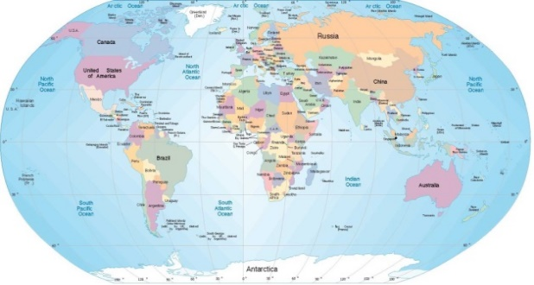

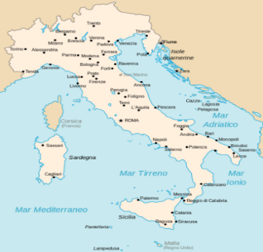
Joint Master Degrees
Joint Master Degrees are very important «raw materials» to build up an international dimension of didactics.
They enable two or more universities of different Countries to share an integrated study path ending to a joint master degree, valid in the respective countries.
In these programmes the student mobility is compulsory.
By now our University offers 16 joint master degrees; 2 of them are Erasmus Mundus Joint Master Degrees, funded in the framework of the Erasmus+ Programme.
https://corsi.unige.it/en/

Slide 11

Academic Cooperation Agreements (1)
to promote reciprocally mobility of students, PhD candidates, lecturers, professors, researchers and technical and administrative staff
to enhance collaboration in specific scientific area
to develop joint / double degrees
Key issues:
Implementation agreements
Intellectual Property Rights
Safety of the staff involved in mobility
Insurance

Slide 12

Academic Cooperation Agreements (2)
Implementation agreements promoting student exchange aimed at establishing as follows:
Mobility typology
Education fields
Admission requirements
Mutual recognition of academic activities
Mutual tuition fees exemption
The templates of the agreements and a complete list of the agreements currently in force are available on the website: https://unige.it/internazionale/Internazionalizzazione.html

Slide 13
Additional UNIGE actions (1)
Since A.Y. 2018-2019 UniGe has promoted several initiatives to increase chances to do a study experience abroad:
Call for study “extra Erasmus”: the students can study at one of the university partners of UniGe worldwide, in the frame of existing academic cooperation agreements.
Call for research thesis: the students can develop their research thesis (both bachelor and master level) at one of the partner of UNIGE (universities, research institutions and companies) in an extra EU Country.
The mobility period is funded by University and Ministerial sources.

Slide 14

UNIGE actions (2)
An increasing number of courses and subjects are taught in English in order to give an added value to the catalogue offered to Unige students but also to attract international students:
https://unige.it/sites/contenuti.unige.it/files/imported/relint/documents/Coursesandsubjectsentirelytaughtinforeignlanguages_2.pdf

Slide 15
Welcome facilities (1)
The International Students Office gives support for:
Visa issues
Procedures for release and renewal of permit of stay in front of Police Department (requested documents and support in presentation of the application form)
Accomodation research (e.g.: in private flats shared with other students)
Fiscal code (tax number) application
Free of charge courses of Italian language

Slide 16
Welcome facilities (2)
The International Students Office gives support for:
Bank account agreement
Public transport (where to apply and requirements for periodical tickets and discounts)
University canteens (location, prices)
Health assistance (public or private health insurance, Health regional system)
https://unige.it/usg/en/welcoming-international-students

Slide 17

Info
https://unige.it/relint/
International Service:
International Activities for Didactics Office
Piazza della Nunziata, 6 - 16124 Genova – 1st floor
Phone +39 010 209 5626 relint@unige.it
International Mobility Sector
Piazza della Nunziata, 6 - 16124 Genova – 2nd floor
Phone +39 010 209 9545 coopint@unige.it
International Students Office (SASS)
Piazza della Nunziata, 6 - 16124 Genova – 1st floor
Phone+ 39 010 209 51525 sass@unige.it
International Cooperation Office:
Piazza della Nunziata, 6 - 16124 Genova – 1st floor
Phone +39 010 209 9420 intstrat@unige.it
https://unige.it/internationalstrategies

Slide 18
Overview of new Erasmus+ programme
General overview
Main novelties
2021 Call

Slide 19
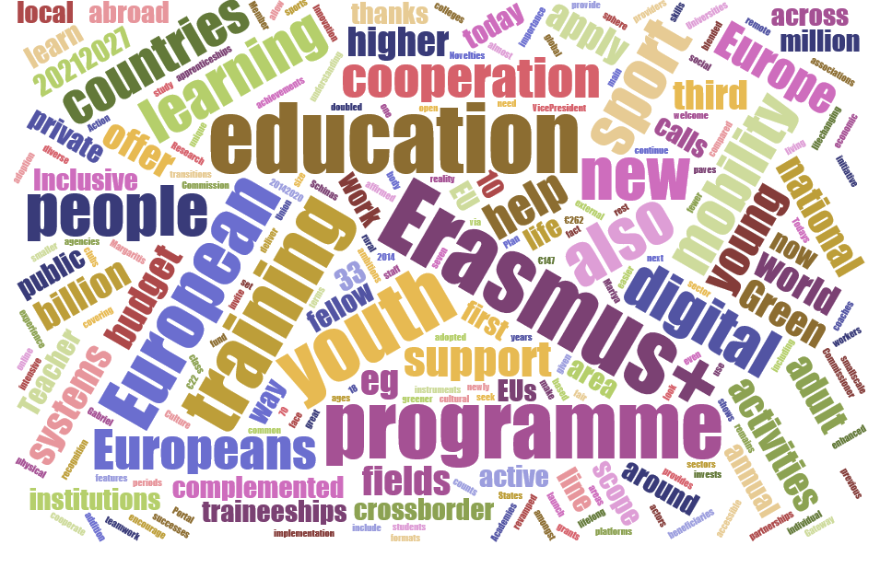
Erasmus+ 2021-2027: overview (I) https://ec.europa.eu/commission/presscorner/detail/en/IP_21_1326

Slide 20
Erasmus+ 2021-2027: overview (II)
General objective
Supporting educational, professional and personal development of people of all ages in education, training, youth and sport, in Europe and beyond
Participating countries
33 Programme Countries + international activities open to the rest of the World
3 Key Actions
Mobility – Cooperation – Policy Development
Implementing mode
Indirect (National Agencies) and Direct (EAC/EACEA)

Slide 21



Horizontal priorities
INCLUSIVE
DIGITAL
GREEN

Slide 22
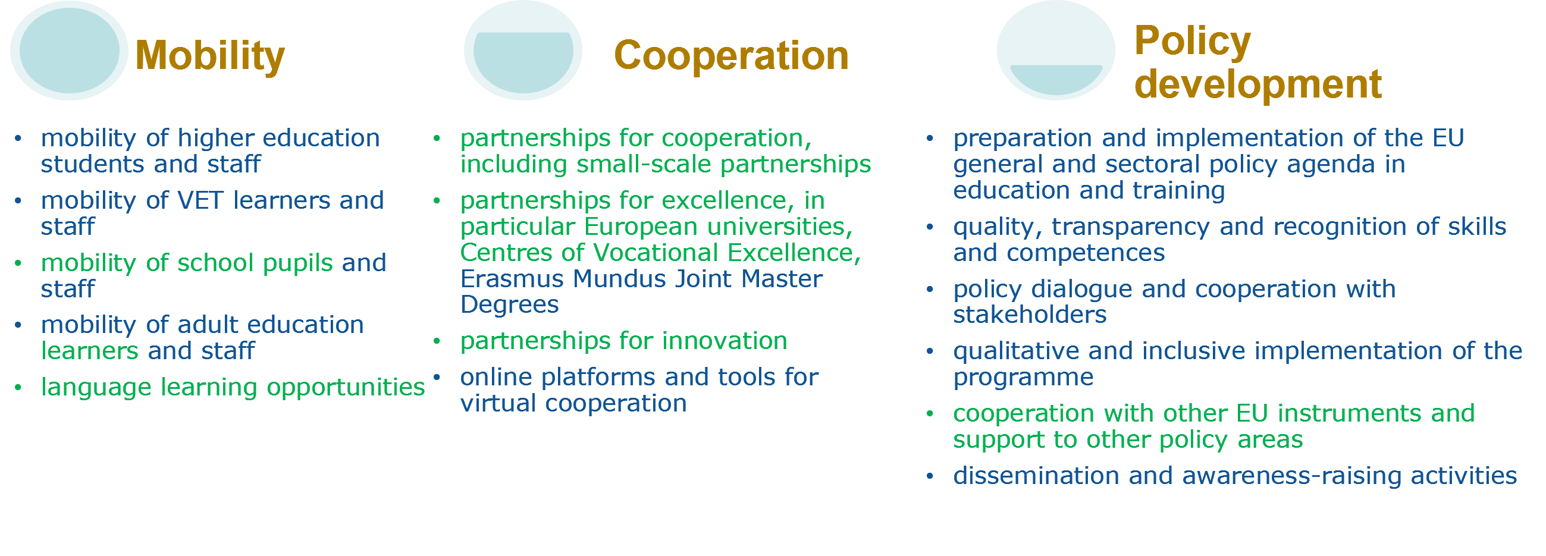
Key Actions 1: Education and Training
Jean Monnet actions
  Jean Monnet in the field of higher education
  Jean Monnet in other fields of education and training

Slide 23
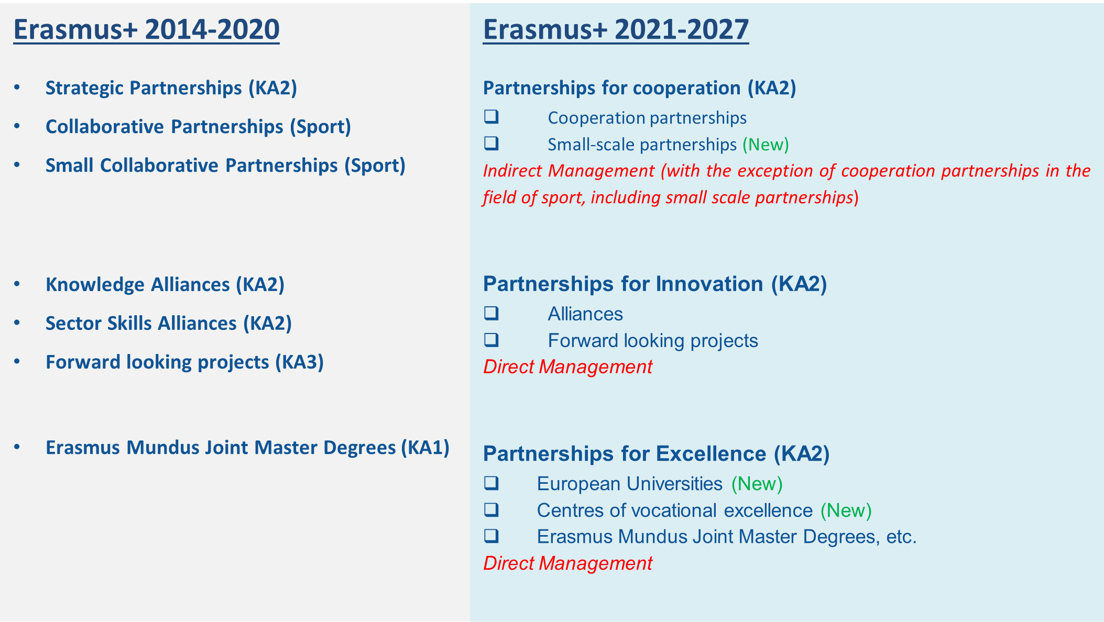
Erasmus+ Partnerships: new architecture

Slide 24

Wider Range of Cooperation models
Partnerships for Excellence
European
Universities
Partnerships for Innovation
Erasmus
Mundus
Ambitious
Alliances
    Partnerships for Cooperation
Forward Looking
Projects
Long-term Strategy
Cooperation
Projects

Slide 25



«Capacity Building»
Something to build goal
Designing project team
Raw materials programmes (both international and national programmes and actions)
Multidisciplinary Skills partnerships

Slide 26

Key Action 2. Capacity Building in HE. What is it about?
Transnational cooperation projects, based on multilateral partnerships, primarily between HEIs from EU Member States and third Countries

Slide 27
Purpose
Focus on the needs of Partner Countries not associated to the Erasmus+ Programme
Focus on the needs of Partner Countries not associated to Erasmus+ and matching them with the EU priorities for these countries
Maximising benefit to Partner Countries not associated to the Erasmus+ Programme

Slide 28
Context (1)
Supports the relevance, quality, modernisation and accountgability of HEIs for socio- economic recovery, growth and prosperity.
➢
Reacts to recent trends, in particular economic globalisation, but also the recent decline in human development, fragility, and rising social, economic and environmental inequalities exacerbated by the COVID-19 crisis.
➢
Aligned with the ’Sustainable Development Goals’ (SDGs) and the Paris Agreement.
➢

Slide 29
Context (2)
➢
Ensures equity, accessibility and inclusion, system strengthening and capacity building, as well as employability transversally across the action.
➢
Global interventions that take into account governance, management and the strengthening of higher education’s wider economic and social ecosystems.
➢
Addresses regional issues, build alliances and coalitions, pilot new approaches and initiatives built on country ownership.

Slide 30
Objectives
Modernisation HEIs & HE
systems
Cooperation / Regional integration
Societal impact
CBHE
Governance
Accessibility
Innovation

Slide 31
Types of CBHE projects
Three types of CBHE projects
National projects | Multi-country regional projects | Multi-country cross-regional projects
HEIs from one Partner Country | HEIs from several Partner Country from one Region | HEIs from Partner Country belonging to several Regions
At least 2 HEIs from two Member States

Slide 32







National projects: eligibility criteria
Partner Countries
EU Member States
1 eligible country
At least 2 countries
Minimum 1 HEI from each participating country
Minimum 2 HEIs

Slide 33






Multi-country projects: eligibility criteria
Partner Countries
Same Region (regional projects)
Different Regions (cross-regional projects)
EU Member States
Minimum 2 eligible
countries
Minimum 2 countries
Minimum 2 HEIs from each eligible country
Minimum 1 HEI from each country
For WESTERN BALKANS, LATIN AMERICA and CARIBBEAN: ONLY MULTI-COUNTRY PROJECTS!

Slide 34
Eligible applicant
Who can apply?
◆ Higher Education Institutions (HEIs) or
◆ Associations or organisations of HEIs
What else?
Applicant must be established in a EU Member State or in an eligible Partner Country
The applicant applies on behalf of all participating organisations involved in the proposal
Exception: organisations from Syria (Region 3) cannot act as applicants.

Slide 35
Eligible partners
What types of organisations are eligible?
◆ any public or private organisation recognised as HEI by
the competent authorities of their country(ies)
◆ any public or private organisation active in the labour market or in the fields of education, training and youth
◆ Associations or organisations of HEIs dedicated to the promotion, improvement and reform of higher education as well as to co-operation within Europe and between Europe and other parts of the world
◆ International governmental organisations on a self-
financing basis.

Slide 36
New features
Three strands
Regional Priorities
New budget
system
New publication
system
a new type of support
overarching &
sub-priorities
lump sum II
FTOP
Funding & Tender Opportunities Portal

Slide 37
Three strands
Strand 1 - Fostering access to cooperation in HE
Facilitate access to newcomers.
First step for participating organisations to enhance
and increase means to reach out to people with
fewer opportunities.
Reduce the internationalisation gap of HEIs from the same country/region.
Fostering social inclusion.

Slide 38






Strand 2 - Partnerships for transformation
Innovation with business involvement to maximize societal impact
Modernising HEIs by promoting reform
Introducing practical learning schemes with a link to business
Implementation of new learning methods
Innovative curricula linked to business Introducing practical learning schemes
Reform governance and management at HEIs

Slide 39
Strand 3 - Structural Reform projects
Mutual learning between public authorities of Member States and those of the Partner Countries
Promote inclusive Higher Education systems
 | Increase capacities of bodies in charge of Higher Education |  | Identify synergies with ongoing EU initiatives
Foster national ownership
Efficient and effective policy making |  |  | Foster common regional strategies in Higher Education |  | Introduction of funding mechanisms

Slide 40
New regional priorities
Overarching priorities
Green deal
Digital transformation
Migration and Mobility
Governance, peace, security and human development
Sustainable growth and jobs

Slide 41
Regions
1 - Western Balkans
Albania, Bosnia and HerzegovinaK, osovo*, Montenegro
2 - Neighbourhood East
Armenia, Azerbaijan, Belarus, Georgia, Moldova, Ukraine as recognised by int'l law
3 - South-Mediterranean
Algeria, Egypt, Israel, Jordan, Lebanon, Libya, Morocco, Palestine*, Syria, Tunisia
5 - Asia
Bangladesh, Bhutan, Cambodia, China, DPR Korea, India, Indonesia, Laos, Malaysia, Maldives, Mongolia, Myanmar, Nepal, Pakistan, Philippines, Sri Lanka, Thailand, Vietnam
6 - Central Asia
Afghanistan, Kazakhstan, Kyrgyzstan, Tajikistan, Turkmenistan, Uzbekistan
7 - Middle East
Iran, Iraq, Yemen
8 - Pacific
Cook Islands, Fiji, Kiribati, Marshall Islands, Micronesia - Federated States of, Nauru, Niue, Palau, Papua New Guinea, Samoa, Solomon Islands, Timor-Leste, Tonga, Tuvalu, Vanuatu
Angola, Benin, Botswana, Burkina Faso, Burundi, Cameroon, Cape Verde, Central A.R., Chad, Comoro
9 - Sub-Saharan Africa
Congo, Congo –D.R., Djibouti, Equatorial Guinea, Eritrea, Eswatini, Ethiopia, Gabon, Gambia, Ghana, Guinea, Guinea-Bissau, Ivory Coast, Kenya, Lesotho, Liberia, Madagascar, Malawi, Mali, Mauritania,
Mauritius, Mozambique, Namibia, Niger, Nigeria, Rwanda, Sao Tome and Principe, Senegal, Seychelles, Sierra Leone, Somalia, South Africa, South Sudan, Sudan, Tanzania, Togo, Uganda, Zambia, Zimbabwe
10 - Latin America
Bolivia, Brazil, Chile, Colombia, Costa Rica, Ecuador, El Salvador, Guatemala, Honduras, Mexico, Nicaragua, Panama, Paraguay, Peru, Uruguay, Venezuela
11 - Caribbean
Antigua & Barbuda, Bahamas, Barbados, Belize, Cuba, Dominican Rep., Grenada, Guya
Haiti, Jamaica, St. Kitts & Nevis, St. Lucia, St. Vincent & Grenadines, Suriname, Trinidad & Tobago

Slide 42
New budget type
Lump sum II: approach – basic principles
In the proposal, applicants must provide a detailed estimation of costs and a split of the lump sum per work package and per beneficiary
Evaluators assess cost details during evaluation and make recommendations if needed.
Based on this, the lump sum is fixed during grant preparation

Slide 43
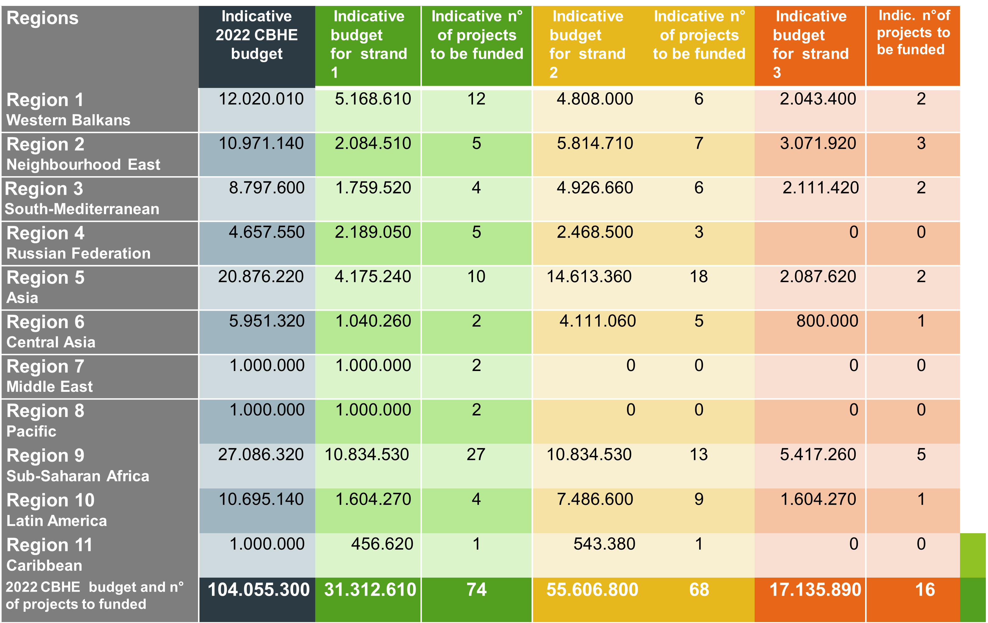
2022. Available budget and n° of projects
24

Slide 44
Duration and funding rules per Strand
◆ Strand 1
Projects can last 24 or 36 months
Funding between EUR 200.000 and EUR 400.000 per project
◆ Strand 2
Projects can last 24 or 36 months
Funding between EUR 400.000 and EUR 800.000 per project
◆ Strand 3
Projects can last 36 or 48 months
Funding between EUR 800.000 and EUR 1.000.000 per project

Slide 45
Probable Timeline
Call: second half of November 2022
Deadline: mid-end February 2023
Evaluation process: March - July 2023
Information to applicants: August 2023
Start of projects:
January 2024

Slide 46
Erasmus+ CBHE Promotion activities
Participation to events and Infodays organized by:
◆ National Agencies
◆ National Erasmus+ Offices
◆ EU Delegations
◆ Other stakeholders (i.e. associations of Higher Education institutions)

Slide 47
More information
Erasmus+ Call for proposals 2021
Erasmus+ Programme Guide 2021
Erasmus+ National Agencies
European Education and Culture Executive Agency
Many thanks for your attention!
For any further info: intstrat@unige.it

