Slide 1
Quality Assurance of Study Programmes in the European Higher Education Area
«MERGE» ERASMUS+ CBHE PROJECT
1st Training Event in the Framework of W.P. 2 «Human Capacity Building»
Prof. Alfredo Squarzoni, Professor Emeritus, University of Genoa, Italy
Mr. Angelo Musaio, Head of ICO, University of Genoa, Italy

Slide 2
Aim of the presentation
To describe the definition of effective Quality Assurance (QA) systems coherent with the «Bologna Process» requirement and the ESG *
To describe some processes to be managed by Higher Education Institutions (HEIs) in the framework of their Study Programmes (SPs).
*: Standards and guidelines for quality assurance in the European Higher Education Area
2

Slide 3
Key words
European Dimension of Higher Education (HE)
↓
Student-centred Study Programmes (SPs) to be recognized in the European Higher Education Area (EHEA)
Quality Assurance (QA) of SPs
3
Notes:
European

Slide 4
Topics of the presentation
Quality and Quality Assurance (QA) of Study Programmes (SPs)
Standards and Guidelines for QA in the European Higher Education Area (EHEA)
A case study. ENAEE Standards and Guidelines for Programme Management
A case study. EQUASP Standards and Guidelines for internal Quality Assurance of Study Programmes (EQUASP Model)
4

Slide 5
a) Quality and QA of SPs
Quality of SPs
Coherently with the ISO 9000 definition, for “quality of study programme” is intended:
the grade (level) of achievement of the objectives established coherently with the needs and expectations of all those who are interested in the educational service provided, including the indirect “interested parties” or stakeholders,…
or, in other words, the level of accomplishment of the quality requirements established coherently with the needs and expectations of all the interested parties.
5

Slide 6
Quality assurance of SPs
Just coherent with the ISO 9000 definition of QA, “quality assurance of study programme” is intended:
the whole of the activities and processes for the mgmt of the educational service aimed at achieving the established educational objectives and then at “ensuring trust” in meeting the quality requirements to all interested parties.
Consequently, the definition of a QA system of a SP means the identification of the set of activities (processes) for the mgmt of the educational service aimed at achieving the established educational objectives.
6

Slide 7
b) Standards and Guidelines for QA in the EHEA
Nowadays the definition of suitable academic strategies in order to promote SP quality can rely on the standards and guidelines for QA established in the document
«Standards and Guidelines for Quality Assurance in the European Higher Education Area (ESG)»
<http://www.enqa.eu/wpcontent/uploads/2015/11/ESG_2015.pdf>
7

Slide 8
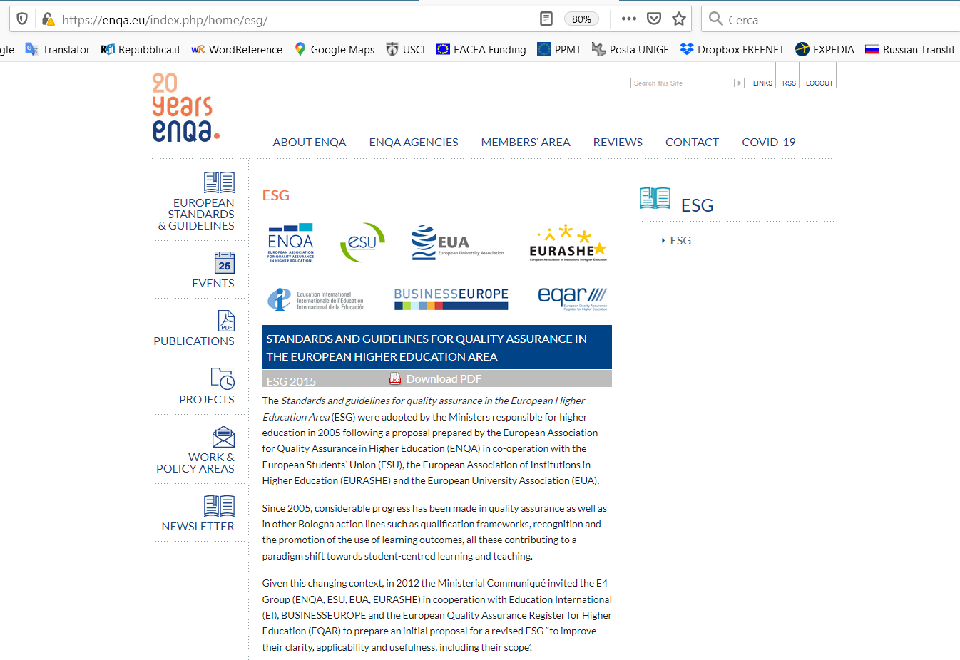

Slide 9
«ESG»
This document was prepared by the European Association for Quality Assurance in Higher Education (ENQA) in co-operation with the European Students’ Union (ESU), the European Association of Institutions in Higher Education (EURASHE) and the European University Association (EUA).
It was adopted by the Ministers of HE of 45 countries during the Bergen (Norway) meeting on May 2005 and revised in the Yerevan (Armenia) meeting on May 2015.
It has found a generalised acceptance in the European context.
9

Slide 10
The standards and guidelines reflect the statement of the European Ministers of Education in the 2003 Berlin communiqué:
«consistent with the principle of institutional autonomy, the primary responsibility for QA in higher education lies with each institution itself and this provides the basis for real accountability of the academic system within the national quality framework».
10

Slide 11
«ESG» aims
they set a common framework for quality assurance systems at European, national and institutional level;
they enable the improvement of quality of higher education in the EHEA;
they support mutual trust, facilitating recognition and mobility within and across national borders;
they provide information on quality assurance in the EHEA.
11

Slide 12
Principles on which ESG are based for QA in EHEA
HEIs have primary responsibility for the quality of their provision and its assurance;
QA processes respond to the diversity of HE systems, institutions and programmes;
QA supports the development of a quality culture;
QA processes involve stakeholders and take into account the expectations of all stakeholders and society.
12

Slide 13
«ESG» Standards
The standards set out agreed and accepted practice for QA of HE in the EHEA and should, therefore, be taken account of and adhered to by those concerned, in all types of higher education provision.
Guidelines explain the importance of the standards and provide information to assist HEIs, agencies and governments in the implementation of the standards in their individual context.
13

Slide 14
It is important to note that the purpose of standards and guidelines is to provide a source of assistance and guidance to HEIs in developing their own quality assurance system, as well as to contribute to a common frame of reference, which can be used by institutions.
These standards and guidelines have not dictate practice or be considered as mandatory or unchangeable.
14

Slide 15
The standards are divided in three parts covering:
Part 1 - Internal QA in HEIs *
Part 2 - External QA of higher education *
Part 3 - QA agencies
It is important to consider that, however, the three parts are intrinsically interlinked and they together form the basis for a European QA framework.
___________________
* Internal QA: QA on the responsibility of the institution
* External QA: QA on the responsibility of the agencies for QA
15

Slide 16
In the following of this presentation, we are interested in
Part 1: Standards (and guidelines) for internal quality assurance within higher education institutions
of the ESG, articulated in 10 standards.
16

Slide 17
S.1 Policy for quality assurance
Standard
Institutions should have a policy for QA that is made public and forms part of their strategic management.
Internal stakeholders should develop and implement this policy through appropriate structures and processes, while involving external stakeholders.
Stakeholders are understood to cover all actors within an institution, including students and staff, as well as external stakeholders such as employers and external partners of an institution.
17

Slide 18
Processes associated to Standard 1
Definition of the policy and organization (processes and organizational structure) for the QA of SPs (at institutional level)
Definition of the management system of SPs (processes and organizational structure for the SPs’ management)
18

Slide 19
Adequate policy for the QA of SPs to be pursued by the HEI which the SP belongs to
The policy should take account of both the national context in which the institution operates and the institutional context.
Such a policy should support:
interrelation between education and (international) professional field;
relationship between research and teaching & learning;
availability and development of facilities & student support services;
organization of the QA system of the SPs;
development of a quality culture in which all internal stakeholders (SPs’ leaders, staff, students) assume responsibility for SPs’ quality;
involvement of external stakeholders (alumni, representatives of the professional fields) in QA of SPs.
Moreover, also in order to contribute to the accountability of the institution, the policy should have a formal status and be publicly available.
19

Slide 20
The policy should be put into practice through internal QA processes, managed by appropriate structures and that allow participation across the institution.
At this aim, the institution should adopt an effective organisation and decision-making structure with regard to the quality of its SPs which clearly defines responsibilities and tasks, in particular referred to:
definition of a QA system of the SPs consistent with the HE’s policy and supporting the SPs leaders and the SPs implementation;
verification of compliance with the procedures and timing of the QA system by the SPs and the monitoring of their results (students in entrance, etc.);
monitoring of the student support services;
evaluation of the extent to which its vision of the SPs’ quality is realised;
improvement of the SPs’ quality wherever required.
20

Slide 21
S.2 Design and approval of programmes
Standard
Institutions should have processes for the design and approval of their programmes.
The programmes should be designed so that they meet the objectives set for them, including the intended learning outcomes.
The qualification resulting from a programme should be clearly specified and communicated, and refer to the correct level of the national qualifications framework for higher education and, consequently, to the Framework for Qualifications of the EHEA.
21

Slide 22
Processes associated to Standard 2
Identification of the educational needs of the labour market and other stakeholders
Definition of the educational objectives
Definition of the learning outcomes
Design and planning of the educational process
22

Slide 23
S.3 Student-centred learning *, teaching and assessment
Standard
Institutions should ensure that the programmes are delivered in a way that encourages students to take an active role in creating the learning process, and that the assessment of students reflects this approach.
* Definition of student-centred learning according to the European Student Union (ESU 2010):
“A learning approach characterised by innovative methods of teaching aimed at promoting learning in communication with teachers and students and which takes students seriously as active participants in their own learning, fostering transferable skills such as problem-solving, critical and reflective thinking”.
Processes associated to Standard 3
Design and planning of the educational process
23

Slide 24
S.4 Student career (admission, progression, recognition and certification)
Standard
Institutions should consistently apply pre-defined and published regulations covering all phases of the student “life cycle”, e.g. student admission, progression, recognition and certification.
24

Slide 25
Processes associated to Standard 4
Definition of the admission, recognition, progression and attestation regulations
It is important that admission processes and criteria are implemented consistently and in a transparent manner.
Fair recognition of higher education qualifications, periods of study and prior learning *, including the recognition of non-formal * and informal * learning, are essential components for ensuring the students’ progress in their studies, while promoting mobility.
* Formal learning means learning typically provided by an education or training institution, structured (in terms of learning objectives, learning time or learning support) and leading to certification.
Non-formal learning means learning that is not provided by an education or training institution and typically does not lead to certification. However, it is structured.
Informal learning means learning resulting from daily life activities related to work, family or leisure. It is not structured and typically does not lead to certification.
25

Slide 26
The SP should also establish management criteria of the students’ career able to favour a regular students’ progression in their studies. These criteria should regard at least:
frequency of the educational activities;
number of ECTS credits necessary for the enrolment in the successive course year;
number of ECTS credits to be accumulated before the holding of training periods.
The SP should establish appropriate rules to regulate the studies progression of:
part time students;
working students,
handicapped students;
students who cannot attend the educational activities for a long period for causes independent from their will (e.g.: illness, etc.).
26

Slide 27
Graduation represents the culmination of the students’ period of study. Students need to receive documentation (Diploma Supplement *) explaining the qualification gained, including achieved learning outcomes and the context, level, content and status of the studies that were pursued and successfully completed.
Diploma Supplement
The Diploma Supplement is an annex to the official qualification documentation that is designed to provide more detailed information on the studies completed according to an agreed format that has been drawn up by the European Commission, Council of Europe and UNESCO/CEPES and is internationally recognised.
27

Slide 28
S.5 Teaching staff
Standard
Institutions should assure themselves of the competence of their teachers. They should apply fair and transparent processes for the recruitment and development of the staff.
Processes associated to Standard 5
Identification and assignment of the teaching staff
The teaching staff in charge of the course units should be quantitatively and qualitatively adequate to favour the achievement of the intended programme learning outcomes by the students.
28

Slide 29
S.6 Learning resources and student support
Standard
Institutions should have appropriate funding for learning and teaching activities and ensure that adequate and readily accessible learning resources and student support are provided.
29

Slide 30
Processes associated to Standard 6
Identification and allocation of facilities (in particular: lecture and study rooms, laboratories, libraries) and support staff
Organisation and management of student support (orienteering, tutoring and assistance) services
Establishment of partnerships with national and international businesses, research institutions and other HEIs for carrying out students’ external education and mobility
Identification of the needs and allocation of financial resources
30

Slide 31
S.7 Information management
Standard
Institutions should ensure that they collect, analyse and use relevant information for the effective management of their programmes and other activities.
31

Slide 32
Processes associated to Standard 7
Monitoring of the incoming students
Monitoring of the students’ learning
Monitoring of the students’ progression in their studies
Monitoring of the students’ opinion on the educational process
Monitoring of the graduates’ placement
Monitoring of the employed graduates and employers opinion on education of graduates
32

Slide 33
Info & data on the graduate placement
The information and data on the graduate placement to gather involving alumni and employers, elaborate and document should regard at least:
percentage of graduates placed on the labour market;
time to placement;
consistency of graduate placement with their education and effectiveness of the degree in the carried-out job (in order to check the real use in the jobof the acquired competences);
alumni’s opinions on the adequacy and suitability in practice of the acquired competences;
employers’ opinions as to adequacy and suitability in practice of the graduates’ competences and therefore their employability;
in order to provide evidence of the adequacy of the degree qualification for the labour market and of the correspondence of the programme competences with the educational needs of the labour market.
Generally, such surveys are carried out 1 year min. and 5 years max. after graduation, through questionnaires, interviews, focus groups with employers.
33

Slide 34
S.8 Public information
Standard
Institutions should publish information about their activities, including programmes, which is clear, accurate, objective, up-to date and readily accessible.
Associated processes
Provision of public access to info on the SP
Info on institutions’ activities is useful for future and current students, as well as for graduates, other stakeholders and the public.
e.g.: SPs they offer, selection criteria for them, planned learning outcomes of the SPs, qualifications they award, T-L-A procedures used, pass rates and learning opportunities available to students, etc.
34

Slide 35
S.9 On-going monitoring and periodic review of programmes
Standard
HEIs should monitor and periodically review their SPs to ensure that they respond to the needs of students and society. These reviews should lead to continuous improvement of the SPs. Any action planned or taken as a result should be communicated to all those concerned.
35

Slide 36
Processes associated to Standard 9
Review
Regular monitoring, review and revision of SPs ensures an appropriate and effective learning environment for students
An analysis process should be carried out, finalised to the identification of strong and weak points of the SP through at least the comparison of the SPs’ results with those obtained in the previous years and the results obtained by other SPs of the same typology, if any, and analysis of the reasons of the weak points (e.g.: dropouts, delays in graduation, etc.).
36

Slide 37
S.10 Cyclical external quality assurance
Standard
Institutions should undergo external quality assurance in line with the ESG on a cyclical basis.
Processes associated to Standard 10
External assessment of SP’s QA
37

Slide 38
c) A case study. EUR-ACE Standards and Guidelines for Programme Management
EUR-ACE (EURopean ACcredited Engineer) is the label awarded to accredited engineering SPs at Bachelor and Master level.
EUR-ACE label is run by the European Network for Accreditation of Engineering Education - ENAEE www.enaee.eu
38

Slide 39
ENAEE aims
ENAEE does not recognize specific engineering degree programmes.
ENAEE carries out its mission by evaluating QA and accreditation agencies in the EHEA in respect of their standards and procedures when accrediting engineering degree programmes.
Those agencies which satisfy ENAEE in respect of these matters are authorized by ENAEE to award the EUR-ACE label to the engineering degree programmes which they accredit.
39

Slide 40
ENAEE structure
Currently ENAEE has 22 full members and 3 associate members.
The agencies authorized to award the EUR-ACE label are 13.
The SPs accredited are more than 2.000, not only in Europe.
The standards which ENAEE requires of engineering degree programmes which are accredited by agencies are described in terms of:
student workload requirements
programme learning outcomes
programme management
as specified in the «EUR-ACE Framework Standards and Guidelines - EAFSG»
http://www.enaee.eu/wp-assets-enaee/uploads/2012/02/EAFSG_full_nov_voruebergehend.pdf
40

Slide 41
d) A case study. EQUASP approach to QA of SPs
The EQUASP project http://equasp.tstu.ru/ is a Tempus project (ref. 543727-TEMPUS-2013-SMGR «On-line Quality Assurance of Study Programmes») funded by EACEA, successfully concluded by promoting the international recognition of technological SPs of Russian Federation.
By means of EQUASP, an internal QA system was adopted by outstanding Russian Polytechnics, focused on:
design of student-centred technological SPs focused on definition of learning outcomes consistent with needs of the stakeholders;
definition and implementation of an on-line documentation system of the QA of SPs.
41

Slide 42
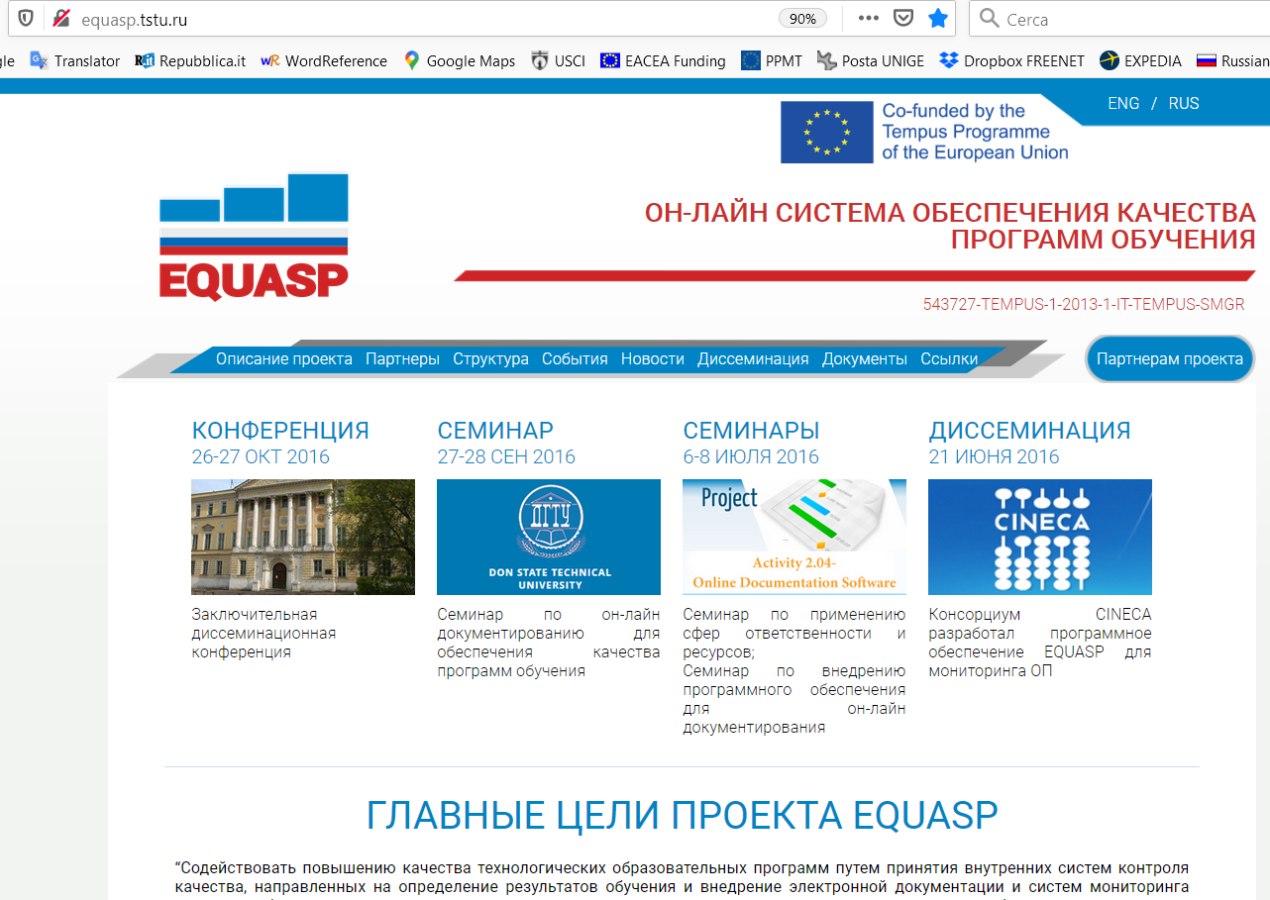

Slide 43
EQUASP standards
According to the EQUASP approach, in order to assure its quality, a SP must comply, in addition to the national standards and requirements, also the five EQUASP standards:
Needs and Objectives
Educational process
Resources
Monitoring and results
Management system
For each of these standards, EQUASP identifies the processes to be considered as fundamental for a mgmt for quality of SPs.
43

Slide 44
EQUASP Model
The whole of standards and quality requirements, with the associated processes to carry out and info & data to be documented, represent the EQUASP Standards and Guidelines for the internal QA of SPs (EQUASP Model), fundamental outcome of the EQUASP project, together with the «EQUASP Software for the on-line documentation of the information and data for the QA of SPs».
The EQUASP Software is the software designed, produced and available on-line, as required by the EQUASP Model. It is possible to check an example of its implementation at
http://equasp.cineca.it/equasp/app/index.html#/studyProgram/EQUASP
44

Slide 45
Thank you for your kind attention!
a.squarzoni@unige.it
musaio@unige.it
https://erasmus-merge.eu/
https://unige.it/internationalstrategies
Project number: 610391-EPP-1-2019-1-IT-EPPKA2-CBHE-JP
"This project has been funded with support from the European Commission. This publication [communication] reflects the views only of the author, and the Commission cannot be held responsible for any use which may be made of the information contained therein"

