Slide 1
European Dimension of Higher Education with reference to Bologna Process
«MERGE» ERASMUS+ CBHE PROJECT
1st Training Event in the Framework of W.P. 2 «Human Capacity Building»
Prof. Alfredo Squarzoni, Professor Emeritus, University of Genoa, Italy
Mr. Angelo Musaio, Head of ICO, University of Genoa, Italy

Slide 2
Aims of the presentation
To increase awareness on Bologna «Declaration» or «Process» as a tool aimed at enhancing the international dimension of Partner Countries Universities with specific reference to:
process of designing a student-centred study programmes (SPs) and related programme handbook,
dissemination of some info for the recognition of SPs in the European Higher Education Area (EHEA),
presentation of the European standards and guidelines for QA in the EHEA (ESG), and to describe what a SP should do in order to define a QA system consistent with the ESG.

Slide 3
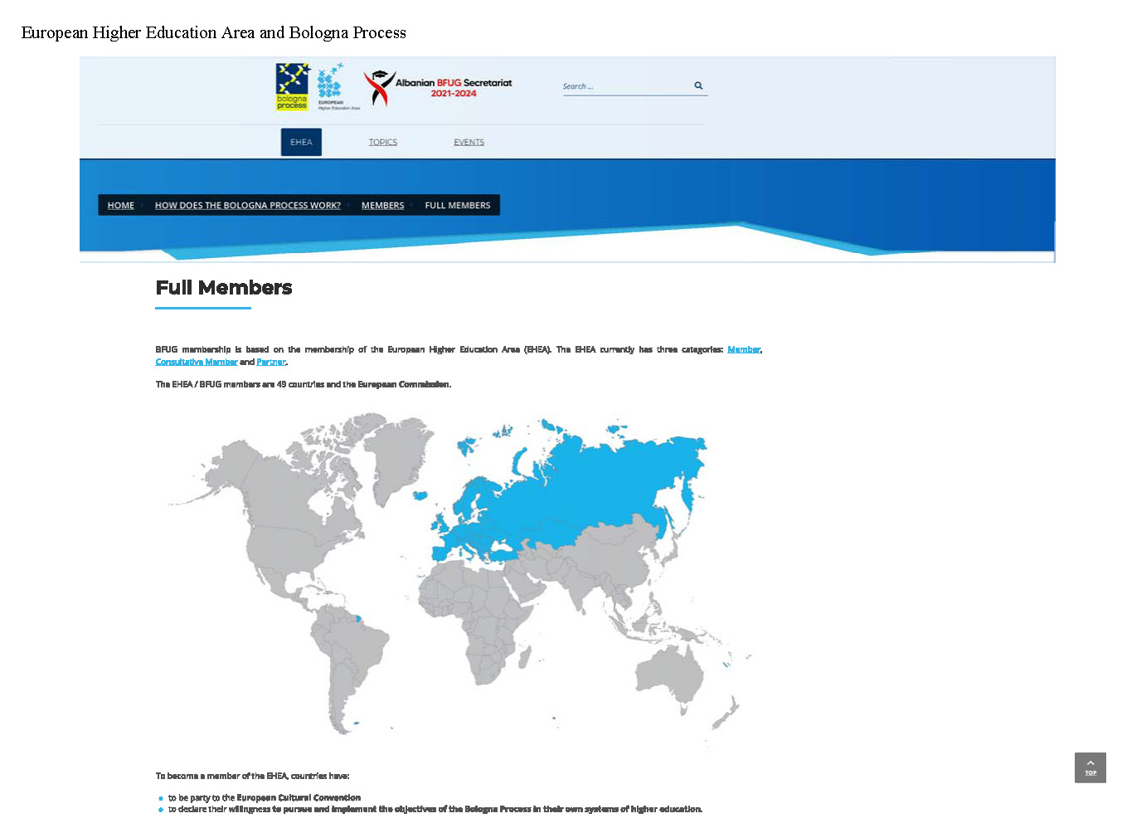

Slide 4
Topics of this presentation
Comparability of Study Programmes and their duration
Comparable Programme Learning Outcomes: Student-Centred Programmes
Design of a Student-Centred Programme

Slide 5
Key words
European Dimension of Higher Education (HE)
↓
Student-centred Study Programmes (SPs) recognisable in the European Higher Education Area (EHEA)
Quality Assurance (QA) of SPs
Notes:
European

Slide 6
a) Comparability of Study Programmes
Aim and objectives of the Bologna Process
To establish the
European Area of Higher Education
and to promote the
European system of higher education world-wide.
By means of…
6

Slide 7
… by means of …
adoption of a system of easily readable and comparable degrees (1st objective),
degrees organized in three main cycles (2nd),
with the students’ workload measured in credits (3rd),
degrees able to assure their quality (5th) in a reliable way,
in order to promote mobility for students (4th) and
necessary European dimensions in higher education (6th).

Slide 8
SPs comparability requirements
Comparable duration, or comparable students’ workloads measured in ECTS (European Credit Transfer and Accumulation System) credits,
Comparable programme learning outcomes, consistent with the programme learning outcomes shared at international level,
Quality assurance, i.e.: assure that every effort is made in order to achieve the established programme learning outcomes.

Slide 9
Comparable Duration
At this regard, the Bologna process suggests an organization of the SPs in three main cycles:
First Cycle - Bachelor
Second Cycle - Master
Third Cycle - Doctorate

Slide 10
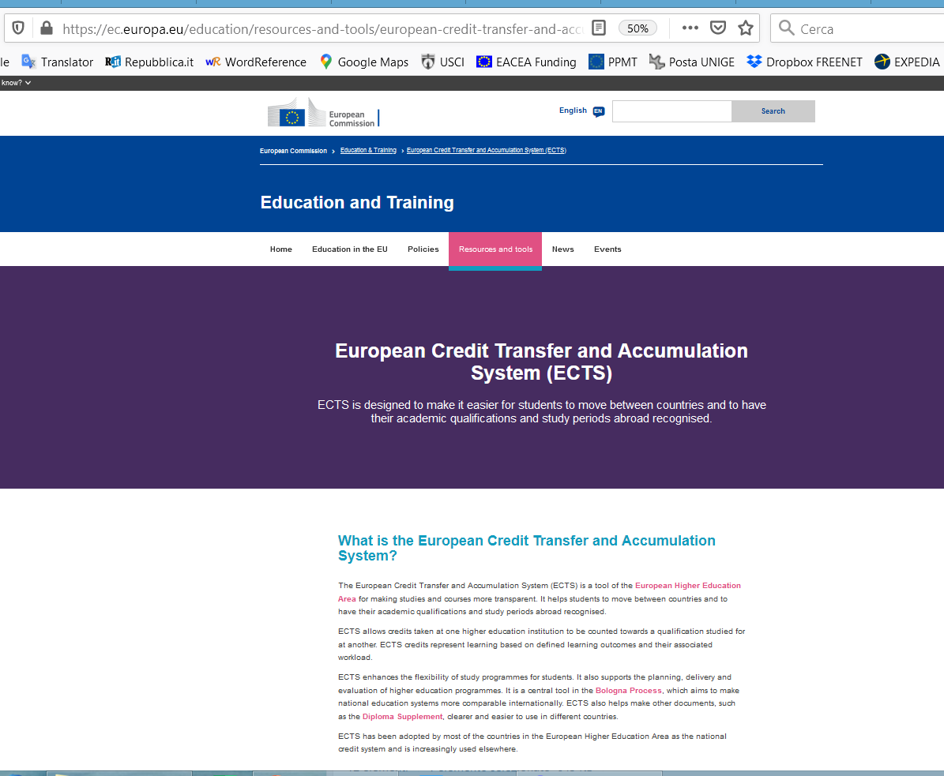

Slide 11
Guidelines for the association of credits with qualifications within national frameworks
(From ‘A Framework for Qualifications of the European Higher Education Area’) http://www.bdp.it/lucabas/lookmyweb/templates/up_files///Processo_Bologna/Doc%20Qualification%20Framework.pdf
First cycle qualifications may typically include / be represented by 180-240 ECTS credits
Second cycle qualifications … 90-120 ECTS credits – the minimum requirement should amount to 60 ECTS credits/year (e.g. LLL)
Third cycle qualifications do not necessarily have credits associated with them (e.g. Doctorate)

Slide 12
b) Comparable Programme Learning Outcomes: Student-Centred Programmes
The objective of the comparability of the programme learning outcomes has had as a consequence the necessity of a new approach for designing SPs after Bologna.
The aim of a student-centred programme is to make students as competent as possible in a given timeframe for their employment outcomes.
These SPs are no more focused on what a student has been taught, but on what a student has learned and is able to do, that is on competence development and the achievement of planned learning outcomes of the learning process.

Slide 13
Consequently programme leaders of courses leading to a Bachelor or Master degree have no more to describe and plan solely according to the SP content, but mainly according to the competences to be developed and obtained by graduates and the programme learning outcomes to be achieved by students at the ending of the educational process.

Slide 14
Programme Learning Outcomes
Programme learning outcomes internationally shared definition:
“Statements of what a learner is expected to know, understand and / or be able to demonstrate after completion of a process of learning”

Slide 15
«TUNING» project
«Tuning Educational Structures in Europe» http://www.unideusto.org/tuningeu/ is a University driven initiative, which started in 2000 and was originally set up to offer a concrete approach to implement the Bologna process at the level of Higher Education Institutions (HEIs) and subject areas.
TUNING makes an interesting distinction between competences and programme learning outcomes, also in order to have distinction between the different roles of the most relevant players:
students/learners and academic staff
____________

Slide 16
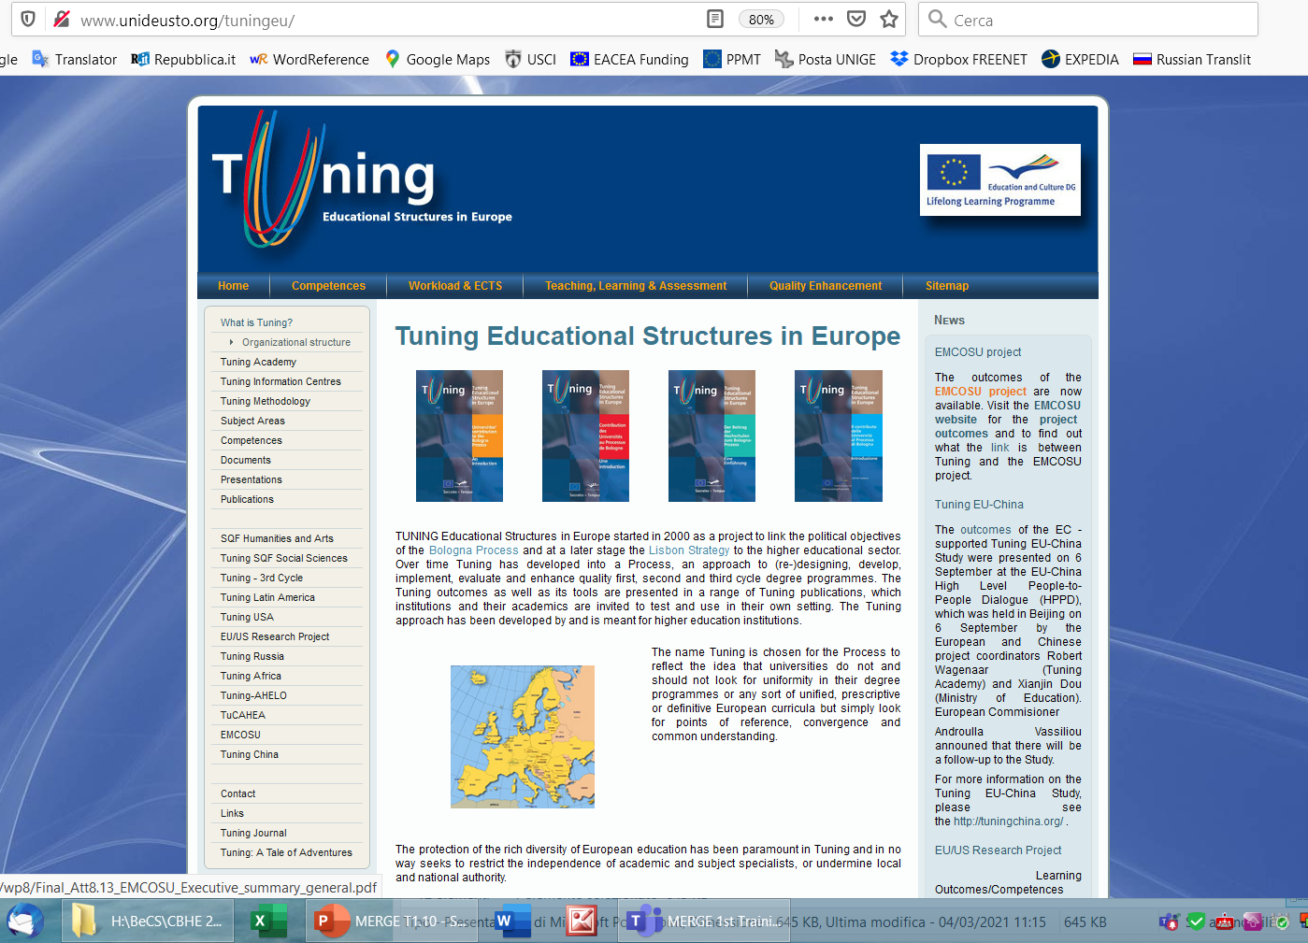

Slide 17
«TUNING» project
The current transformation process towards the ‘output-based’ or ‘student-centred’ approach that takes the student as the centre of the teaching and learning process, is still running.
[“…, the actual implementation of the LOs based approach at degree programme level, and its underpinning with suitable Teaching, Learning and Assessment (TLA) strategies and methodologies, has had limited success so far in the wider European context.
It is in fact accepted that the modernization process of HE-programmes in Europe … has made limited progress … . Although the architecture seems to be in place in most Countries, the actual implementation process and the realization of the expected benefits, have been far from smooth and complete. Rather, in many contexts, actual change in learning teaching and assessment methods and philosophy has met resistance, ...”]
Robert Wagenaar, Groningen University, coordinator and “father” of the Tuning project,

Slide 18
c) Design of a Student-Centred Programme
Fundamental steps of the design of a student-centred SP
Identification of the educational needs
Definition of the programme educational objectives
Definition of the programme learning outcomes
Definition of the programme structure

Slide 19
Case study of Student-Centred SP implementation - ENAEE
Implementing Study Programmes consistent with the standards and guidelines for programme management set-up by TUNING:
ENAEE - European Network for Accreditation of Engineering Education http://www.enaee.eu/
ENAEE is the network that runs the EUR-ACE (EURopean ACcredited Engineer) label awarded to accredited engineering SPs at Bachelor and Master level.

Slide 20
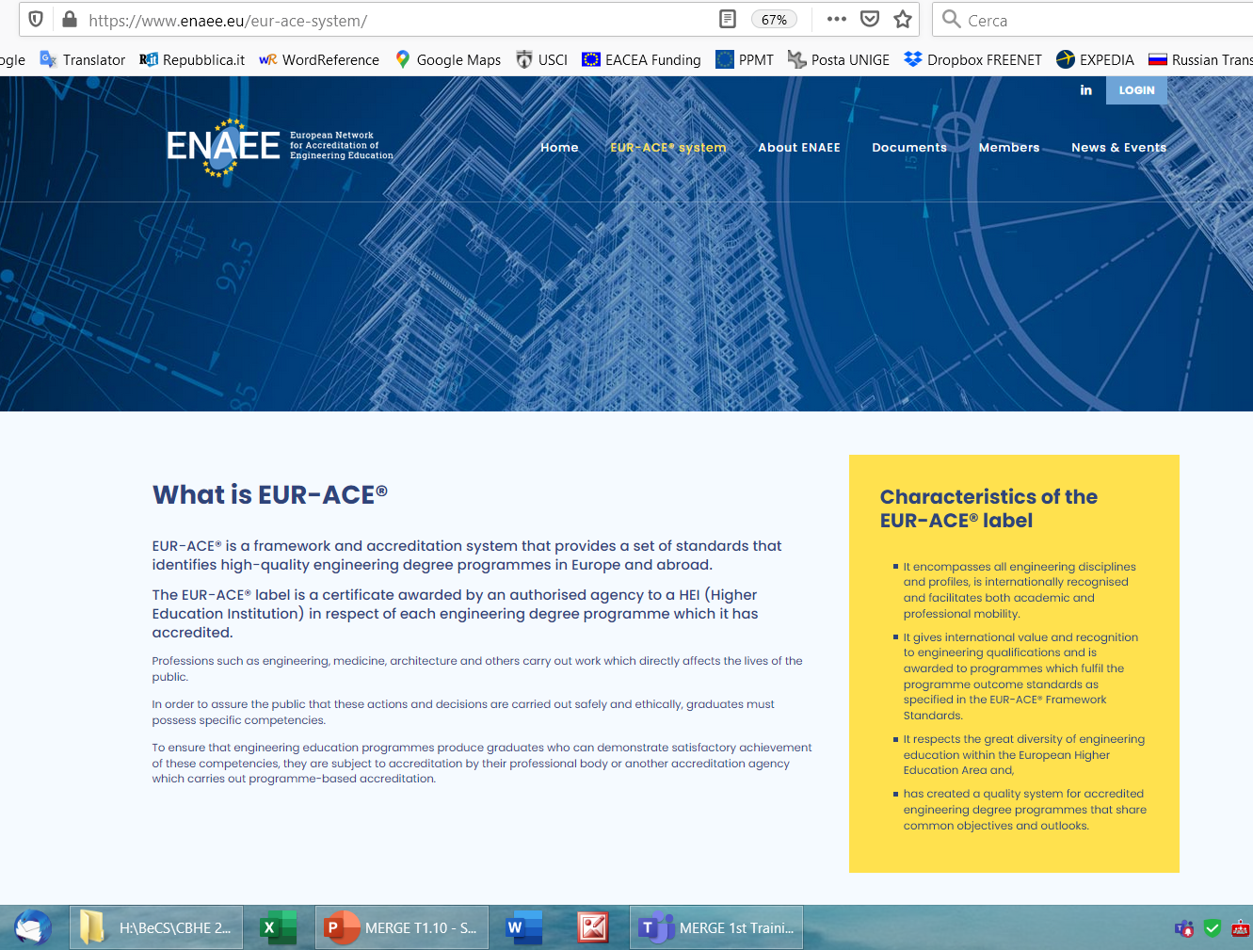

Slide 21
EUR-ACE Framework Standards and Guidelines
http://www.enaee.eu/wp-assets- enaee/uploads/2012/02/EAFSG_full_nov_voruebergehend.pdf
2.4 Programme Management
2.4.1 Programme Aims (=Programme educational objectives) *
The aims of accredited programmes must reflect the needs of employers and other stakeholders. The programme outcomes must be demonstrably consistent with the aims.
_________________
* Programme aims: Functions / roles / activities students are to be prepared for and associated key competences to be developed and obtained by graduates. Programme aims are based on the educational needs of the stakeholders.

Slide 22
ENAEE Programme Aims
1.1 Educational needs of the labour market and other stakeholders | Documentation to be provided Relevant industry and labour market organisations and other stakeholders consulted, and methods and schedule of consultation. Identified educational needs of the labour market and other stakeholders.
1.2 Programme Aims | Documentation to be provided Set of Programme Aims.
1.3 Programme outcomes | Documentation to be provided Set of programme outcomes.

Slide 23
Case study of Student-Centred SP implementation - ABET
Implementing Study Programmes consistent with TUNING requirements:
Accreditation Criteria established by the Accreditation Board for Engineering and Technology (ABET)
https://www.abet.org/

Slide 24
ABET criteria
Criterion 2. Program Educational Objectives *
The SP must have published program educational objectives that are consistent with the mission of the institution, the needs of the program’s various constituencies, and these criteria.
______________________
* Program Educational Objectives: Program educational objectives are broad statements that describe what graduates are expected to attain within a few years of graduation.
Program educational objectives are based on the needs of the program’s constituencies.
Criterion 3. Student Outcomes
The program must have documented student outcomes that prepare graduates to attain the program educational objectives.

Slide 25
Identification of the educational needs
The SP should identify the educational needs of all its stakeholders and in particular those of the local labour market.
The educational needs should be identified in terms of functions / roles / activities expected for the graduates in the first years of their placement in the labour market and required competences.

Slide 26
Ways of identification of the educational needs of the labour market of reference:
documents, studies, labour market analysis of the external stakeholders (Ministries, organisations representative of the production, services and professions world, etc.);
direct contacts with organisations representative of the production, services and professions world and/or employers by questionnaires, interviews, focus groups, etc.;
relationships with organisations for carrying out training periods outside the University (in companies, etc.) by students;
results of the graduates’ placement in the labour market.

Slide 27
Definition of programme educational objectives
The SP should define educational objectives in terms of:
professional profiles of the graduates,
functions / roles / activities students are prepared,
associated key competences to be developed and obtained by graduates, consistent with the mission of the HEI and the identified educational needs.

Slide 28
Definition of programme learning outcomes
The study programme should define programme learning outcomes, in terms of:
what students are expected to know, understand and/or be able to demonstrate at the ending of the educational process,
consistent with the national qualification framework, if any, and the established educational objectives (programme competences).

Slide 29
Definition of the programme structure
Definition of the curriculum (approved set of course units)
Definition of the characteristics of the course units (or modules)

Slide 30
Definition of the curriculum
Generally the info supplied by agencies carrying out programme evaluation / accreditation operating at European level, such as:
the curriculum, with the list of the course units, their sequence (year and semester of delivery), the number of ECTS credits associated at each unit (and the unit lecturer) (see the following table).
Year / Semester | Course Unit | ECTS Credits | (Lecturer/s)
… | … | … | …

Slide 31
European Credit Transfer and Accumulation System (ECTS)
An important role in the definition of the curriculum should be played by the European Credit Transfer and Accumulation System (ECTS).
ECTS is used as a tool for designing curricula since:
It expresses student workload measured in time,
It allows HEIs to plan the most effective way to achieve desired results within the length of the degree programmes,
It permits the best planning of students’ time to achieve the aims of the educational process, rather than considering teachers’ time as a limit and students’ time as basically limitless.

Slide 32
Other characteristics of the course units
For each course unit a SP should define at least:
SP name, number of ECTS credits, list of lecturer/s);
learning outcomes specific of the course unit being consistent with the established SP learning outcomes;
contents (and schedule);
typologies of the educational activities (e.g.: theoretical lessons, practical lessons, laboratories, projects, etc.) and related forms of education (e.g.: face to face education, distance education, etc.);
assessment methods (e.g.: written examinations, oral examinations, etc.) and criteria for measuring students’ learning (e.g.: attribution of a final grade, fitness declaration, etc.) and criteria of attribution of the final grade, if any;
preparatory didactic units, if any;
didactic material of reference (e.g.: textbooks, lecture texts, etc.).

Slide 33
Other references
From ESG *
regarding Student assessment procedures,
checking the coverage of the key “generic” and “subject-specific” programme learning outcomes,
checking the curriculum balance and feasibility, that means:
to check whether the completed programme is balanced in terms of the effort it requires and the competences to be achieved;
to check whether the credits have been allocated on sound principles and that the students can complete the individual units and the whole programme within the allotted time.
* European standards and guidelines for Quality Assurance in the European Higher Education Area

Slide 34
Thank you for your kind attention!
a.squarzoni@unige.it
musaio@unige.it
https://erasmus-merge.eu/
https://unige.it/internationalstrategies
Project number: 610391-EPP-1-2019-1-IT-EPPKA2-CBHE-JP
"This project has been funded with support from the European Commission. This publication [communication] reflects the views only of the author, and the Commission cannot be held responsible for any use which may be made of the information contained therein"

