Slide 1
To build a Strategic Plan in order to strengthen internationalization processes of Universities
«MERGE» ERASMUS+ CBHE PROJECT
1st Training Event in the Framework of W.P. 2 «Human Capacity Building»
Andrea Mignone, Monica Penco
University of Genoa, Italy

Slide 2
Summary
To define a strategic plan: institutional strategies (e.g. change strategic plans, better governance, etc.); mission, vision, leading values, goals and objectives (30 minutes)
Break 10 minutes: discussion
KPI (Key Performance Indicators) and good practices for the development of internationalization / reorganization of IROs (personnel / structures / tools and technological equipment). Methodology for external evaluation of results: balanced scorecard and dashboard instruments (30 minutes)
Break 20 minutes: proposal of a questionnaire on the lessons carried out and presentation of a SWOT analysis by the participants, with reference to their own universities

Slide 3
Relevance of internationalization in universities
Over past few years, HEIs have undergone various changes, mainly conditioned by society demands. Other factors that are gaining in importance in HE systems are increasing demands to improve quality, the globalization of knowledge and the increase in the competitiveness at national and international levels. In particular, internationality currently plays a key role in HEIs and within the overall context of HE policies. Graduates increasingly have to find their way and present themselves in a global job market. Internationalization is one of the most important values to be taken into account when referring to universities' performance and position in rankings.

Slide 4
Internationalization process
Internationalization of universities is the intentional process of integrating an international, intercultural or global dimension into purposes, functions and delivery of HE, in order to enhance the quality of education and research for all students and staff, and to make a meaningful contribution to society.
Internationalization is not a goal in itself but a medium, a means which help universities to implement strategic goals and priorities.

Slide 5
Different modes of internationalization
We differentiate two modes of internationalization of higher education, each of which contains five phases. The Reactive mode involves academic personnel making preliminary contact with foreign colleagues, the formalization of some of these contacts with formal agreements, increasing central control as these activities grow, conflict between top management seeking to take control of this process and employees involved in it from the beginning, reaching a maturity level and then switching to the other mode or allowing this work to decline. The Proactive Mode involves setting concurrent and long-term strategic plans, creating strategic policies, implementing plans, evaluating the results, and then modifying or reinforcing further activities. These two modes are based on two different approaches: The first is based more on spontaneous activities while the other is more organized and shares the principles of general strategic management.

Slide 6
Phases of internationalization
The three phases of internationalization process. The first phase is to set up the design of internationalization (this would be mainly represented by the strategic intent, mission statement, strategic vision, corporate strategy and strategic plan). The second phase is to choose the best ways to activate the design with real actions (this is represented by the organizational steps taken by management to implement the design). The third phase is to evaluate this process by comparing the design with the implementation (this could be done by comparing real internationalization achievements with the intended initial strategy design).

Slide 7
Factors that influence the internationalization strategy
External factors
Competitiveness
Reputation
University place in the market
Legal regulations
National priorities
Internal factors
University misssion and vision
University culture, traditions
Priorities and ambitions
Human and financial resources
University structure and infrastructure

Slide 8
Broad themes of internationalization
Internationalization policy/strategy
Benefit, drivers, and values of internationalization
Risks and challenges of internationalization
Internationalization activities and funding

Slide 9
Four axis of internationalization
Internationalization of institutional culture. With the objectives of: improving linguistic competence of all University members. Making the international projection of university an institutional priority.
Teaching and research with an international dimension. With the objectives of: fostering the internationalization of the training offer, promoting international R&D, rewarding capabilities and international initiatives of the university staff by increasing the participation in international public calls of teaching and research.
Development of mobility and international networks. With the objectives of: enabling the participation in university networks with outstanding quality, improving the quality and the managing mobility/international exchange activities and diversifying the types of mobility.
International cooperation for development.

Slide 10
Strategic plan of internationalization as a part (or not) of the general Strategic plan of university
Internationalization is a strategic element. Moreover, it may be a part of a more general Strategic plan of the university or an autonomous plan separate from the other.
There is another difference: internationalization is seen as a transversal competence and a key strategic element, thus influencing all the so-called “strategic challenges” included in the plan and which have to do with international projects and networks, transfer or results at national and international level, and being considered a strategic partner by other universities, companies and institutions worldwide. On the other side, it may be a unitary policy administered by a single structure or directorate.

Slide 11
Strategic Plan
Strategic Plan is:
About positioning the university
Designed to strengthen and enhance the performance and quality of university
Dynamic, partecipative, and future focused
Fundamentally a change process
About decisions and actions

Slide 12
Benefits of a Strategic Plan
Strategic Plan offers the opportunity to:
Align the organization with its environment
Establish vision
Create a framework for future direction
Set clear priorities
Create a process for implementation and review
Develop criteria for resource acquisition
Benchmark with good practices
Take greater control of events
Build a stronger organizational culture

Slide 13
Definition of a Strategic Plan
Strategic planning is a systematic process through which an organization agrees on – and builds commitment among key stakeholders to – priorities that are essential to its mission and are responsive to the environment. Strategic planning guides the acquisition and allocation of the context of higher education; a strategic plan is ideally developed through an inclusive, collective process through which the participants develop a mission and a set of priorities to move the university toward an aspirational, but attainable, future state over a period of five or more years. Ideally, a strategic plan brings all stakeholders together to work toward common goals, in the process improving their understanding of the institution’s mission and vision while fostering a sense of ownership and belonging. A good strategic plan outlines clear, measurable steps to attain desired outcomes, but is not a rigid document. Rather, through periodic assessment of the progress made toward the goals identified in the plan, the plan is adjusted to meet unforeseen circumstances and new opportunities, thus remaining fresh and relevant throughout its tenure.

Slide 14
Preamble to the Strategic Plan
The Strategic Plan for Internationalization will be developed to prioritize selective investment in high-impact areas of internationalization. The plan is intended to focus internationalization activity by promoting deliberate and strategic decision-making among all institutional stakeholders. It provides a set of thematic goals and measurable objectives for advancing the international vision and mission.
The Strategic Plan for Internationalization is intended to guide internationalization activity for the entire University community and therefore builds directly upon the broader goals and objectives of the University Strategic Plan.
The Strategic Plan for Internationalization is intended to guide international initiatives abroad, but it is also intended to increase local opportunities for global engagement. Indeed, the plan conceives of internationalization and multiculturalism as two sides of the same coin and aims to promote these perspectives through both local and global opportunities for teaching, learning, scholarship and service.

Slide 15
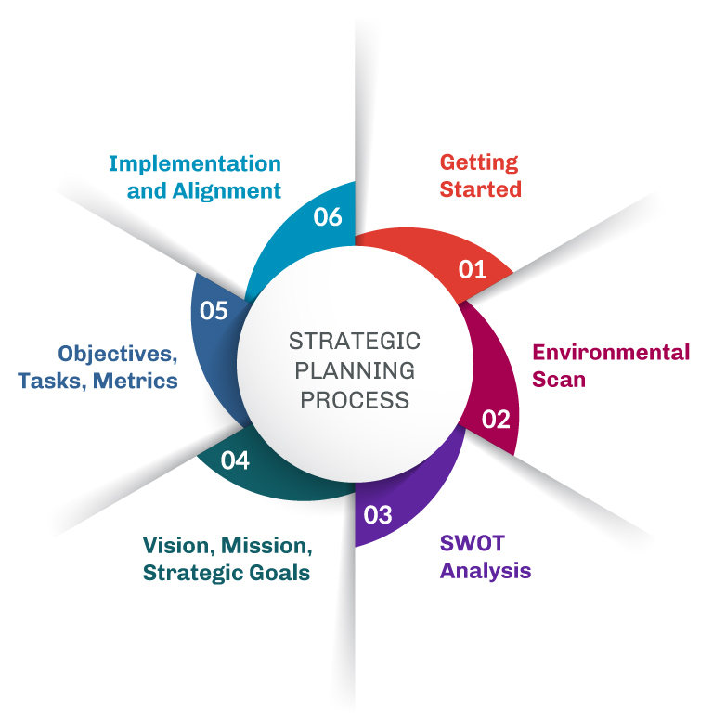
General overview of strategic plan process

Slide 16
Steps of the Strategic Plan
We outline each step of the general strategic process from the angle of internationalization. We prepare detailed guidelines on how to carry out each step of the strategic process in university internationalization, which involves environmental analysis, internal resource evaluation, setting achievable goals and objectives, formulating and evaluating strategic options, planning for implementation and executing the derived strategies. The steps are:
Define the organizational mission, create a mission statement
Acquire and analyze data. A SP has to be based on the best data available (from surveys and other sources). SWOT model is one of many analytical tools for this type of analysis
Set strategic priorities. To identify 3-5 major priorities that have emerged from the data and analysis conducted. Strategic priorities are broad goals that will move the institution towards the fulfillment of its mission and vision. The priorities are accomplished through concrete action plans defining the specific steps that must be accomplished over the life of the plan. Action steps should be SMART: specific, measurable, achievable, realistic/relevant, time-limited
Assess and measure progress. A critical step in every SP is to determine the standards by which success will be measured. SP needs to be adaptive to survive changing or unintended consequences and to environmental challenges. A SP should be living documents, it needs to be fine-tuned and adjusted at least annually by applying the assessment methods to determine what has been accomplished, identifying obstacles blocking progress and consider emerging opportunities that warrant adjustment in the plan. Every process has its challenges

Slide 17
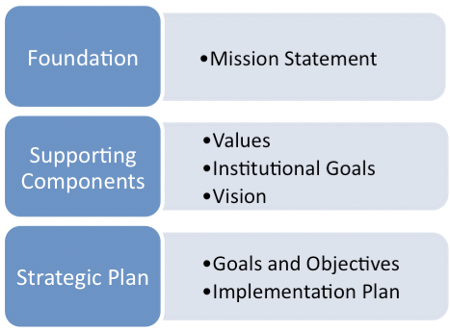
Components of a Strategic Plan

Slide 18
Contents of a Strategic Plan
Timeframe (temporal validity of the plan)
Mission and vision
SWOT analysis
Strategic goals
SMART Objectives
Workplan
KPIs
Review and ongoing evaluation

Slide 19
Timeframe
The timeframe for strategic plans is often 3-5 years.
A dynamic strategic plan evolves by responding to changes in the organization and in the environment.
It elicits dialogue and can be continually reformed and improved.

Slide 20
Mission
Mission
The foundation of any strategic plan is the institutional mission statement. This statement delineates, in concise language, why the institution exists and what its operations are intended to achieve. For publicly controlled institutions, this statement of purpose may be dictated by the state, but for all institutions the statement serves as the explanation for the existence of the organization.
In our case, the mission is to expand and consolidate strategies that could improve the internationalization processes of universities.
A mission statement talks about how the university will get to where it want to be.

Slide 21
Vision and values
Vision –
A vision statement describes the desired future position of the institution. University wishes to consolidate, expand and become an international reference in its strategic areas, reinforcing the formation of highly qualified human resources nationally and internationally recognized
Values –
Excellence in international research and innovation
International visibility
Improvement of international rankings
Continuous promotion of formation
Return of educational and scientific investments to society

Slide 22
SWOT Analysis
SWOT analysis is the strategic planning tool generally used to evaluate Strengths, Weaknesses, Opportunities and Threats in order to achieve strategic objectives. Strengths are the organization's attributions that are helpful in achieving goals.
Weaknesses are the organization's attributions that are detrimental to achieving goals.
Opportunities are the external conditions that are useful for achieving goals.
Threats are external conditions that could harm performance.

Slide 23
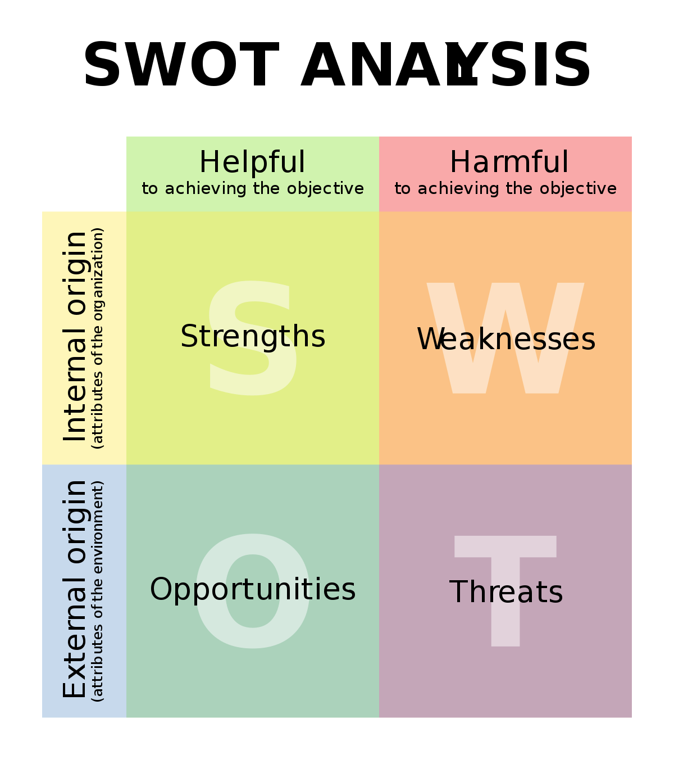
SWOT Matrix

Slide 24
SWOT Components
S
• Internationally recognized world-class postgraduate programs • The existence of consolidated partnership in strategic countries
• Highly-qualified faculty members • Encouragement for academic and professional continuing development • Well-equipped laboratories • Support and focus of the institutional higher administration on the strategic plan for internationalization
O
• Expansion of international cooperation, especially through agreements • Expansion of strategies for attracting foreign resources and international scholarships
• Expansion in the use of new technologies for faculty and researcher participation in examination boards, tutoring meetings and collaborations
• Expansion of the possibilities to access international databases for support in multicentric research
W • Lack of bilingual support from administrative and technical staff • Insufficient offer of graduate courses in English • Need for improvement of internal processes to support internationalization
• Need for financial resources to expand language teaching strategies and English text revision
T
• Political and financial instability • Institutional budget cuts to provide internationalization promotion • Difficulty in receiving and processing international resources • Competitiveness with the other Higher Education Institutions of the Region

Slide 25
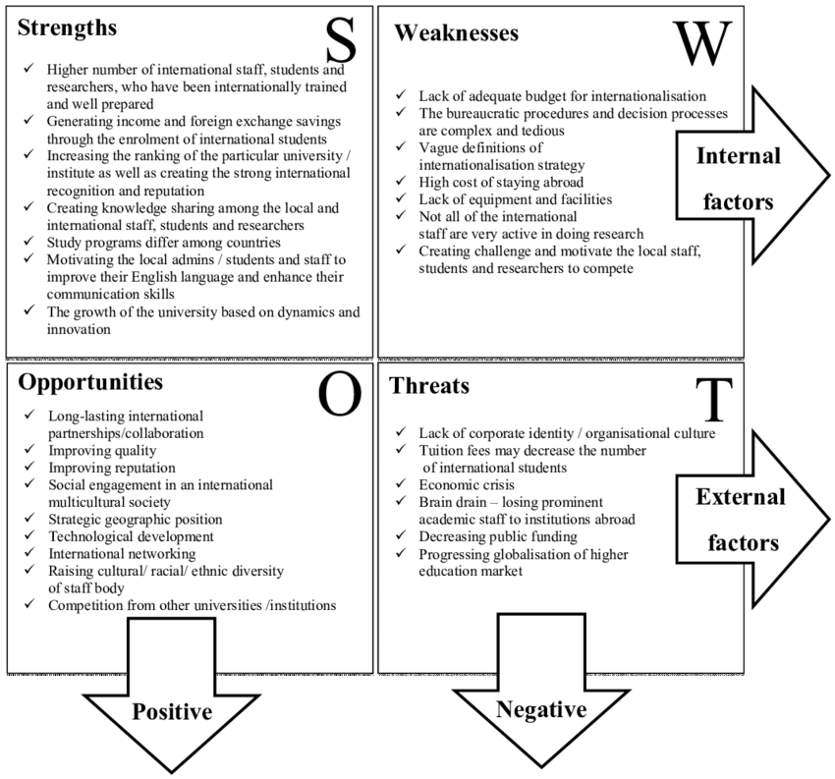
SWOT in Strategic Plan for Internationalization of universities

Slide 26
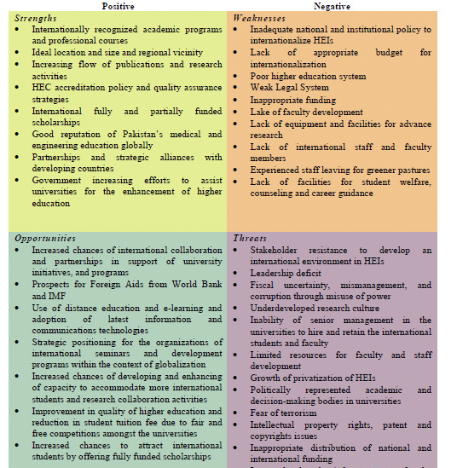
SWOT for Internationalization strategy

Slide 27
Development of the SP on internationalization
The development of the Strategic Plan is guided by four broad principles assumed to be central to the planning effort:
Strategic plan is a dynamic and flexible process
Internationalization of university is inherently a desirable and beneficial process for the entire national community
Internationalization must be oriented and organized by a unitary action with a strong leadership
Strategic plan will be strongly supported by all units of university system
Strategic plan priority areas
Increase visibility, communication and advocacy for international engagement
Enhance the quality of and expand the options for international learning experiences
Promote international discovery opportunities and research networks
Strengthen and make widely known the activities of IROs
Objectives, strategies and indicators: key objectives provide a framework for strategic plan implementation. Objectives are connected to strategies

Slide 28
Strategic Goals (1)
The general anticipated results of internationalization
Examples:
To extend international partnership
To increase international visibility (i.e. rankings)
To enhance the quality of research and education
To build organizational structures supporting internationalization processes

Slide 29
Strategic Goals (2)
Main components of SP on internationalization
International mobility (students, academic and administrative staff)
Curriculum development
Joint and double degrees
International students’ recruitment
International marketing and promotion
Internationalization at home
International research and cooperation
International networks and partnership

Slide 30
SMART Objectives
The specific accomplishments that the efforts or activities are aimed to.
Examples
Delivery of at least x courses in English by Autumn XY (2021?)
Increase the number of foreign students to yy (10%?)
Increase the number of Faculty members with medium or long term experience abroad (more than yy?)
Increase the number of doctorate students with experience abroad in strategic countries (double the number? in 3 years?)
2 (?) new Erasmus/Mobility projects in XY (2022?)
3 (?) new agreements signed with foreign partners by XY (2023)
Participation of at least XX (15?) department members in the internationalization of the curriculum workshop by ZY (2022?)

Slide 31
Proposed Conceptual Framework
The proposed conceptual framework links three interdisciplinary areas. It emphasizes the strategic nature of the higher education internationalization process. The strategic process outlined in the first column analyzes the environment and resources; first and then identifying vision, mission and objectives, and also identifying the existing mission, goals and strategies; first and then conducting external and internal analyses accordingly.
The scheme (Figure 1) synthesizes these views and is consistent with the strategic decision-making process for higher education internationalization.

Slide 32
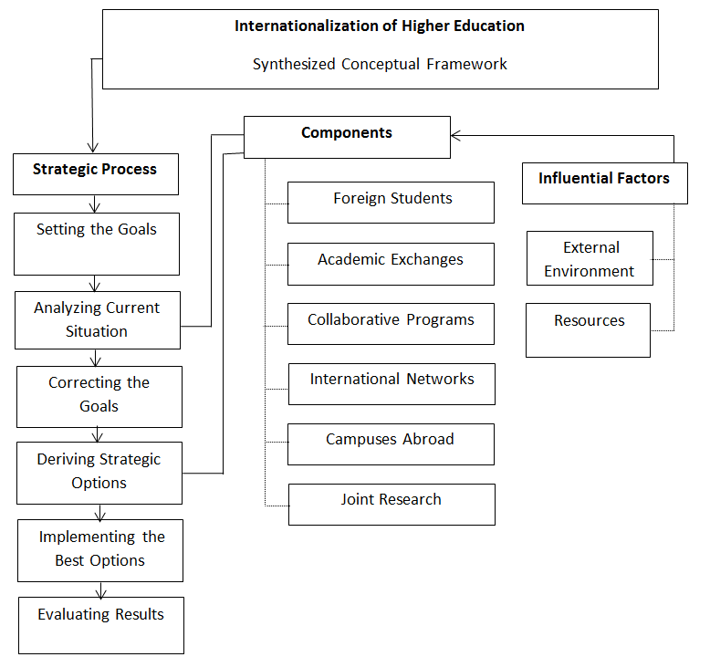
Proposed Conceptual Framework

Slide 33
Indicators for evaluation are also objectives
Due to the complexity of the internationalization concept and the changes in the international environment of institutions, there is no consensus about defining a methodology to measure this concept. Many studies focus on the assessment of the internationalization in Higher Education Institutions (HEI) at different countries and areas.
In this analysis we propose the use of indicators as measurement tools that can greatly assist with efficient management in complex systems such as those that operate in universities nowadays. In this case, indicators can be defined as objective, and usually quantitative, measurement tools for an institution or a whole Higher Education system. However, an indicator by itself rarely provides enough information to measure complex phenomena such as the teaching activity of faculty. Internationalization is a multidimensional concept whose measurement requires a diverse set of indicators that reflects the various dimensions which define the concept to be measured.

Slide 34
Different dimensions, sub-dimensions and indicators for measuring internationalization performance of the University

Slide 35
Table 1. Sub-dimensions and Indicators defined in dimension.
Academic exchange activities and recruitment of exchange students
Sub-dimension | Indicators
Volume of academic exchange activity | No of students sent
 | No of students received
 | Academic staff sent for teaching
 | Administrative staff sent for training
 | Academic staff received for teaching
 | Administrative staff received for training
 | International visiting students
 | International regular students
Efficiency in mobility | Efficiency in student mobility: sent
 | Efficiency in student mobility: received
 | Efficiency in academic staff mobility
 | Balance between Erasmus students sent and received

Slide 36
Table 2. Sub-dimensions and Indicators defined in dimension
Quality
Sub-dimension | Indicators
User satisfaction | Satisfaction level of students sent
 | Satisfaction level of students received
 | Satisfaction level of academic staff sent
 | Satisfaction level of administrative staff sent
Participation in excellence programs | No of active double degree agreements and official joint degrees with outgoing mobility
 | No of Erasmus + masters with active participation of the School/Faculty
Academic management | Subject credit recognition ratio for students sent with respect to the ECTS workload per semester
 | Ratio of students sent with a % of recognized credits of at least 70% of the whole number per stay decided by the School or department
 | Ratio of passed credits by students received studying subjects with respect to their ECTS workload per semester
 | No of degrees (bachelor & master) taught at School or department level with at least 10% of their credits in English offered for exchange students with respect to the total number of degrees of the School or faculty
 | No of institutions with Exchange activity of students and staff with respect to the total number of institutions with which the School has Exchange agreements in the two previous academic years.
International Accreditations | Percentage of students enrolled in a School covered by an International Accreditation Quality Agency

Slide 37
Table 3. Indicators defined in Dimension
International development cooperation
Indicators
No of international cooperation activities organized by Schools or Departments
No of students with actions in calls from the International Cooperation Services (ICS)
No of departments of a School with cooperation actions in cooperation promoted by the ICS
No of administrative staff from a School with actions in cooperation promoted by the ICS

Slide 38
Table 4 Indicators defined in Dimension
International projects
Indicators
No of competitive international projects
No of academic staff belonging to a School with participation in international projects from calls managed by the Vice-rectorate of International Relations and Cooperation
Study Abroad
.

Slide 39
Table 5. Indicators defined in Dimension
Other activities
Indicators
Collaboration in institutional activities, committees, events, etc.
Active participation in representing the School or University as speaker in conferences, courses, networks, seminars, exhibitions having to do with internationalization.
Resources in euros of external funding (not fees) for the support of internationalization actions not taken into account in previous indicators
Participation in courses and seminars dealing with internationalization with enrolment fees

Slide 40
Workplan and KPIs
Detailed list of activities to be carried out in the short term:
Define milestones to signal anchors, significant events or stages in the progress of internationalization
Increase the available human resource skills and capacities
Assign clear responsibilities for each prioritized activity in the plan
Define financial resources needs
KPIs – Measurable values that demonstrate how effectively the institution is achieving key internationalization objectives
Measuring inputs (resources to achieve outputs)
Measuring activities (actions taken to achieve the outputs using the inputs)
Measuring outputs and outcomes (results of activities)

Slide 41
Performance indicators for internationalization
Performance Indicators: 1. University Leadership for Internationalization
Performance Indicators: 2. Internationalization Strategic Plan
Performance Indicators: 3. Institutionalization of International Education and Research
Performance Indicators: 4. Support Infrastructure－Professional International Education Units and Staff
Performance Indicators: 5. Internationalized Curriculum
Performance Indicators: 6. International Students and Scholars
Performance Indicators: 7. Study Abroad
Performance Indicators: 8. Faculty Involvement in International Activities
Performance Indicators: 9. Campus Life/Co Curricular Programs
Performance Indicators: 10. Monitoring the Process

Slide 42
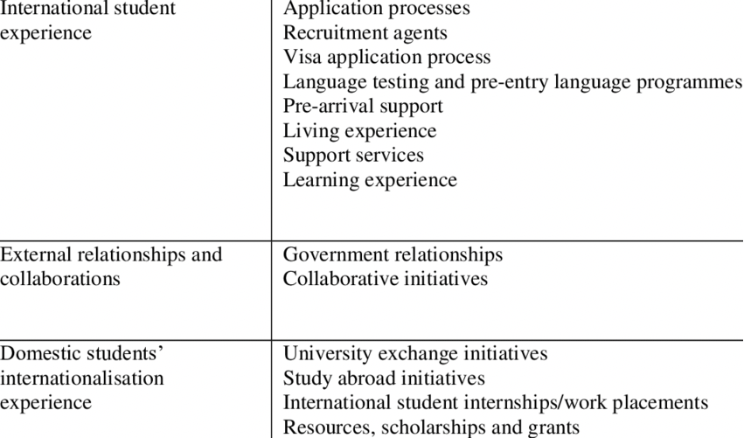
KPIs with reference to students

Slide 43
The relevance of Human Resources
It is important for people working in International Relations to possess a number of attributes that will make a difference:
• Personality: extrovert, pleasant personality, open-minded, professional and committed. Need to love their job so as to be effective ,and also, to be able to adapt to change.
• Skills: knowledge of languages, IT skills, managerial skills, problem- solving skills, crisis management skills
Additionally, continuous training is a MUST, due to the dynamic, continuously changing environment in International Relations, in order to keep up with:
✓Recent developments in national policies
✓International recent developments in education, especially in the EU and in the Asian countries.
Besides training, many other factors help both educate people and giving them incentives:
Clear career paths
Recognition of their work
Activities outside the workplace which help the team come closer
Opportunities for on-the-job training

Slide 44
Internationalization: some examples of priorities and initiatives in the strategic plan
Internationalization builds upon both the University’s mission and vision and provides a vision for developing, extending, and enhancing the range of international initiatives over the next five years. This Internationalization Strategic Plan must be the result of a thoughtful discussion among administrators, faculties, students, and staff. The University has to set priorities and to determine which options work best within its budget and overall strategic institutional initiatives.
Internationalization is both a multidisciplinary and interdisciplinary endeavor requiring action in many areas simultaneously. The Internationalization Strategic Plan may focuse on five strategic priorities and 12 initiatives:

Slide 45
Examples of priorities
Priority 1: Promote Internationalization of the Curriculum
Initiative 1: Promote and integrate education abroad experience into the curriculum across the university.
Initiative 2: Expand international curriculum in targeted areas.
Priority 2: Increase International Research and Faculty Development Activities
Initiative 1: Integrate research, teaching, and service effectively into international activities
Initiative 2: Promote and support international faculty development activities
Initiative 3: Promote and support Study Abroad programs for faculty and staff
Priority 3: Promote and Support Int’ Student Recruitment, Retention and Alumni Services
Initiative 1: Attract, admit, and retain high quality degree-seeking international students. Initiative 2: Enhance University’s marketing strategies to potential international students.
Initiative 3: Formalize outreach and engagement of University’s international alumni.
Priority 4: Expand International Campus and Community Outreach Activities Initiative 1: Increase interaction between international students, visiting scholars, and international faculty and host families.
Initiative 2: Increase interactions between international students, faculty, and staff.
Initiative 3: Strengthen University’s engagement with public constituencies in its international activities.
Priority 5: Enhance Campus and Community Communication
Initiative 1: Improve communication regarding international programs and opportunities within the campus and community.

Slide 46
Examples of Goals in a strategic plan for internationalization of university
GOAL 1: EDUCATION ABROAD AND EXCHANGE
Provide innovation and leadership in education abroad to increase student participation through improved program quality, variety, credentialing and opportunities for multicultural learning.
• Objective 1: Increase the number and disciplinary variety of students participating in education abroad programs overall
• Objective 2: Increase the variety of education abroad and exchange programs to include more international internships, community learning opportunities and alternatives to faculty-led program formats
• Objective 3: Improve quality of education abroad by developing formal assessment and evaluation mechanisms alongside recommendations for improving outcomes.
• Objective 4: Support targeted and sustainable international partnerships and exchanges that advance
GOAL 2: INTERNATIONAL RESEARCH AND COLLABORATION
Provide innovation and leadership to support international research, scholarly and creative activity through targeted and sustainable international partnerships and collaborations.
• Objective 1: Facilitate targeted and sustainable international partnerships and collaborations that advance faculty and student research, scholarly and creative activity in significant ways.
• Objective 2: Promote local faculty and student research, scholarly and creative activity that is international in focus, design or scope
• Objective 3: Support faculty and student research, scholarly and creative activity

Slide 47
To be continued…
GOAL 3: INTERNATIONALIZING THE CURRICULUM
Provide innovation and leadership in the promotion of international, intercultural and interdisciplinary competency within academic curricula.
• Objective 1: Develop internationally focused instructional materials, coursework and/or degree programs to support international, intercultural and interdisciplinary competency within your University
• Objective 2: Facilitate educational lectures, workshops and discussions for students, faculty and staff
• Objective 3: Promote University’s international faculties and students as valuable contributors to the internationalization of the campus curriculum through classroom and co- curricular discussions.
GOAL 4: GLOBAL COMMUNITY ENGAGEMENT
Provide innovation and leadership to increase multicultural, multinational and multilingual engagement through increased opportunities for global-to-local and local-to-global community engagement
• Objective 1: Support reciprocal and meaningful community engagement and/or service-learning opportunities as a component of all study abroad programs and technology-mediated cultural exchanges, as appropriate.
• Objective 2: Support community engagement with local international community organizations (IGOs)
• Objective 3: Promote community outreach to share University’s globally- focused learning activities to the local community
• Objective 4: Increase interaction and collaboration with the consular corps and local international business contacts

Slide 48
To be continued…..
GOAL 5: INTERNATIONAL STUDENT RECRUITMENT AND SUPPORT
Provide innovation and leadership to increase recruitment, exchange and support for international students before, during and after matriculation.
• Objective 1: Support strategically targeted international student recruitment in close collaboration with deans and the Office of Enrollment Services
• Objective 2: Promote academic and acculturation support for international students before, during and after matriculation
• Objective 3: Support coordination among University offices that are directly involved in international student recruitment and/or support
GOAL 6: STRATEGIC PROFILE RAISING
Provide innovation and leadership to increase the international profile of your University by recognizing and promoting international accomplishments and cultivating new resources to sustain future campus internationalization activities.
• Objective 1: Support profile raising initiatives/events that directly advance one or more other strategic priorities for university internationalization and build upon existing programs with a reputation for distinction and excellence
• Objective 2: Appropriately recognize and support student, faculty and staff accomplishments that advance the University strategic plan for internationalization

Slide 49
To be continued…..
GOAL 7: ACCOUNTABILITY AND SUSTAINABILITY
Provide innovation and leadership to ensure accountability and tracking of current internationalization activities while entrepreneurially cultivating new resources to sustain future campus internationalization activities.
• Objective 1: Develop new and additional internal controls to ensure that resources for internationalization are allocated in a transparent and strategically impactful manner.
• Objective 2: Develop new metrics and data collection tools to track, assess and evaluate the outcomes associated with individual internationalization activities.
• Objective 3: Cultivate new fiscal models for sustaining existing and future international activity that directly advance one or more other strategic priorities for campus internationalization

Slide 50
Strategic plan evaluation tools: the Dashboard
The Dashboard is a powerful online tool to help universities identify strengths and weaknesses and pinpoint student groups that may be struggling. It reports performance and progress of a strategic plan on internationalization. It is a platform useful for self assessment and monitoring activities. Through this platform it is possible to carry out multidimensional analyses on all the information contained.
Performance is based on data from both the current and prior years. There are five performance levels, and each is assigned a different color: Red is the lowest performance level, Orange is the second lowest, Yellow is the middle point, Green is the second highest, and Blue is the highest performance level.

Slide 51
To be continued….
A dashboard is a HEIs tool that displays a set of indicators and other relevant information to a academic/administrative/student user. The information is usually represented graphically and must include the indicators involved in achieving the university objectives. All organizations need an information system that enables communication of key strategies and objectives and decision making. In short, a dashboard should contain limited, understandable, visual, important and goal-oriented information. The main objective of a dashboard is transforming data into information and turn this into knowledge for the university. • Analyze the root cause of problems by exploring relevant and timely information from multiple perspectives and at various levels of detail. • Manage people and processes to improve decisions, optimize performance, and steer the organization in the right direction. A dashboard shows the information needed to achieve specific objectives, so its design requires complex, unstructured and tacit information from various sources. Information is often a set of Key Performance Indicators (KPI), but other information may also be needed. • These indicators are usually high-level measurements of how well an organization is doing in achieving critical success factors. In short, more dynamic dashboards are obtained, to be adapted to the changing environment conditions. The need to reduce information means that many data and indicators collected at universities do not end up as part of the dashboard.

Slide 52
To be continued….
A dashboard is a visualizing tool which provides awareness, trending, and both planning and actual comparisons, frequently visualized in a slick simplified user interface.
In this regard, it is necessary for the dashboard to communicate information about the pros and cons of decision alternatives quickly, highlight factors that merit consideration, and provide information in a non-linear format to facilitate its incorporation in decision making deliberations.

Slide 53
Strategic Plan evaluation tools: the Balanced Scorecard (BSC)
The BSC makes it possible to monitor the performance trend over time using management indicators.
It is based on the balanced examination of many factors believed to be influential in achieving goals
It helps to consider intangible outputs and to anticipate any negative results (ex ante or ongoing strategy). It aligns strategy initiatives and provides information for strategic learning

Slide 54
To be continued…..
It is a balanced examination between quantifiable outcomes and subjective assessments of the participants in the process. Integrates past performance measures (lag indicators) with measures of future performance impact indicators (lead indicators).
A balanced evaluation form is prepared which contains:
Strategic objectives, essential drivers;
Human resources at disposal and internal processes;
Necessary actions (critical factors of success);
Growth and learning (reengineering);
Indicators (that inform about success/failure of actions)

Slide 55
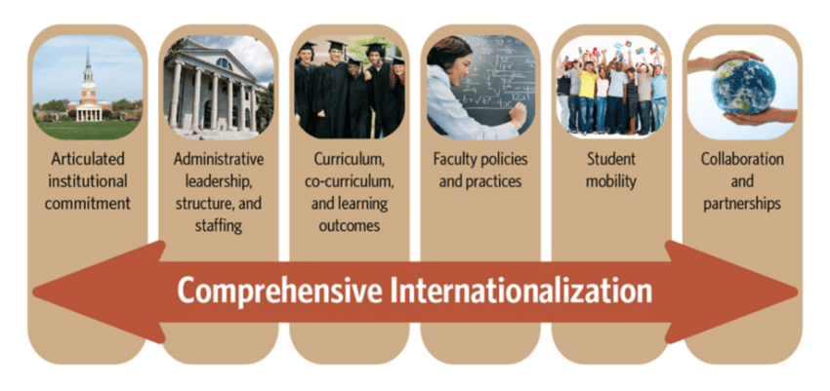
Possible result

Slide 56
Exercise on Strategic Plan
With reference to internationalization process in your university and to contents of mentioned above slides, write three words that explain the indicated topic to you:
Mission ……………. ………………… …………………..
Vision ……………… ………………… ………………….
Core values …………… ………………….. ……………….
Priority areas …............. ……………….. …………….
Objectives …................. ……………… …………….......
Measurement of the results ………… …… ....................

Slide 57
Thank you for your attention! andrea.mignone@unige.it monica.penco@unige.it intstrat@unige.it https://erasmus-merge.eu/
Project number: 610391-EPP-1-2019-1-IT-EPPKA2-CBHE-JP
"This project has been funded with support from the European Commission. This publication [communication] reflects the views only of the author, and the Commission cannot be held responsible for any use which may be made of the information contained therein"

