Slide 1

Strategic planning for internationalization in University.
A business overview
«MERGE» ERASMUS+ CBHE PROJECT
1st Training Event in the Framework of W.P. 2 «Human Capacity Building»
Prof. Renata Dameri, Deputy Rector for International Cooperation, University of Genoa, Italy

Slide 2

Why strategic planning?

Slide 3

Strategic planning is an organization's process of defining its strategy, or direction, and making decisions on allocating its resources to pursue this strategy.
Please note that →
Resources are scarce!

Slide 4

Therefore:
Strategic planning is not only an economic issue… but it assume an economic role → in allocating the scarce resources in the best way, that is to reach the best result
So the question for university is:
  Which are our goals?
  Which are our most precious and scarce resources?

Slide 5
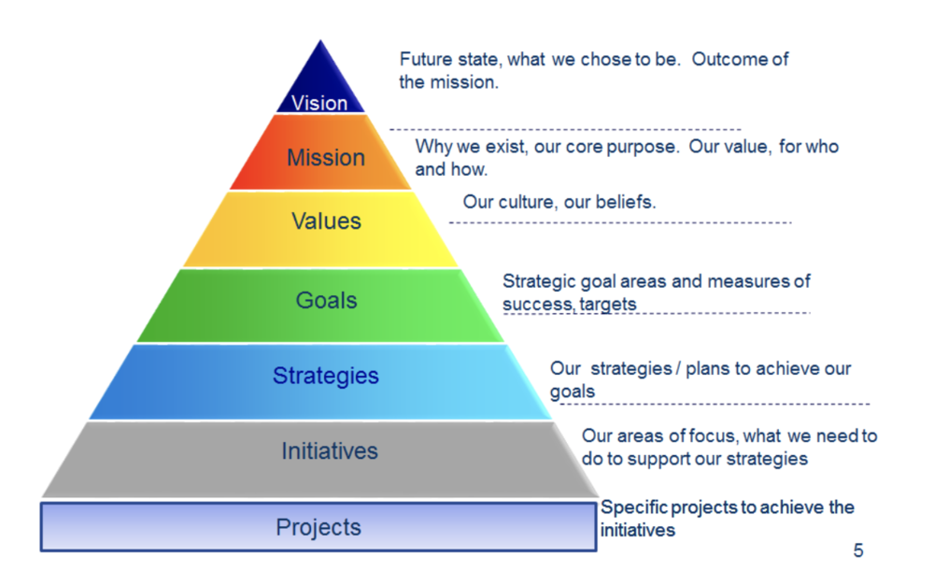
Strategic planning is not a one-step task
The long journey to
the strategy implementation

Slide 6

The first step is:
To define our vision and mission
The University’s vision and mission are….
…and the International Department’s vision and mission are….
…and they are linked with the University’s vision and mission because….

Slide 7

An example: Harvard University
Mission: The mission of Harvard College is to educate the citizens and citizen-leaders for our society. We do this through our commitment to the transformative power of a liberal arts and sciences education.
Vision: Harvard College sets the standard for residential liberal arts and sciences education. We have committed to creating and sustaining the conditions that enable all Harvard College students to experience an unparalleled educational journey that is intellectually, socially, and personally transformative.

Slide 8
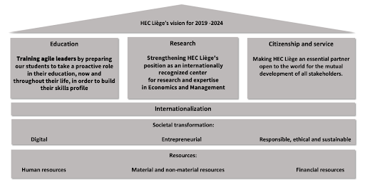
The position of Internationalization

Slide 9
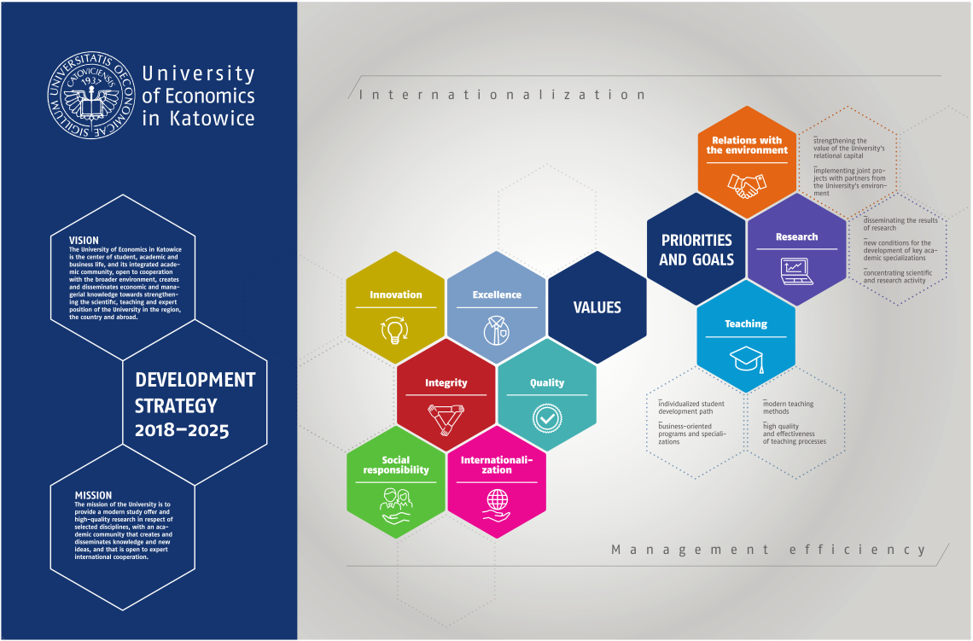
Another example

Slide 10
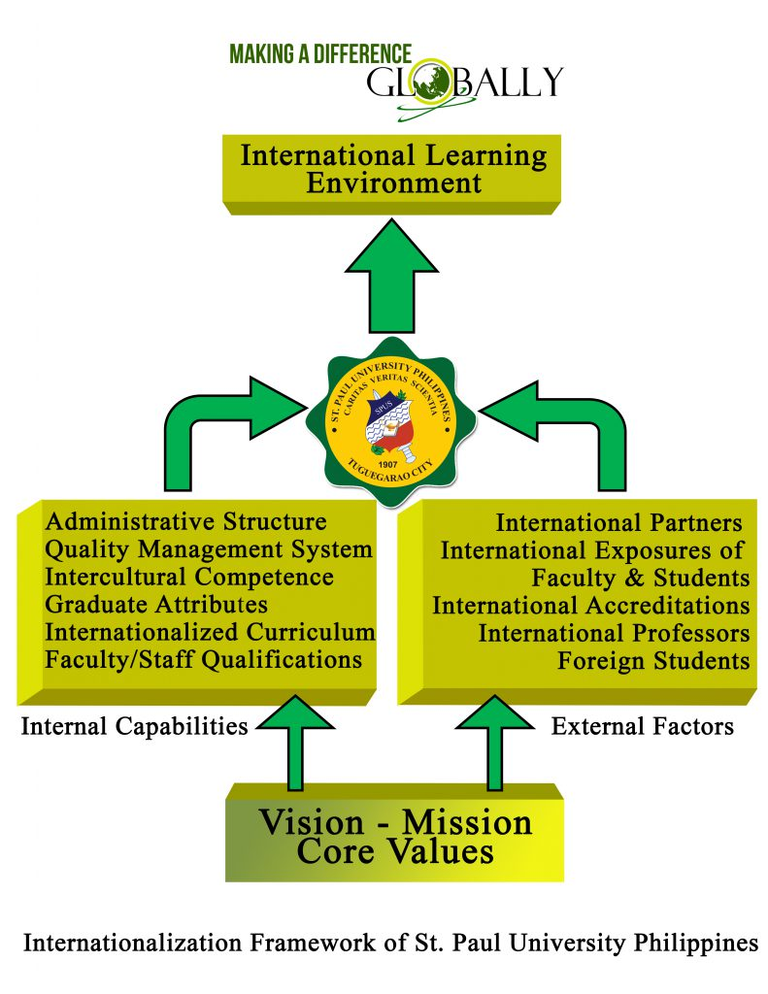
How to translate vision and mission in concrete activities?

Slide 11
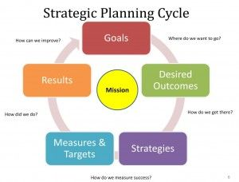
Michael Porter’s lesson
Consider four key elements:
  Organisation strengths and weaknesses;
  Personal values of the key implementers;
  Industry opportunities and threats; and
  Broader societal expectations.
Nota a piè di pagina

Slide 12
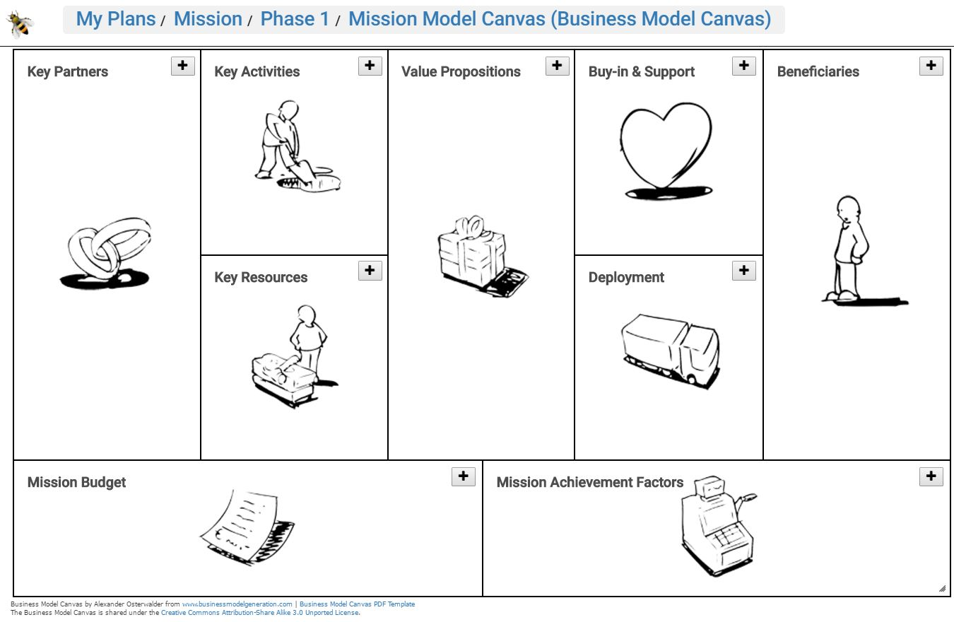

Slide 13
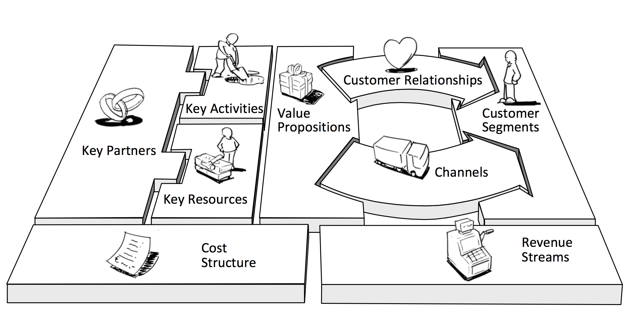

Slide 14
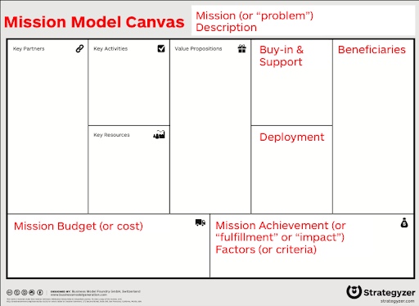

Slide 15
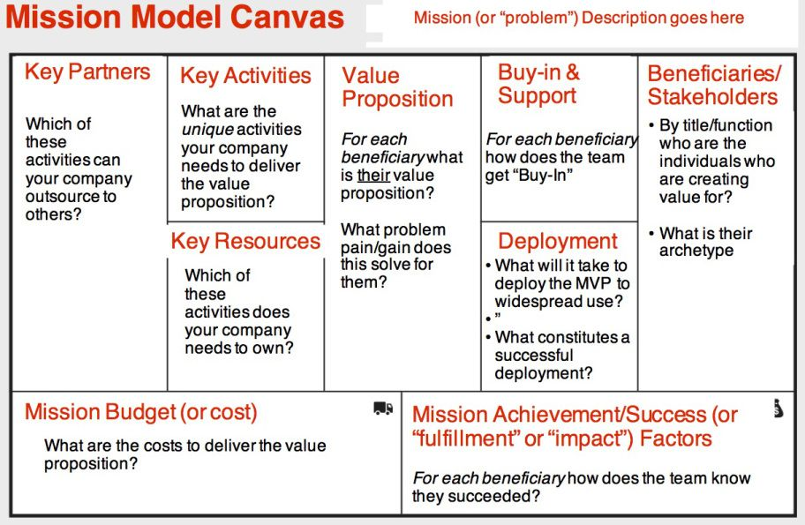

Slide 16
Thank you for your attention! dameri@economia.unige.it
Project number: 610391-EPP-1-2019-1-IT-EPPKA2-CBHE-JP
"This project has been funded with support from the European Commission. This publication [communication] reflects the views only of the author, and the Commission cannot be held responsible for any use which may be made of the information contained therein"

