Slide 1
INTRODUCTION ON Internationalization PROCESSES AND ORGANIZATION OF IROs IN ROMANIA AND LBUS. Strategic Planning for Internationalization Development
«MERGE» ERASMUS+ CBHE PROJECT
1st Training Event in the Framework of W.P. 2 «Human Capacity Building»
Prof. Daniela PRADA
Dr. Corina Maria MARIN
LBUS “Lucian Blaga” University of Sibiu, Romania

Slide 2
Strategic planning can be a vital tool for higher education institutions as measurable objectives are essential for daily decision-making and institutional management and development.
That is why a set of priorities, a clear vision should be strategically planned so that a team follows the same direction, has similar goals and contributes to the achievement of common objectives.
Key components in the strategic planning process:
- strategic analysis
- strategy formulation
- strategy implementation
- monitoring

Slide 3
1.
Analyze the impact of external environment on HEIs internationalization
2.
Understand and set vision, values and mission of Internationa-lization Strategy
4. Elaborate a strategic plan
5.
Apply the strategic plan
6. Constantly monitor performance and achieve-ments
3.
Organise specific structures and teams to oversee the implement-tation of Internatio-nalization strategy

Slide 4
Standalone strategy
Internationalisation included in overall
Institutional strategyy
Strategy is under development
Faculty-level strategies only
No structured internationalization approach
The internal environment, strategy, management and quality assurance is to be corelated with the way internationalization strategy is present and evidenced:

Slide 5
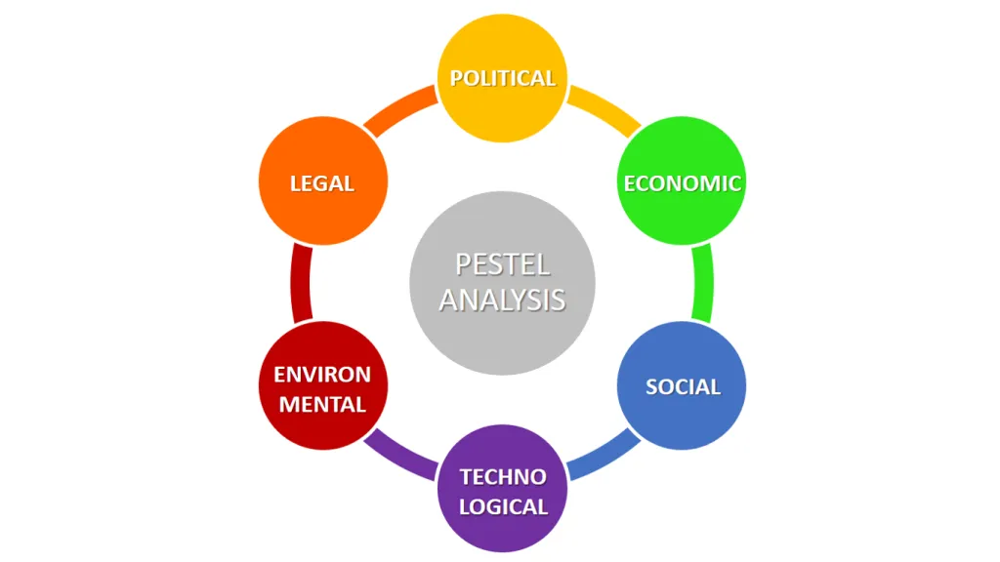
1. Preparatory work: Identify institution’s internationalization status and strategic position
The PESTEL analysis (=Political + Economic + Socio-Cultural + Technological + Environmental + Legal) enhances the acknowledgement of the macroeconomic context, of the social, political, and technological environment in which a university is positioned

Slide 6
PESTEL analysis > Case of LBUS
P E S T E L
Many periods of political uncertainty. 24 successive ministers in charge of national education.
Underfunding of education and research is a problem we have been facing for the last 30 years.
Three major problems: the negative demographic increase, emigration and declining interest in the Romanian education system.
New learning platforms, new ways of accessing information or new professions are challenges for the university environment.
The discourse on sustainability and environmental protection is beginning to take shape in Romania in recent years.
Frequent legislative changes put pressure on administrative and management staff.

Slide 7
Impact of external policies and national policies on internationalization
National Policies influencing internationalization
Immigration regulations
Admissions regulations
Accreditation framework
Excellence programmes
Quality assurance framework
Higher Education funding mechanism
Research infrastructure
Funding for internationalisation
National agencies/organisations
External policies are viewed, in general, as having a positive impact on internationalization.
At national level, governments commonly undertake a breadth of activities to regulate and enhance internationalisation.

Slide 8
The EAIE Barometer Study (2018): Internationalisation in Europe (second edition) identifies a wide range of internal challenges to be reported in HEIs’ pursuit of internationalisation.
Top 10 internal challenges:
Insufficient internal budget
Lack of commitment by some staff
Lack of internal recognition
Lack of int. scholarships
Lack of student/staff foreign language skills
Lack of inst. structure/leadership
Lack of staff expertise
Students not pursuing int. ed
Lack of integration of int. students
Lack of int. student/staff local language skills
Top 10 external challenges
Insufficient external funding
(Inter)national competition
National legal barriers
Perceived high living costs
Lack of int. recognition of HEI
Lack of national support/strategy
Lack of employer recognition
Low-priority country for int. partnerships
Political nationalism/xenophobia
Emigration of local students
Political instability/insecurity

Slide 9
1. Vision, values and mission of Internationalization Strategy
International strategy:
must align to the institutional overall strategy for management and academic development and be an explicit part of it.
represents a guiding framework for international actions / initiatives / extent, that is why it is mostly recommended to be elaborated as a stand-alone document.

Slide 10
Important aspects:
enclose organizational development in the existing patterns of internationalization policy of the institution;
set goals for curriculum innovation, staff development and student mobility as results of international cooperation;
extended international cooperation in order to bring excellence in teaching and academic research.
fructify the institutional capacity potential for prioritizing internationalization in your university.

Slide 11
Review
Review internationalization practices South Asian Higher Education, with a regional dimension and, in Afghanistan , India and Nepal in order to identify deficiencies to be improved;
Analyse
Analyse the strength of institutional capacity in implementing internationalization in your university;
Initiate or adhere
Initiate or adhere to regional networks active in the field of internationali-sation on higher education in South Asia;
Identify
Identify ways to attract extra funds, as public funding is insufficient for institutional development;
Re-examine
Re-examine the institution`s profile and background in order to forge paths toward industry and services sectors with international dimensions;
Look back
Look back to your mission statement, institutional values and work culture and opening to international engagement;
Set
Set internationalizations as a strategic direction and a main priority in institutional management;
Valorify
Harness Cultural Identity;
Start
Start with projects, end with checkmarks.

Slide 12
Main goals of internationalization:
Prepare students for global world
Improve the quality of education
Institutional reputation/competitiveness
Improve the quality of research
Financial benefits
Better service local community
Respond to demographic shifts

Slide 13
Lucian Blaga University Sibiu strives to continuously increase its level of internationalization.
This includes activities of „Internationalization abroad” like
Increasing the number of mobilities of students, teachers and staff
Increasing the number of cooperations with international universities
Increasing the number of international research collaborations and projects
Increasing the number of international visiting profesors and researchers.
However it comprises also activities of „Internationalization at home” like
Cultural events and exchanges with international participants
On-boarding events for international students and staff
Events that foster international understanding and integration
Continue the internationalization process around the Bologna Process
To achieve these overall objectives LBUS has defined a number of long-term strategic goals and corresponding measures.

Slide 14
2. Organise specific structures and teams to oversee the implementation of the Internationalization strategy
Specific missions of International Relations Offices (IROs):
Strategic
Development and coordination
Leading activities and assistance in international cooperation
Liaison, information and promotion of public relations

Slide 15
Case of Lucian Blaga University of Sibiu, Romania
The administrative structure in charge of International Relations is officially entitled ‘Division of Internationalization: Programs, Partnerships and Promotion’ and it is divided in 3 offices:
Erasmus+ Office
International Promotion and Intercultural Exchanges Office
International Partnership Office

Slide 16
It is highly recommended that a more strategic approach to be taken to staff training in internationalization.
The practitioners working on the process of international relations:
should be continuously trained so that they can successfully manage the international projects and to be able to plan, organize, coordinate and verify the activity of the department in the most efficient way.
In-house or external training programs on internationalization should be available to faculty of administrative staff, as well as English language training and participation to international conferences.
For the internationalization of curriculum, courses in teaching methodologies for international classroom should be facilitated.

Slide 17
Collect data from all relevant structures inside your university: faculties, research department, cultural institutes etc.
Study Study Programs / Modules in Foreign Language(s) International Cooperation Projects International Research Cooperation Agreements with other Relevant Stakeholders Erasmus+ Mobility Students Associations in your Faculty + contact person + website Alumni Associations Affiliation to International Networks/ Consortium/ Subdivisions-Institutes hosted by your Faculty, relevant ranking etc) | Current International Activity | Targets for 2021-2027 Objectives in the direction of Internationalization (2021-2027) (It is expected to refer to aspects related to internationalization of education, mobility, institutional modernization through internationalization, digitization, international research, labor-market and educational trends in your field) Proposals/Recommendations for improvement of Internationalization in the Structure providing the info

Slide 18
4. Elaborate the strategic plan
Strategic priority activities:
Distance/online/blended learning
International mobility of home students
Capacity building in developing countries
International strategic partnerships
International student recruitment
Engagement with local community
International mobility of home staff
Campus internationalisation
Programmes in non-local language
Courses developing international awareness
International rankings-focused activities
Joint/dual/double degrees
Internationalisation of home curriculum
Branch campuses
Internationalisation staff training
International staff recruitment
source: EAIE Barometer study (Sandström, A-M., & Hudson, R., 2019)

Slide 19
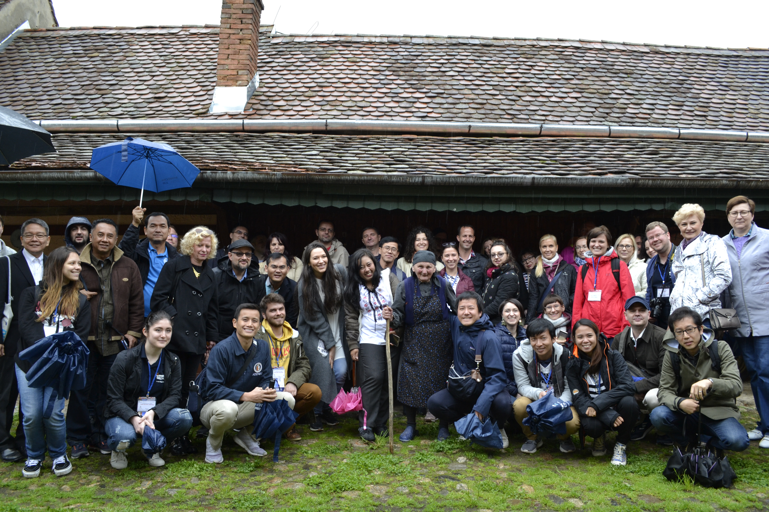
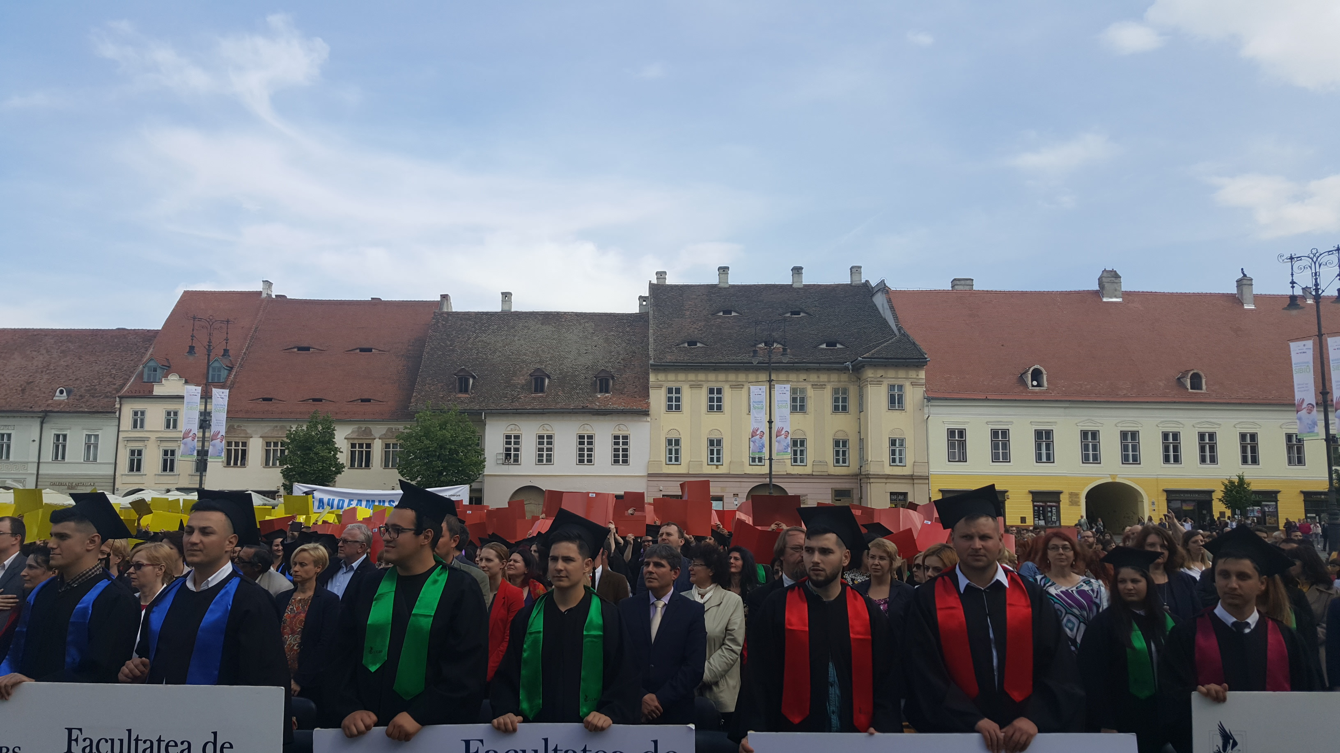
5. Apply the strategic plan – LBUS internationalization approach

Slide 20
DISCLAIMER:
This document presents the internationalization strategy of Lucian Blaga University Sibiu for 2021-2027. The overall university strategy for the same time period has not yet been released. As the latter document represents the guiding framework for international activities, adaptations to the document at hand might become necessary in order to achieve alignment between the two documents. Both documents – the overall and the internationalization strategy – will be subject to approval by the university Senate before coming into effect.
Table of contents_template of LBUS’s Strategy:
TABLE OF CONTENTS
Introduction
International Activities
The „acting” framework
Labour-Market Regional and Educational Trends
The Internationalization Strategy
Vision
Mission
Overall objectives
Internationalisation of education
Incoming and outgoing student mobility
Internationalization of research
Incoming and outgoing research mobility

Slide 21
Internationalization – one of the most important strategic axes of LBUS development (2021-2027)
Directions for increasing the degree of internationalization & stakeholder cooperation:
in educational activity in an inclusive and sustainable manner
in research activity
in projects and partnerships from abroad (institutions, organizations, economic entities, networks)
In administration and communication processes (using innovative digital tools)
photo credit: Transilvania Business, International Week of "Lucian Blaga" University

Slide 22
Erasmus+ Program as main pillars of the internationalization strategy in LBUS
It facilitates institutional modernization through:
the exchange of knowledge
good practices
innovative academic initiatives for creating flexible
learning pathways
recognition and understanding of skills and qualifications
updating and synchronizing curricula according to
international successful models
gaining a global perspective on academic dynamics

Slide 23
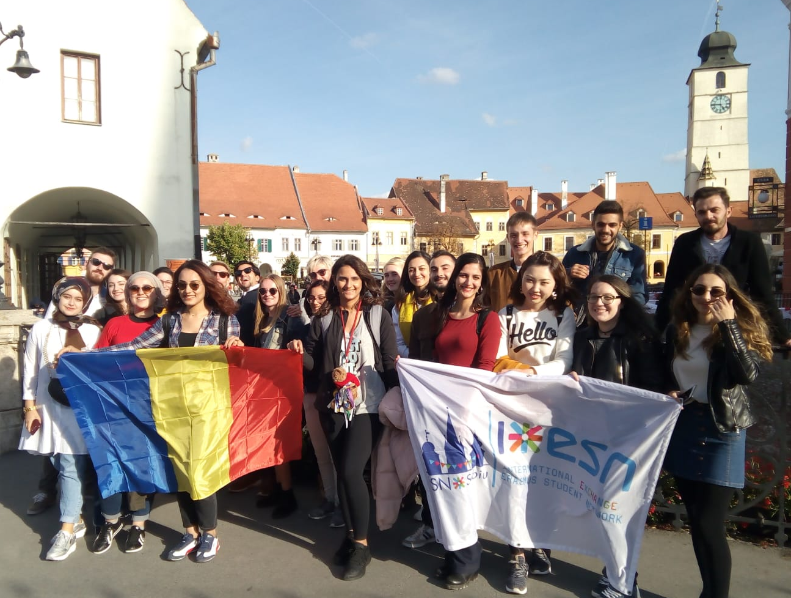
Erasmus Student Network (ESN) Sibiu collaborates with the International Relations Office of "Lucian Blaga" University of Sibiu.

Slide 24
9 SIGNPOSTS OF SUCCESS
Alignment of internationalisation with the academic mission
Commitment to a broad internationalisation portfolio
Existence of an institution-wide strategy
Established targets for priority activities
Regular strategy evaluation
Funding for priority activities
Coordinated organisation
Training to support priorities
Systematic quality assurance
source: EAIE Barometer study (Sandström, A-M., & Hudson, R., 2019)

Slide 25
6. Constantly monitor performance and achievements
So, strategic plan in 3 steps:
1. elaborate
2. implement
3. monitor the achievements
For monitoring 3 sections should be focused on:
1) check the progress
2) compare to other HEIs
3) measure the degree of confidence about the future of internationalization

Slide 26
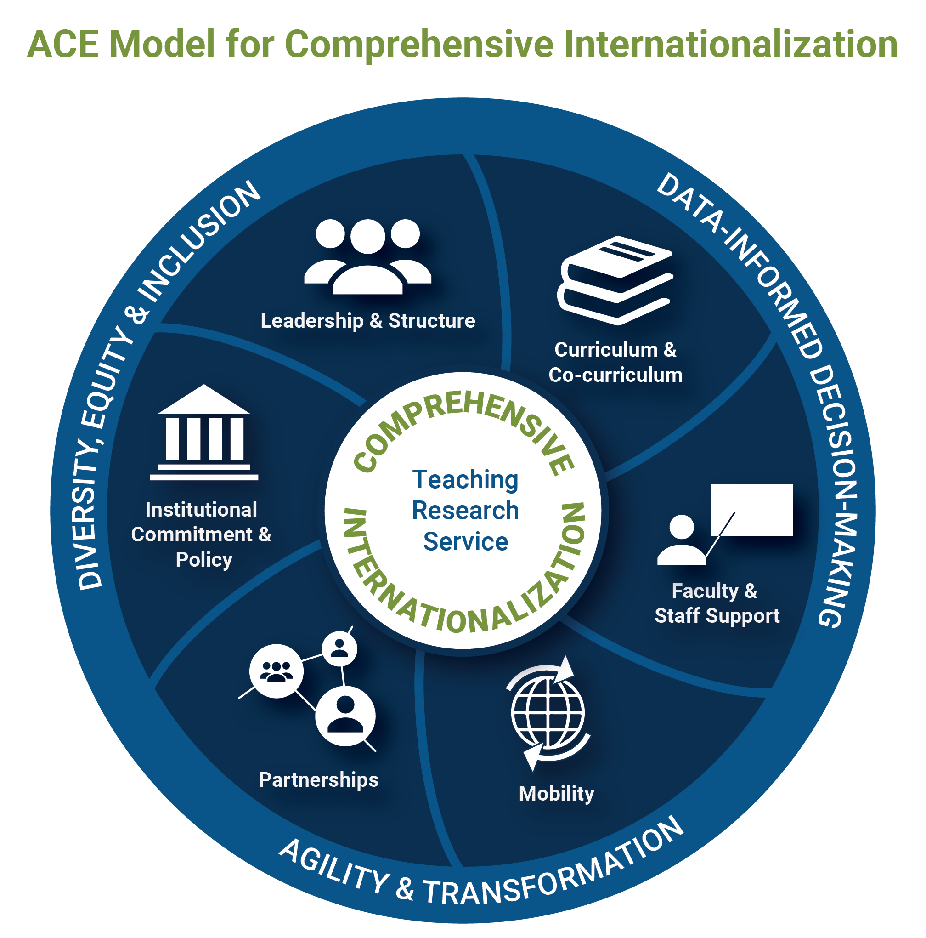
Let's reflect on a key concept:
“Comprehensive Internationalization”
“A commitment, confirmed through action, to infuse international and comparative perspectives throughout the teaching, research, and service missions of higher education. It shapes institutional ethos and values and touches the entire higher education enterprise. It is essential that it be embraced by institutional leadership, governance, faculty, students, and all academic service and support units. It is an institutional imperative, not just a desirable possibility.”
Source: Hudzik, John, Comprehensive Internationalization: From Concept to Action, 2011
Graphic credit: American Council on Education, https://www.acenet.edu/Research-Insights/Pages/Internationalization/CIGE-Model-for-Comprehensive-Internationalization.aspx

Slide 27
Now let's interract!
Brainstorming exercise: propose tools for monitoring the internalization process in your institution, taking into account the three items of monitoring: check, compare, measure.
Critical thinking exercise: identify what you consider to be the most vulnerable point in your institution's internationalization strategy; starting from this point you will propose three tangible objectives for the next three years;
Creative exercise: propose a slogan for your university to express its openess for internationalization.

Slide 28
Conclusions:
Internationalization adds value to higher education sector if managed appropriately, therefore, to make the management of international relations practice more efficient, it is fully recommended to:
develop a strategic approach
optimize the implementation of internationalization
monitor and evaluate the process.

Slide 29
Thank you for your attention!
Dr. Corina Marin
Lucian Blaga University of Sibiu, Romania
corina.marin@ulbsibiu.ro
Project number: 610391-EPP-1-2019-1-IT-EPPKA2-CBHE-JP
"This project has been funded with support from the European Commission. This publication [communication] reflects the views only of the author, and the Commission cannot be held responsible for any use which may be made of the information contained therein"

